Slide 1
Intro

Slide 2
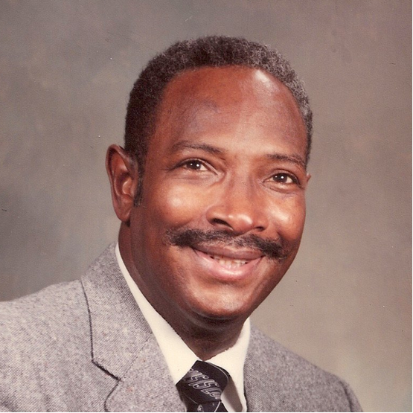
Christian Mission for the Deaf
Deaf Ministry
Deaf Ministry
A subset of cross-cultural ministry

Slide 3
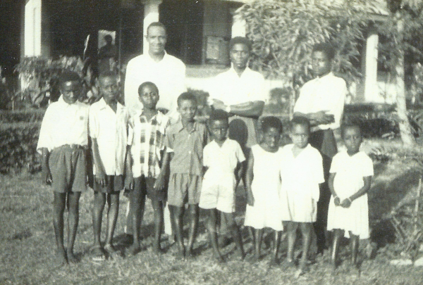
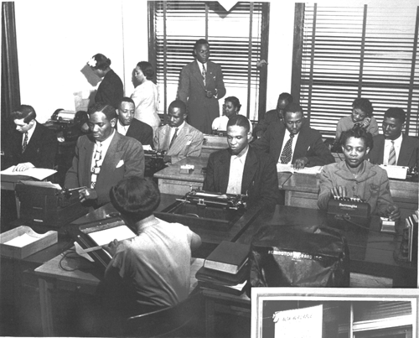
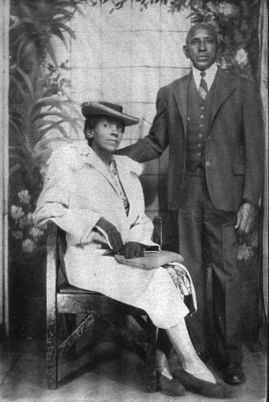
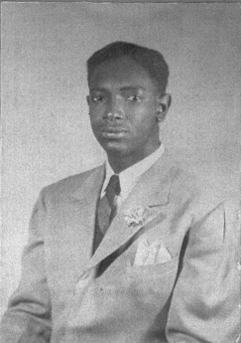
CMD
...Grace & Knowledge

Slide 4
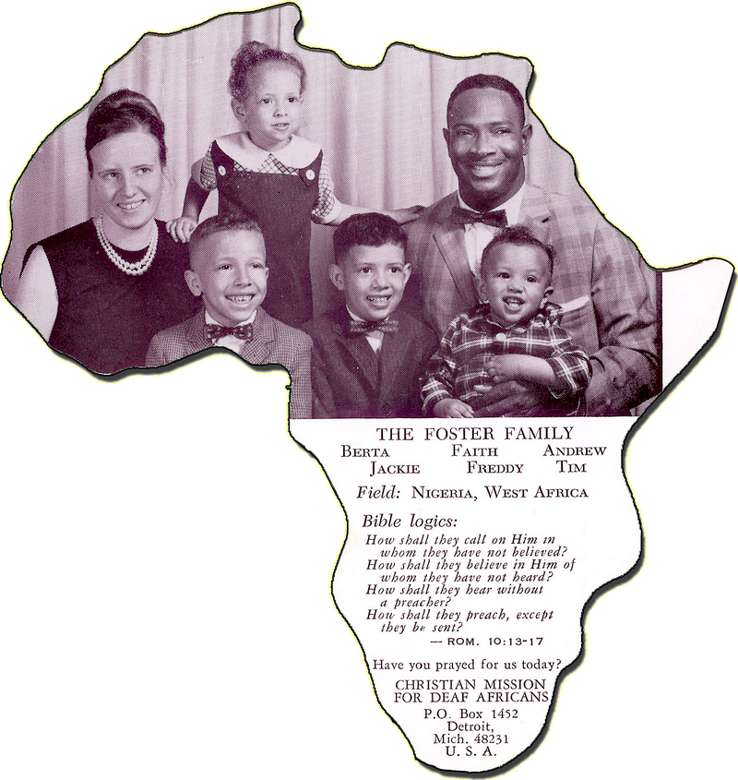
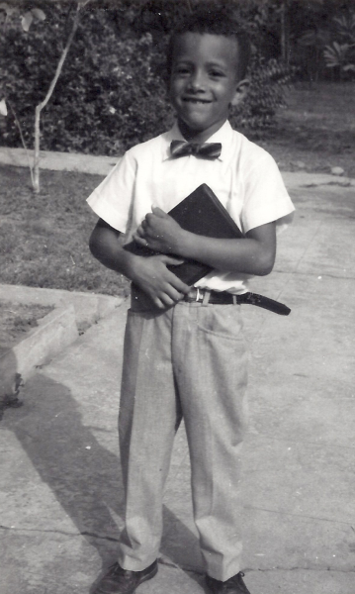
CMD
...Grace & Knowledge

Slide 5
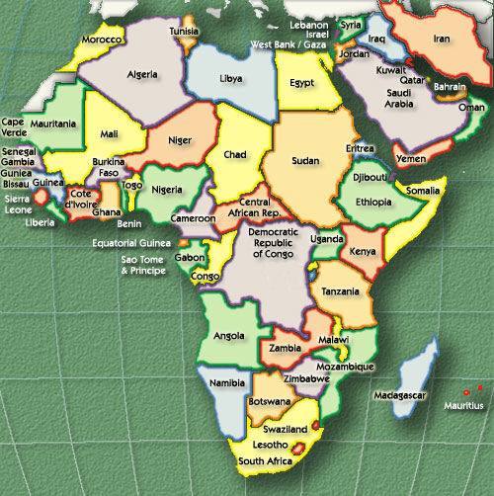
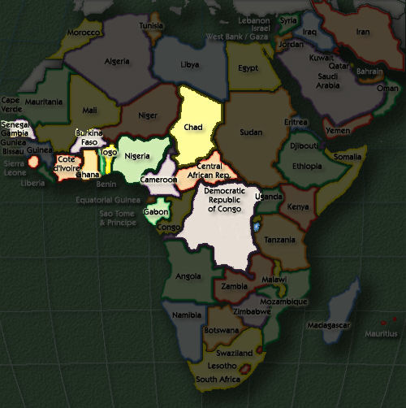
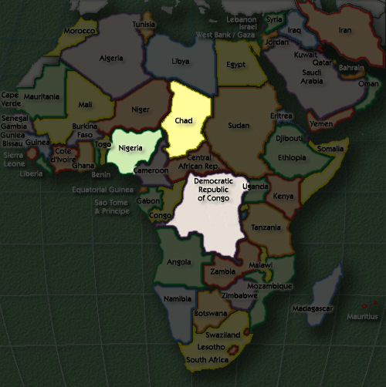
CMD
...Grace & Knowledge

Slide 6
My Teaching Mandates
I believe the Bible is Inspired, Inerrant, and Infallible.
I believe the Bible is the only final authority for Christian faith and practice.
I believe the Bible is intended to be intelligible.
Wherever possible, I will provide Bible references for the content I teach.
If you do not understand what I’m teaching, you are obligated to raise your hand and ask for clarification.
...Grace & Knowledge

Slide 7
My Teaching Mandates
If your question deals with Christian faith and practice, my answers must come from the Bible directly or indirectly,
and/or must comport with sound reason,
and/or must comport with observable nature.
My answer must make sense, and be satisfactory to the average audience member.
“I do not know” and “we cannot know” may be an acceptable answer. ..for now.
“Do not ask that question!” is never an acceptable response, unless the question is personal in nature, or it can shown from Scripture that the question is unwarranted (eg, Rom 9:20).
...Grace & Knowledge

Slide 8
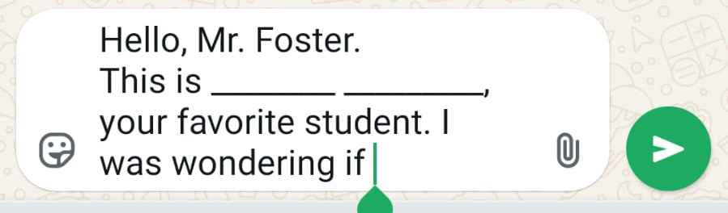
Contacting Me
Tim Foster
tim@cmdeaf.org www.CMDeaf.org
WhatsApp: +1 817-607-3913
  Hello Mr. Foster.
  This is _______ _______,
  your favorite student.
...Grace & Knowledge

Slide 9
Your Turn
Your Name
Where are you from?
Why are you here?
How long have you been here?
What do you hope to do after you graduate?
Tell us something about you that most people don’t know
...Grace & Knowledge

Slide 10
Assignment
Assignment #1: Bible Timeline
  Present your Bible Timeline
  Launch: How to draw a HDPQPABT

Slide 11
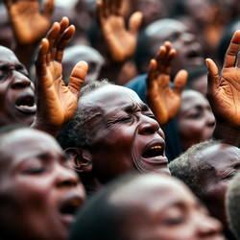
Theological Preliminaries for
Effective Ministry
Deaf Ministry
Deaf Ministry
A subset of cross-cultural ministry

Slide 12
Ministry
love the lord your God with all your heart, with all your soul, with all your mind, and with all your strength
What is the
MOST IMPORTANT
command God gave to mankind?
love your neighbor
as you love
yourself

Slide 13
Ministry
What is the
FIRST
COMMAND
God gave to mankind?
Exploitation
Slavery
Environmental Extremism
Laziness
And God created man in His own image, in the image of God He created him; male and female He created them. And God blessed them; and God said to them, “Be fruitful and multiply, and fill the earth, and subdue it; and rule over the fish of the sea and over the birds of the sky, and over every living thing that moves on the earth.” - Genesis 1:27-28

Slide 14
Ministry
God
Man
What is the
FIRST
COMMAND
God gave to mankind?
Create
Ordain
Sustain
Fruitful
Fill
Subdue
And God created man in His own image, in the image of God He created him; male and female He created them. And God blessed them; and God said to them, “Be fruitful and multiply, and fill the earth, and subdue it; and rule over the fish of the sea and over the birds of the sky, and over every living thing that moves on the earth.” - Genesis 1:27-28
Man is created in God’s image
Man’s work is in God’s pattern

Slide 15

















Ministry
Exploitation
Slavery
Environmental Extremism
Laziness
And God created man in His own image, in the image of God He created him; male and female He created them. And God blessed them; and God said to them, “Be fruitful and multiply, and fill the earth, and subdue it; and rule over the fish of the sea and over the birds of the sky, and over every living thing that moves on the earth.” - Genesis 1:27-28
Creation Mandate

Slide 16
Ministry
Authority
Domain
Command
What is the
FIRST
COMMAND
God gave to mankind?
“All authority has been given to Me in heaven and on earth. Go therefore and make disciples of all the nations, baptizing them in the name of the Father and the Son and the Holy Spirit, teaching them to observe all that I commanded you; and lo, I am with you always, even to the end of the age.” - Matthew 28:18-20
And God created man in His own image, in the image of God He created him; male and female He created them. And God blessed them; and God said to them, “Be fruitful and multiply, and fill the earth, and subdue it; and rule over the fish of the sea and over the birds of the sky, and over every living thing that moves on the earth.” - Genesis 1:27-28
Great Commission

Slide 17
Ministry
What is a good passage that summarizes EFFECTIVE MINISTRY?
But grow in the grace and knowledge of our Lord and Savior Jesus Christ. To Him be the glory both now and to the day of eternity. Amen.
2 Peter 3:18

Slide 18

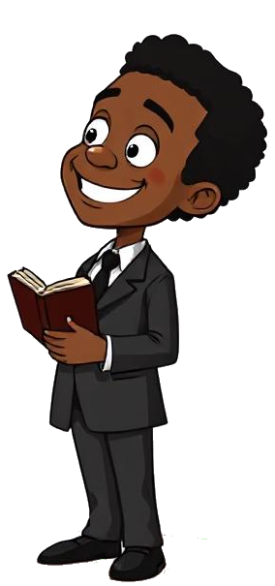
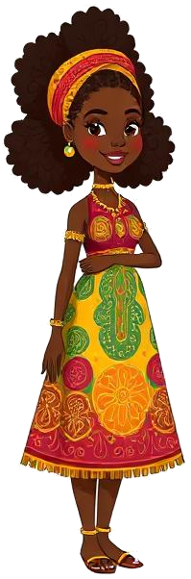
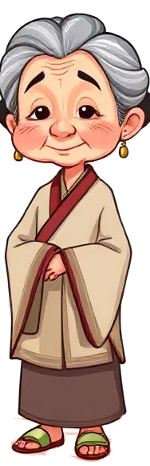
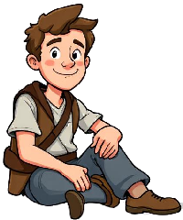
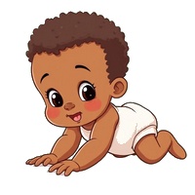
Grow...
...Grace & Knowledge

Slide 19
Ministry
To the Jews I became like a Jew, to win Jews; to those under the law, like one under the law - though I myself am not under the law - to win those under the law ... To the weak I became weak, in order to win the weak. I have become all things to all people, so that I may by every possible means save some.
1 Corinthians 9:20-22

Slide 20

Diversity
Language
History
Food
Geography
Habits
Protocols
gender, character, intelligence, education, abilities, disabilities

Slide 21


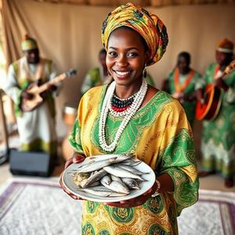
Diversity...
Discomfort
Disaster

Slide 22
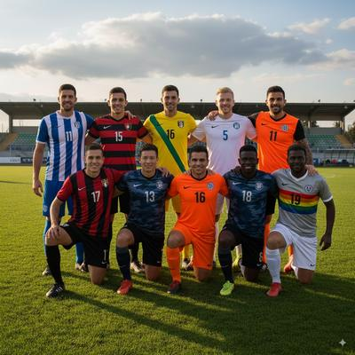
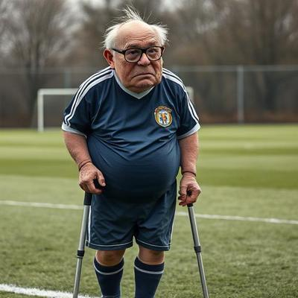
Diversity...
language
history
Analyzing Toxic Diversity
------------------
Know your objectives
Prioritize your objectives
Assess threats
Endure discomforts
Reject disasters
food
geography
habits
protocols

Slide 23

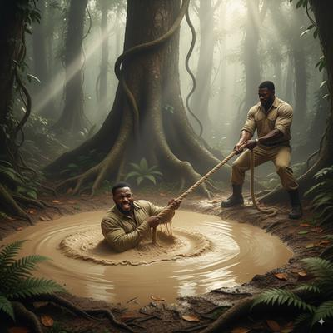
Watch yourself...
know your objectives
prioritize your objectives
assess threats
endure discomforts
reject disasters
Analyzing Quagmire
------------------
Keep your feet on solid ground
Avoid getting in the quagmire
Pull in the direction of safety
protocols

Slide 24

Watch yourself...
Reach
know your objectives
prioritize your objectives
assess threats
endure discomforts
reject disasters
Tow
Row
protocols
The only thing worse than one person drowning
is two people drowning
Throw
Go

Slide 25
Ministry
Brothers, if anyone is caught in any transgression, you who are spiritual should restore him in a spirit of gentleness. Keep watch on yourself, lest you too be tempted.
Bear one another's burdens, and so fulfill the law of Christ.
Galatians 6:1-2

Slide 26
Assignment
Group Assignment #1: Answering Questions
1: Angels are spirit. We read that angels sat with Abraham and ate. But how can angels eat if they have no teeth?
2: Based on the story of the 5 wise / 5 foolish virgins, half of us are going to heaven. Which half?
3: Genesis 1 says God made the heavens (sky) and the earth (dirt). Then we see Him hovering over the water in v2. It doesn't say God made the water!! So who made the water?
4: James 5:14 says we should anoint the sick with oil and they will be healed. Which oil should we use?
5: Many people would be saved if you did miracles. Why do you not do miracles today? I think you lack faith!

Slide 27
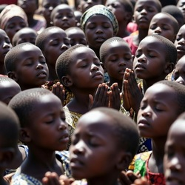
Principles of Communication
Deaf Ministry

Slide 28
Communication
The Communication Process Model (Modified)
1. Notion: A vague idea or a gut feeling
2. Idea: A clear thought or plan

Slide 29
Communication
The Communication Process Model (Modified)
3. Encode: Converting the idea into a message (speech, signs, written, SMS, etc)
4. Send: Communicating the message on the channel
5. Reception: Receiving the message via the channel
6. Decode: Converting the message into an idea
7. Comprehend: Understanding the idea

Slide 30
Communication
Notion
Idea
Encode
Send
-------
Receive
Decode
Comprehend

Slide 31
Communication
Ignorance
Disability
Aphasia
Interference
-------
Misperception
Unintelligible
Education
Notion
Idea
Encode
Send
-------
Receive
Decode
Comprehend

Slide 32
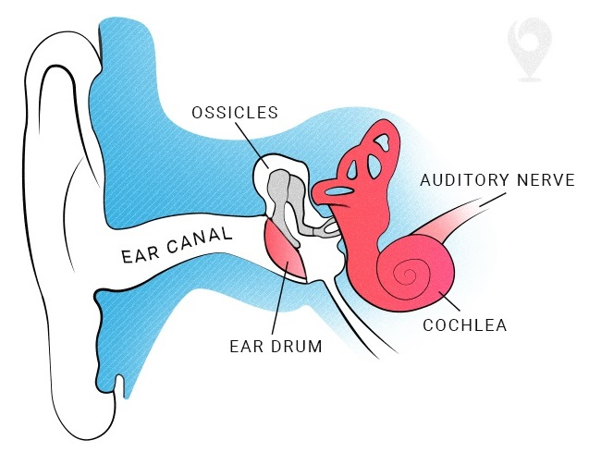
Breakdown

Slide 33
Breakdown
Deafness
“Would you rather be deaf or blind?”
“Blindness cuts you off from things. Deafness cuts you off from people.”
- Dr. Andrew Foster -

Slide 34
Breakdown
Who made us deaf?
[+] And the LORD said to him, “Who has made man’s mouth? Or who makes him dumb or deaf, or seeing or blind? Is it not I, the LORD? Now then go, and I, even I, will be with your mouth, and teach you what you are to say.” (Exod 4:11-12)

Slide 35
Breakdown
Deafness
A partial or total inability to hear sounds
Conduction deafness: a disruption between outer ear and inner ear nerve cells
damage; age → hearing aids
Nerve deafness: a defect in the nerves that prevents sound impulses from reaching the auditory center of the brain
disease; birth → cochlear implants

Slide 36
Breakdown
Deafness
It has no impact on intelligence
“Deaf and dumb” → “can’t hear; can’t speak”
Deafness can happen early in life or late in life:
pre-lingual vs post-lingual
Deafness can be partial or complete

Slide 37
Breakdown
Deafness : Communication
Deafness destroys casual communication
Alternate methods are required
Gestures
Drawing / writing / reading
Sign language
Lip-reading

Slide 38
Breakdown
Deafness : Communication
Challenges...
Technical specificity
  medical, legal, theological
Group settings
  distractions
  listener feedback

Slide 39
Breakdown
Deafness : Communication
Challenges...
Environmental conditions
  lighting, clothing
  fatigue

Slide 40
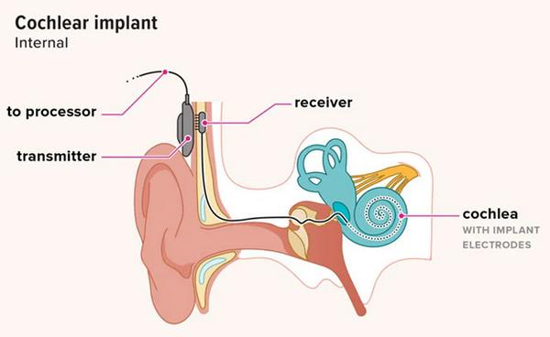
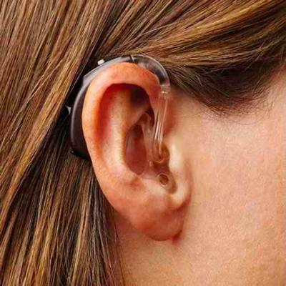
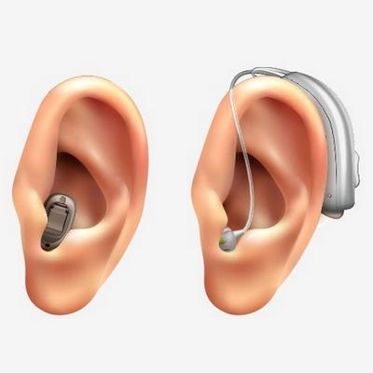
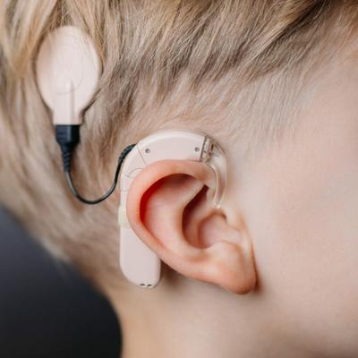
Breakdown
deafness
a partial or total inability to hear sounds
conduction deafness: a disruption between outer ear and inner ear nerve cells
damage; age -> hearing aids
nerve deafness: a defect in the nerves that prevents sound impulses from reaching the auditory center of the brain
disease; birth -> cochlear implants

Slide 41
Breakdown
VIDEO: “Deaf People Hear for the First Time”
What’s happening in this video?

Slide 42
Assignment
Assignment #2: Communication Challenges
Write a 1-page paper summarizing the following:
What communication challenges have you experienced in your home, school, church, work, etc? (spouse, children)
What are specific ways you have attempted to circumnavigate those challenges?

Slide 43
Assignment
Group Assignment #2: Answering Questions
1: The UN and NGOs say husbands and wives are equal, and the husband is not the head. Is this true?
2: We're hearing some preachers say that they are the Levites of the Old Testament. They say we should give them 10%. Is this true?
3: What did David’s 5 stones represent? Grace. Truth. Love. Joy. Peace…
4: Women should not wear pants in church. In America, the women wear pants to church, but that’s because it’s cold there.
5: David was right to kill Goliath. Am I right to kill the evil soldier in my village?

Slide 44

Language
Challenges
Deaf Ministry

Slide 45
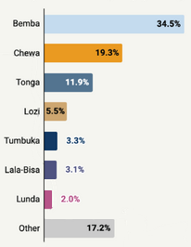
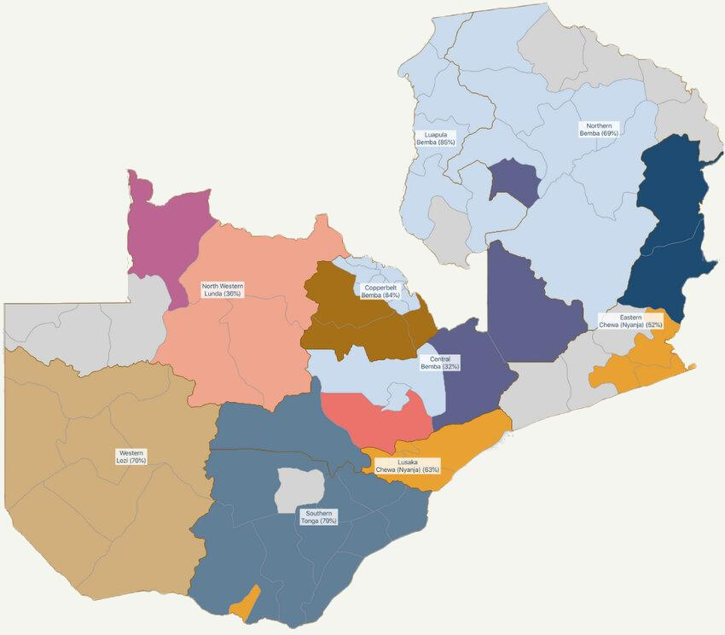
Language
Zambia
Language Map
1 official language
7 national languages
72 tribal languages (45)

Slide 46

Language
“Learning in one’s first language is ‘essential for the initial teaching of reading.’ Children arrive on the first day of school with thousands of oral vocabulary words and tacit knowledge of the sound system of their mother tongue, but are unable to use and build upon these linguistic skills because they are instructed in a foreign language. Dismissing this prior knowledge, and trying to teach children to read in a language they are not accustomed to hearing or speaking, makes the teaching of reading difficult, especially in underresourced schools in developing countries.”
National Literacy Foundation - Unicef Zambia
Impact of Language Policy, 2017
english
Bemba
Chewa
Tonga
Lozi
Tumbuka
Lala-Bisa
Lunda

Slide 47
Language
Unicef India
A Bridge to Understanding:
When children learn in mother tongue, they navigate knowledge with confidence and ease. Concepts become clearer, ideas flow freely, and the joy of discovery amplifies. Imagine a tribal child understanding math through their own language, promoting a sense of belonging and active participation.
Building a Strong Foundation:
Studies have consistently shown that children who receive education in their mother tongue develop stronger cognitive skills, particularly in critical thinking, problem-solving, and creativity. This solid foundation lays the groundwork for future academic success, allowing them to not only grasp complex subjects but also excel in other languages they may encounter later.
Boosting Confidence and Self-Esteem:
Beyond academic benefits, mother tongue education fosters a sense of self-worth and cultural identity. When a child expresses themselves confidently in their native language, they radiate self-assurance and a deep connection to their heritage. This intrinsic motivation fuels their desire to learn, propelling them forward on their educational journey.
Embracing Diversity:
India's linguistic landscape, with over 22 official languages and countless dialects, is rich and diverse. Embracing this diversity through mother tongue education celebrates each language's cultural heritage, creating an equitable and inclusive system that values all children's unique identities.
Why Mother Tongue Education holds the key to unlocking every child's potential
The transformative role of learning in children’s native language
Gowri Sundararajan

Slide 48
Language
Unicef India
A Bridge to Understanding:
When children learn in mother tongue, they navigate knowledge with confidence and ease. Concepts become clearer, ideas flow freely, and the joy of discovery amplifies. Imagine a tribal child understanding math through their own language, promoting a sense of belonging and active participation.
Building a Strong Foundation:
Studies have consistently shown that children who receive education in their mother tongue develop stronger cognitive skills, particularly in critical thinking, problem-solving, and creativity. This solid foundation lays the groundwork for future academic success, allowing them to not only grasp complex subjects but also excel in other languages they may encounter later.
Boosting Confidence and Self-Esteem:
Beyond academic benefits, mother tongue education fosters a sense of self-worth and cultural identity. When a child expresses themselves confidently in their native language, they radiate self-assurance and a deep connection to their heritage. This intrinsic motivation fuels their desire to learn, propelling them forward on their educational journey.
Embracing Diversity:
India's linguistic landscape, with over 22 official languages and countless dialects, is rich and diverse. Embracing this diversity through mother tongue education celebrates each language's cultural heritage, creating an equitable and inclusive system that values all children's unique identities.
Why Mother Tongue Education holds the key to unlocking every child's potential
The transformative role of learning in children’s native language
Gowri Sundararajan

Slide 49
Language
Unicef India
A Bridge to Understanding:
When children learn in mother tongue, they navigate knowledge with confidence and ease. Concepts become clearer, ideas flow freely, and the joy of discovery amplifies. Imagine a tribal child understanding math through their own language, promoting a sense of belonging and active participation.
Building a Strong Foundation:
Studies have consistently shown that children who receive education in their mother tongue develop stronger cognitive skills, particularly in critical thinking, problem-solving, and creativity. This solid foundation lays the groundwork for future academic success, allowing them to not only grasp complex subjects but also excel in other languages they may encounter later.
Boosting Confidence and Self-Esteem:
Beyond academic benefits, mother tongue education fosters a sense of self-worth and cultural identity. When a child expresses themselves confidently in their native language, they radiate self-assurance and a deep connection to their heritage. This intrinsic motivation fuels their desire to learn, propelling them forward on their educational journey.
Embracing Diversity:
India's linguistic landscape, with over 22 official languages and countless dialects, is rich and diverse. Embracing this diversity through mother tongue education celebrates each language's cultural heritage, creating an equitable and inclusive system that values all children's unique identities.
Why Mother Tongue Education holds the key to unlocking every child's potential
The transformative role of learning in children’s native language
Gowri Sundararajan

Slide 50
Language
Unicef India
A Bridge to Understanding:
When children learn in mother tongue, they navigate knowledge with confidence and ease. Concepts become clearer, ideas flow freely, and the joy of discovery amplifies. Imagine a tribal child understanding math through their own language, promoting a sense of belonging and active participation.
Building a Strong Foundation:
Studies have consistently shown that children who receive education in their mother tongue develop stronger cognitive skills, particularly in critical thinking, problem-solving, and creativity. This solid foundation lays the groundwork for future academic success, allowing them to not only grasp complex subjects but also excel in other languages they may encounter later.
Boosting Confidence and Self-Esteem:
Beyond academic benefits, mother tongue education fosters a sense of self-worth and cultural identity. When a child expresses themselves confidently in their native language, they radiate self-assurance and a deep connection to their heritage. This intrinsic motivation fuels their desire to learn, propelling them forward on their educational journey.
Embracing Diversity:
India's linguistic landscape, with over 22 official languages and countless dialects, is rich and diverse. Embracing this diversity through mother tongue education celebrates each language's cultural heritage, creating an equitable and inclusive system that values all children's unique identities.
Why Mother Tongue Education holds the key to unlocking every child's potential
The transformative role of learning in children’s native language
Gowri Sundararajan
But is this true?
Is this practical?

Slide 51
Language: Reflection
What are the advantages of “Mother Tongue Education” in a multi-lingual society?
(linguistic, personal, social)
What are the disadvantages?
(Not everyone tells the truth about this topic)
American acculturation & teaching of English

Slide 52
Language: ASL, PSE, SEE
A P S
ASL in America...
“American Sign Language (ASL) is a complete, natural language that has the same linguistic properties as spoken languages, with grammar that differs from English. ASL is expressed by movements of the hands and face. ASL is a language completely separate and distinct from English. It contains all the fundamental features of language, with its own rules for pronunciation, word formation, and word order.”
- National Institute on Deafness
But is this true?
Is this practical?

Slide 53
Language: ASL, PSE, SEE
A P S
ASL in America...
“American Sign Language (ASL) is a natural language that serves as the predominant sign language of Deaf communities in the United States and most of Anglophone Canada. ASL is a complete and organized visual language that is expressed by employing both manual and nonmanual features.”
- Wikipedia
But is this true?
Is this practical?

Slide 54
Language: ASL, PSE, SEE
A P S
ASL in America...
“Because ‘listeners’ must use their eyes to ‘receive’ the information, this language was specifically created to be easily recognized by the eyes. The visual component refers to the body movements or signs that are performed to convey a message.”
- Commission on the Deaf and Hard of Hearing
But is this true?
Is this practical?

Slide 55
Language: ASL, PSE, SEE
A P S
SEE in America...
“Signing Exact English (SEE) is a sign system that matches signs with the English language. SEE was developed with one objective in mind – to provide the deaf or hard of hearing child with the same English communicating capability as his/her hearing counterpart. The system provides a visual counterpart to match both spoken and written English.”
- Hands & Voices
But is this true?
Is this practical?

Slide 56
Language: ASL, PSE, SEE
A P S
Differences Between ASL and SEE in America...
“These differences go far beyond grammar or vocabulary—they speak to deeper issues of culture, identity, and communication effectiveness. ... ASL is more than just a tool; it is a complete, natural language with a deep cultural foundation.
SEE, on the other hand, is a constructed system aimed at replicating English in a visual format. While SEE was developed with good intentions—namely, to support English literacy—it falls short in fostering meaningful communication and cultural identity.”
- Start ASL
But is this true?
Is this practical?

Slide 57
Language: ASL, PSE, SEE
A P S
ASL, SEE, & PSE in America...
“When using ASL to communicate, you will leave out words such as conjunctions because ASL is straight to the point making it unnecessary to include non-essential words.
SEE is not focused on expression, and it is an exact word-for-word translation of spoken English. Signs are in spoken English grammatical order as it would be written. Some of the signs are different as well.
PSE can be thought of as a combination of ASL and SEE. Many people who are hearing will often use this method of Sign Language as it is a fusion of both languages that are used. When using PSE, you use ASL signs with an English spoken order.”
- Sign Tribe
But is this true?
Is this practical?

Slide 58
Language: ASL, PSE, SEE
A P S
ASL
Own grammar and word-order
Strong emphasis on facial and body expression
Different from and Independent of English (no articles, identifiers)
“Natural” language
Deaf Culture, Identity, Inclusion
Self-image
SEE
Follows English grammar strictly
Independent of facial and body expression
Use of modifiers, initialization (eg, I, me, my, self. Is, am, are, be; -ing)
“Created” language
Designed for English accessability
??
cultural idiosyncrasies
-------
kil/swahili bible
bembe bible
french test
tribal bibles
ASL
SEE
P S E
Everything inbetween
Notes:
Swahili Bibles in Tanzania use a more sophisticated dialect of Swahili than a Congolese Bible.
A friend asked me to get a Bembe Bible for him in the USA...
Conference attendees requested a mix of French, Swahili, and English notes. When it came time to take an exam, they all wanted French because their minds are wired to comprehend formal instruction (and take tests) in French, even though their conversational langauge is English.
Some tribes will consider a tribal Bible to be proof that Christianity is for TribeX and therefore not TribeY because there is no tribal Bible in their language. But if you make the Bible in their national language, they’ll consider the religion suitable for their consumption.
CSL Bible ???

Slide 59
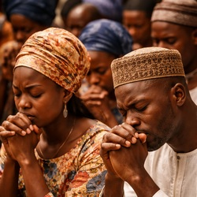
An Informal
Survey
Deaf Ministry

Slide 60
Language
An Informal Survey in Ibadan, N’Djamena, Uvira, Baraka, & Lusaka
Q1. Based on your experience and your daily use, does your sign language follow the grammar rules of your spoken and written language?
For example, if you write in English "I am going to the store," to what extent do your signs follow that word order? Do you sign "I am going to the store," or do you sign "store I go" or some other order?

Slide 61
Language
Q2. If your signs do not follow the written word order, are there established rules regarding word order in your sign language?
For example, in English, our sentences generally follow the "subject-verb-object" order, where "I" is the subject, "am going" is the verb, and "store" is the object, so we say "I am going to the store." If your sign language uses a different word order, are there rules to determine whether a particular word order is correct or incorrect?

Slide 62
Language
Q3. If the word order in your country's sign language is different, do you find that different groups of people use different rules?
For example, do you find that older deaf people use one set of rules for signed grammar, while younger deaf people use another? If so, why?

Slide 63
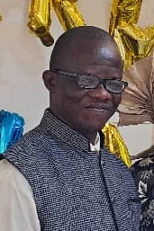
Language
N’Djamena, Chad
Q1. Based on your experience and daily practice, does your sign language respect the grammar of your spoken and written language?*
Yes, of course, in our country.
Here in Chad, we respect grammar. We sign according to the word order of written sentences. In addition, we use the Signing Exact English (SEE) system.
Yves Beosso
12 - 35

Slide 64
Language
Chad
Q2. If your sign language does not follow the written word order, are there established rules regarding word order in your sign language?
In Chad, we do not have a dictionary for Chadian Sign Language. We use the old manual "A Basic Sign Manual" translated into French. Research on Chadian Sign Language is ongoing to gather data and validate a dictionary. This research will take a long time; we plan to combine the signs from Signing Exact English with the signs of the national Chadian sign language for the deaf, in order to obtain official recognition.

Slide 65
Language
Chad
Our sign language follows the exact word order, except when some students don't understand the lesson. In that case, we use their local Chadian sign language to help them understand the text and the content of the lesson. The local Chadian sign language is a separate language that does not follow grammatical principles; these signs are not used in the education of deaf children in schools because they hinder their ability to form sentences; that is why we discourage their use.

Slide 66
Language
Chad
Q3. If the word order in your country's sign language is different, do you observe that different groups of people use different rules?
No. Older deaf people use the local Chadian sign language, as do young people who are not in school—we could call this group "deaf and illiterate."
It is their culture, their pride, and their way of seeing the world. But the consequences are significant. For example, French is one of the official languages; if this group of deaf people cannot speak, sign, or write French fluently, they have no place in society, except for low-skilled jobs that might allow them to make a living, but their economic income will be very limited.

Slide 67
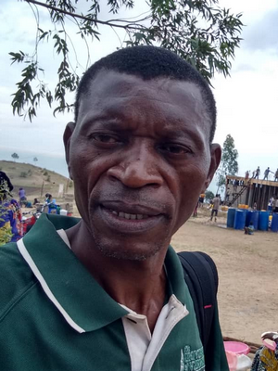
Language
Uvira, DR Congo
a) Sign language used by prenatally deaf-mute individuals:
Regarding this:
1. Sign language does not follow the rules of spoken and written grammar.
2. Yes. The established rules for written sign language consist of representing signs literally, without regard to punctuation or grammatical rules.
3. For this question, we observe that different groups of deaf people (young or old) use the same rules.
Pililo Amani
H - 20+

Slide 68
Language
Uvira, DR Congo
b) Sign language used by postnatally deaf and/or mute children:
Regarding this:
1. Sign language, to some extent, follows the rules of spoken and written grammar, given the prior linguistic experience of these individuals.
2. For these individuals, there is a certain order and established rules in written sign language. However, there are no rules to determine whether the word order is correct or incorrect.

Slide 69
Language
Uvira, DR Congo
3. In this context, the word order in sign language in my country varies because different groups use different rules depending on whether they are postnatally deaf and/or mute children and their geographical location.
Note: Further considerations on this topic will take into account whether the deaf and/or mute children are prenatally or postnatally deaf, and whether they are in school or not. However, ultimately, within a signed language (French, English, Arabic, etc.), the rules of spoken and written grammar are followed, regardless of geographical location or whether the person is prenatally or postnatally deaf and/or mute.

Slide 70
Language
Uvira, DR Congo
Beyond any geopolitical implications, I believe the best approach would be to harmonize the use of sign languages within geographically proximate regions (for example, the sign language of the Great Lakes region, or that of the East African Community, or that of ECOWAS, etc.). This would foster social cohesion, serve as a means of transmitting knowledge, and provide a common language for work and communication, thus promoting progress in various aspects of daily life for deaf people and their hearing counterparts who share the same local or regional geographical area. This is what I have always dreamed of. But how can we achieve this? With what resources?

Slide 71
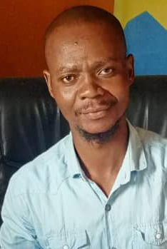
Language
Baraka, DR Congo
First we write the lesson on the black board, then we learn the sentence by speaking and by using ASL at the same time. Our signs follow French word order for all lessons.
1. English, 2. French, 3. Maths
4. Geography, 5. History, 6. Etc.
Shukuru Heritier
6 - 12

Slide 72
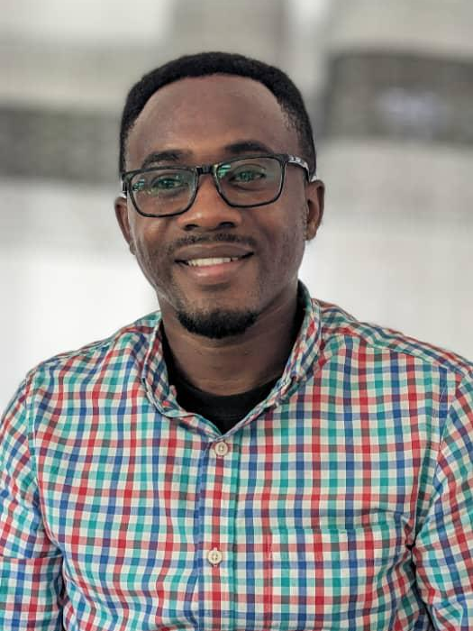
Language
Lusaka, Zambia
Q1. In Zambia, does sign language follow the spoken/written grammar of your language?
In Zambia, our sign language (Zambian Sign Language, ZSL) does not follow English grammar exactly. We don’t usually sign word by word like “I am going to the store.” Instead, we change the order. For example, we may sign “store I go” or “I go store.” It is more natural in our language to put the main idea first and then add the rest. So, the grammar is different, but it still makes sense to us.
Pascal Niyonsenga
9 - 10

Slide 73
Language
Lusaka, Zambia
Q2. If your signs do not follow your written word order, are there established rules for the word order in sign language?
Yes, we have our own rules, even if they are not written down in books. Zambian Sign Language often uses topic–comment style. That means we put the important thing first (the topic) and then say something about it (the comment). Example: “store — I go.” We also use the face, body, and signing space to show tense, questions, or emphasis. So instead of signing “am, is, are” like English, we can just raise our eyebrows or change body position. The rules are clear inside the Deaf community, but they are not always taught in schools.

Slide 74
Language
Lusaka, Zambia
Q3. Do different groups of people use different rules for word order?
Yes, this happens. Older Deaf people usually use more natural ZSL grammar — they learned sign language from other Deaf people in the community. But younger Deaf students sometimes sign more like English word order. This is because many teachers in special schools are hearing, and they use Signed English in the classroom. So, the younger generation may mix English grammar with ZSL. This creates two styles: one closer to natural ZSL and one closer to English.

Slide 75
Language
Lusaka, Zambia
Zambian Sign Language is still growing and being standardized. There are some regional differences — for example, a Deaf person from Lusaka may use one sign, while a Deaf person from the Copperbelt might use a slightly different one. But the grammar (topic–comment, use of space) is the same across the country.
Right now, ZSL is not fully recognized as an official language, though the Deaf community is pushing for this. If it becomes official, it will be easier to train teachers properly and to make one standard dictionary for schools.

Slide 76
Language
Lusaka, Zambia
For me, the important thing is this: ZSL is its own language, not just English on the hands. It has its own way of showing meaning, and that is what makes it strong for Deaf identity and communication.

Slide 77
Grace
Q: When a person newly becomes deaf, surely he or she must feel some sadness. What do the deaf preachers and teachers tell such a person?

Slide 78
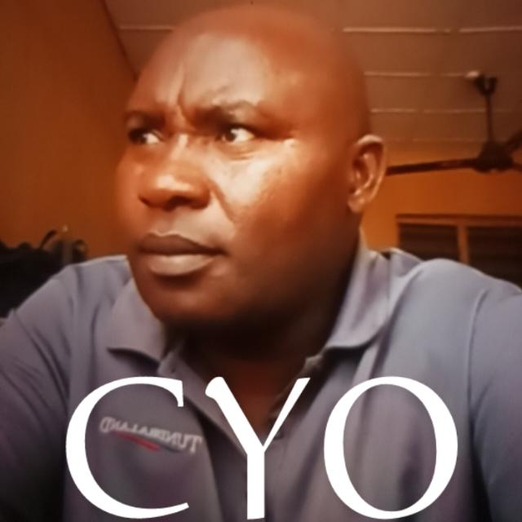
Grace
Ibadan, Nigeria
When a child or person newly becomes deaf, it can truly be a painful and confusing experience. Deaf preachers and teachers often encourage them by reminding them that deafness does not mean the end of life or purpose. They tell them that God still loves them, that they can learn to communicate through sign language, and that they are still valuable and important in society. They also encourage them with Bible stories and testimonies of other deaf people who are living joyfully and serving God. This helps them not to feel hopeless, but to see a future full of possibilities.
Cyprain Oraetoka
6 - 12

Slide 79
Grace
N’Djamena, Chad
Africa in general, many people see deafness as a matter of sympathy and charity and not of a right. Others think that it is the curse of God or the gods have inflicted on the deaf person. While many others see that the deaf person cannot make any economic contribution to the extended life of the family, they consider him useless and refuse to waste time and support to improve the future life of their deaf child. For example, there are many of our deaf pupils at school who are neglected and abandoned to their sad reality.
Yves Beosso
12 - 28

Slide 80
Grace
N’Djamena, Chad
I cannot narrate everything here, but I would like to mention a deaf child named Derbe Gedeon, aged 6. When his father heard our announcement on the radio about the existence of our school, he came with his son. I gave him a questionnaire form to fill out and on reading the questionnaire he was sad and hesitated. I observed his face and decided to ask him how he felt about his deaf child.
He replied that his son is the first born in the family, but unfortunately he is deaf. He is worried about his situation. I understood and advised him, by narrating my life example exactly from what had happened to them. I made him understand that I too became deaf at the age of 12.

Slide 81
Grace
N’Djamena, Chad
My father was also worried about my deafness and even refused to pay for my schooling. But God supported me until today and I became the founding director of this school. I live with a family of 3 hearing children; my wife is also deaf. We should not doubt the power of God because He has a plan for each one. Jeremiah 29:11, Exodus 4:11. That was how he gained courage and filled out the questionnaire.
After completing it, I asked him to bring us a photocopy of Gedeon's birth certificate. To my surprise, he told me that Gedeon didn't have his birth certificate because he was born deaf. I asked if Gedeon's younger siblings had their birth certificates. He replied yes.

Slide 82
Grace
N’Djamena, Chad
Hmmmm! From that answer, I understood that Gedeon being a deaf child, they think it’s not necessary for him to have his birth certificate. They think perhaps he is useless, so there's no need to waste money on uncertain thing etc.
I gave them a lot of advice, and today, thanks to his hard work at school, Gedeon is a brilliant pupil in his class. He always comes first among his classmates in school examinations. His father was very happy with him and regularly pays his school fees.

Slide 83
Grace
N’Djamena, Chad
I like to use my life example to advise parents of deaf children and adults when they worry about their deaf child's disability. Using someone's life example to advise them is important. For them, seeing is believing.
But the word of God tells us blessed are those who have not seen but have believed. John 20:29. People need the word of God to enlighten them of God's purpose for His creation.
For the one who is a deaf unbeliever, we tell him that he or she should not be shamed for being deaf and that disability is not weakness. He who is stong and intelligent also has wisdom to achieve something in life.

Slide 84
Grace
Baraka, DR Congo
When some people becomes deaf, I first encourage them to understand that being deaf is not a curse, but rather, it is God's will according to Exodus 4:11. So I always tell them to be happy in their lives and not to be discouraged. The very important priority is to ask them to learn sign language so that they can communicate with each other and with their families.
Shukuru Heritier
6 - 12

Slide 85
Ministry
Praise the God and Father of our Lord Jesus Christ, the Father of mercies and the God of all comfort. He comforts us in all our affliction, so that we may be able to comfort those who are in any kind of affliction, through the comfort we ourselves receive from God. For as the sufferings of Christ overflow to us, so through Christ our comfort also overflows.
2 Corinthians 1:3-5

Slide 86
Assignment
Group Assignment #3: Answering Questions
1: I do not understand your doctrines. Nontheless, you should help me: pay me to travel to distant villages to preach to deaf people there.
2: If my wife can’t get pregnant, can I send her back to her father and marry another? My tribe says this is permissible.
3: Isaac paid a dowry. Jacob paid a dowry. Therefore every man must pay a dowry. Yes?
4: My neighbor won’t share rice with me and I’m very hungry. So tonight, I will pray that God protects me when I go to steal his rice. I will pray “in Jesus’ name”, therefore God will protect me. Right?
5: One preacher says we MUST be baptized. Another says no. Which is true?

Slide 87
Assignment
Homework Assignment #2: Covenants Timeline
Present your Covenants Timeline
Tim Foster’s Covenants Timeline

Slide 88
Toxic Culture
Deaf Ministry

Slide 89
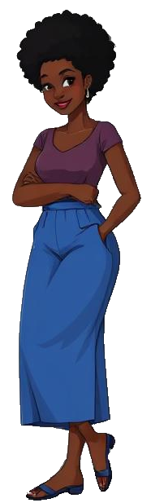
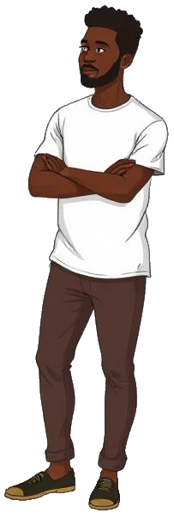
Language
Acts 8:14-24
Deut 29:18-21
language
culture
laws
identity
pride
toxic?
phil 4:10-13
2 cor 12:6-10
1988 Gallaudet protest
Racists & audists
“Nothing to fix”
Cochlear implants
“God made us”
sound
smell
smell
taste
taste
touch
touch
sight
sight
Notes:
Ethics of cochlear implantation in young children
https://www.sciencedirect.com/science/article/pii/S0194599896700979
1988 Gallaudet
The 1988 Gallaudet protests, known as Deaf President Now (DPN), were a week-long student-led uprising in March 1988 demanding a deaf president for Gallaudet University, the world's only liberal arts college for the deaf. Students, faculty, and alumni protested the Board of Trustees' decision to appoint a hearing candidate (Elisabeth Ann Zinser) over deaf contenders, shutting down the campus and gaining national attention. The movement, focused on representation and self-determination, ultimately succeeded, leading to Zinser's resignation and the historic appointment of Dr. I. King Jordan, the first deaf president, marking a major victory for the deaf rights movement.
SEE EXTENDED NOTES
Racists & Audists
I engaged with an ASL interpreter who said ASL would be in heaven base on Rev 5:9
[+] And they sang a new song, saying, "Worthy are you to take the scroll and to open its seals, for you were slain, and by your blood you ransomed people for God from every tribe and language and people and nation, (Rev 5:9)
She called me clueless about deaf culture, a racist and an audist because I said there wouldn’t be ASL in heaven.
Nothing to Fix
In Toxic Deafness, Deaf Advocates will say that deafness is not a handicap and there is nothing to fix. How would you comment on tha?
Cochlear Implants
In Toxic Deafness, some Deaf Advocates will say that the CI videos showing deaf people hearing for the first time are “baloney”.
God Makes Us
In the Congo, you can ask an audience of deaf people “Why are you deaf?” This question is met with a chukle. “Exodus 4:11. Because God made us this way!” This question can’t even be raised among Toxi Deaf.

Slide 90
Culture
Cochlear Genocide
Deafness as Culture, not Disability
Analogy to Genocide
Threat to Cultural Transmission
Parental Autonomy vs. Community Goals
sound
smell
smell
taste
taste
touch
touch
sight
sight
Notes:
Ethics of cochlear implantation in young children
https://www.sciencedirect.com/science/article/pii/S0194599896700979
Deafness as Culture, not Disability: A core tenet of this perspective is that Deaf people are members of a linguistic and cultural minority group, not individuals with a medical disability that needs to be "cured".
Threat to Cultural Transmission: Deaf culture is typically transmitted through institutions and interaction within the community, as over 90% of deaf children are born to hearing parents. The concern is that if deaf children receive cochlear implants and are primarily raised using spoken language and integrated into the hearing world, fewer people will learn and use signed languages, leading to a decline in community membership and, eventually, the potential extinction of the culture itself.
Analogy to Genocide: Proponents of the term argue that the systematic elimination of a minority group can occur by destroying the distinct elements that bind the collectivity, such as language and customs, which they see as parallel to linguistic or cultural genocide (glottocide).
Parental Autonomy vs. Community Goals: This issue creates a conflict between the desires of hearing parents, who may want their child to have the opportunity to hear and participate in the hearing world, and the goals of the Deaf community to preserve its way of life.
Handicaps as an Identity:
Even if disabilities are considered accidents in Aristotelian thought, that does not imply that a person is their accident or should identify as their accident. Accidents modify a substance, but they do not constitute its essence. Identifying as an accident collapses the distinction between essence and attribute — something Aristotle considered a metaphysical error.

Slide 91
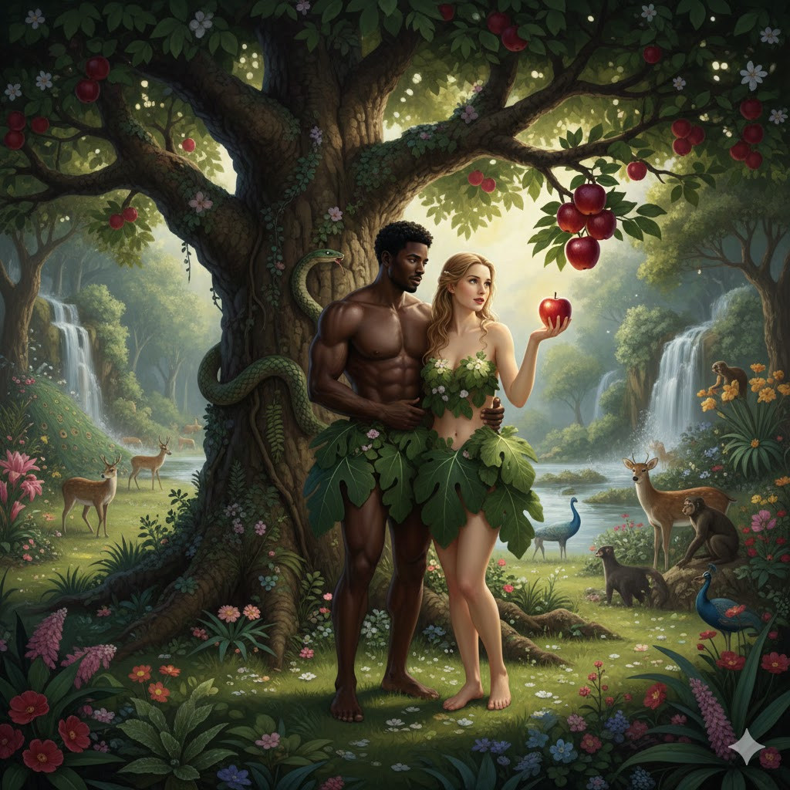
Toxic Desire
WWJD
“If you are the Son of God, turn these stones into bread....”
Man shall not live by bread alone..!
“let everyone see angels rescue you from a fall from the temple...”
Do not put God to the test!
“All these things I will give to you. (Take your lordship now...)”
Worship God only!
[+] So when the woman saw that the tree was good for food, and that it was a delight to the eyes, and that the tree was to be desired to make one wise, she took of its fruit and ate, and she also gave some to her husband who was with her, and he ate.
Genesis 3:6
Pattern?
  Good to eat
  Good to look at
  Good to make one wise
Lust of flesh
Lust of eyes
Pride of life
Notes:
Man shall not live by bread alone: Deut 8:3
Do not put the Lord your God to the test: Deut 6:16
Worshp God only: Deut 6:13
Hello

Slide 92
Toxic Desire: Roots
A Few Types of Violations:
  Ownership: Taking something God did not give you
  Examples & Opposites?
  Timing: Taking something before God’s appointed time
  Examples & Opposites?
  Use: Misusing what God has given you
  Examples & Opposites?
  Identity: Reclassifying what God has established
  Example: Toxic Identity - making an attribute an identity
[+] Woe to those who call evil good and good evil, Who substitute darkness for light and light for darkness, Who substitute bitter for sweet and sweet for bitter.
Woe to those who are wise in their own opinion and clever in their own sight.
Woe to those who are heroes at drinking wine, Who are fearless at mixing beer, who acquit the guilty for a bribe and deprive the innocent of justice.
Isaiah 5:20-23
Notes:
Man shall not live by bread alone: Deut 8:3
Do not put the Lord your God to the test: Deut 6:16
Worshp God only: Deut 6:13

Slide 93
Ministry: Antidote
Psalms 13 - From Lament to Praise
1 LORD, how long will You forget me? Forever? How long will You hide Your face from me? 2 How long will I store up anxious concerns within me, agony in my mind every day? How long will my enemy dominate me?
3 Consider me and answer, LORD my God. Restore brightness to my eyes; Otherwise, I will sleep in death. 4 My enemy will say, "I have triumphed over him," and my foes will rejoice because I am shaken.
5 But I have trusted in Your faithful love; My heart will rejoice in Your deliverance. 6 I will sing to the LORD, Because He has treated me generously.
Psalms 13 - From Lament to Praise
1 LORD, how long will You forget me? Forever? How long will You hide Your face from me? 2 How long will I store up anxious concerns within me, agony in my mind every day? How long will my enemy dominate me?
3 Consider me and answer, LORD my God. Restore brightness to my eyes; Otherwise, I will sleep in death. 4 My enemy will say, "I have triumphed over him," and my foes will rejoice because I am shaken.
5 But I have trusted in Your faithful love; My heart will rejoice in Your deliverance. 6 I will sing to the LORD, Because He has treated me generously.
Psalms 13 - From Lament to Praise
1 LORD, how long will You forget me? Forever? How long will You hide Your face from me? 2 How long will I store up anxious concerns within me, agony in my mind every day? How long will my enemy dominate me?
3 Consider me and answer, LORD my God. Restore brightness to my eyes; Otherwise, I will sleep in death. 4 My enemy will say, "I have triumphed over him," and my foes will rejoice because I am shaken.
5 But I have trusted in Your faithful love; My heart will rejoice in Your deliverance. 6 I will sing to the LORD, Because He has treated me generously.

Slide 94
Assignment
Assignment #4: Your Spiritual Gifts
What are your spiritual gifts?
  Administration Being an apostle Discernment
  Evangelism Exhortation Faith
  Giving Healing Helps
  Hospitality Knowledge Leadership
  Mercy Prophecy Serving
  Speaking in tongues Teaching Wisdom

Slide 95
Assignment
Assignment #1: Ministry Gifts
Write a 1-page paper summarizing the following:
What do you believe are YOUR spiritual gifts? (use your Bible!)
What are specific ways YOU can help YOUR ministry using YOUR gifts?
What are YOUR weaknesses that you will need to consider and protect? How will you plan to protect yourself?

Slide 96
Extra
Launch: Covenants
Launch: How to draw a HDPQPABT
Launch: Hermeneutics
Launch: Homiletics
Launch: Genealogies & Time
Launch: Logic
Launch: Perez (Gen 38)

Slide 97
Assignment
Assignment #3: Isaiah’s Pronouns
Rewrite Isaiah 53 but replace all pronouns with proper nouns
Proper Nouns: “The Father”, “The Son”, “the Holy Spirit”, “the prophets”, “all the world”, “the elect”, etc.
If in doubt about which proper noun should be used, list the various proper nouns that Isaiah might have intended.
[+] Who has believed what he has heard from us? And to whom has the arm of the LORD been revealed? For he grew up before him like a young plant, and like a root out of dry ground; he had no form or majesty that we should look at him…
[+] Who has believed what he has heard from us? And to whom has the arm of the LORD been revealed? For he grew up before him like a young plant, and like a root out of dry ground; he had no form or majesty that we should look at him…
[+] Who has believed what [the world] has heard from [the prophets]? And to whom has the arm of the LORD been revealed? For [the Son] grew up before [the Father] like a young plant, and like a root out of dry ground; [the Son] had no form or majesty that [the world | the elect] should look at [the Son

Slide 98
Assignment
Group Assignment #4: Answering Questions
1 Some say we should worship on Sunday. Others say we should worship on Saturday. Which is true?
2 I do not understand the doctrine you are teaching. Therefore, I will not believe it!
3 Explain the Trinity! I don’t understand it.
4 I got my girlfriend pregnant. I want to still be an evangelist in my church. What should I do?
5 David can't be a type of Christ: David committed adultery!

Slide 99
Assignment
Group Assignment #5: Answering Questions
1 Which Bible translation should I use?
2 Why did God put the Tree of the Knowledge of Good and Evil in the Garden of Eden? He knew they would sin!!
3 We don’t need the Old Testament; it’s old. That’s why the missionaries always give us New Testaments.
4 God hates Swahili. See: all the good things come to French and English people.
5 Judas is in heaven because he did the will of God in betraying Jesus ...yes?

Slide 100
Conclusion
Your Christian duty is to 1) Love God & 2) Love your ‘neighbor’
Your neighbor is anyone/everyone that God puts in your path
The best way to love your neighbor is by helping him/her move to their next step closer to God
If your neighbor is different from you, figure out how to connect to him/her ...and do so
Connect meaningfully and personally with the people in your path
Know when to dismiss tradition and culture
Grow in the grace and knowledge of our Lord and Savior, Jesus Christ
...Grace & Knowledge

Slide 101
The End
...Grace & Knowledge

