Slide 1
theWord Tutorial
TheWord is a very powerful Bible app for your PC computer. You can use it for Bible reading and Bible study. This tutorial will give you some suggestions on how to use TheWord.
[Press ENTER > ]

Slide 2
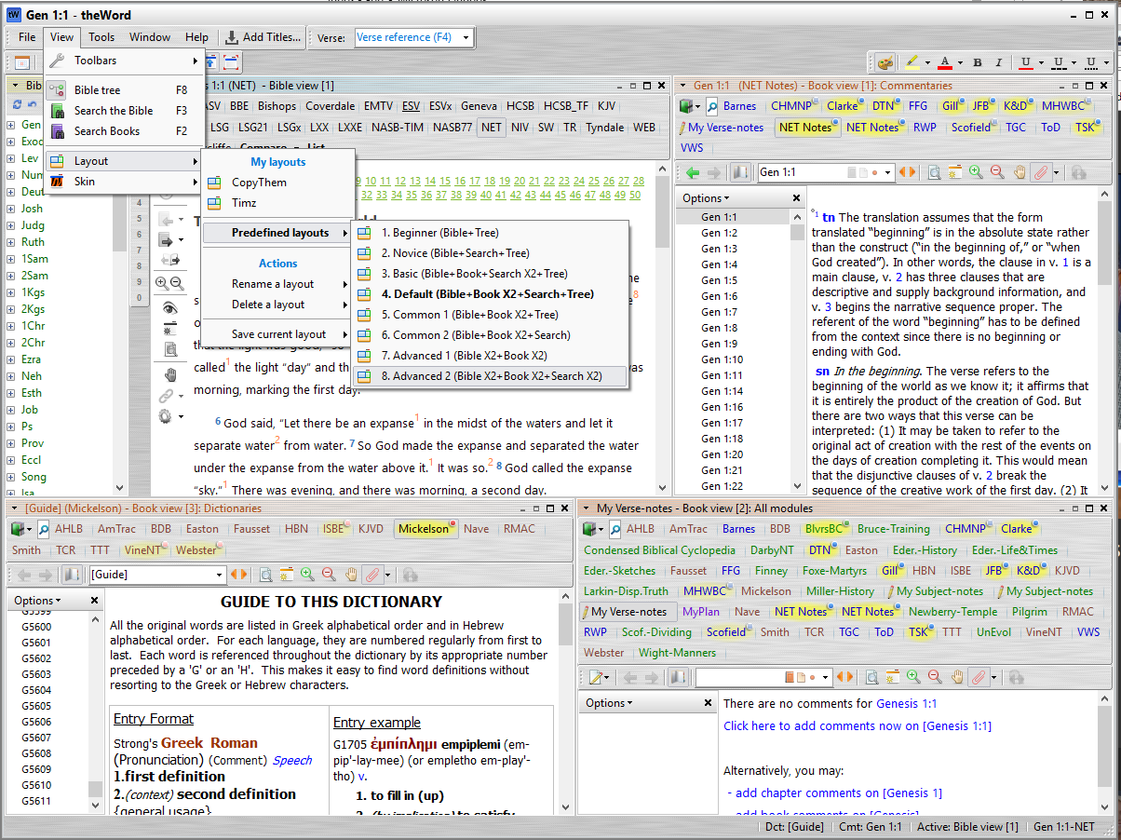
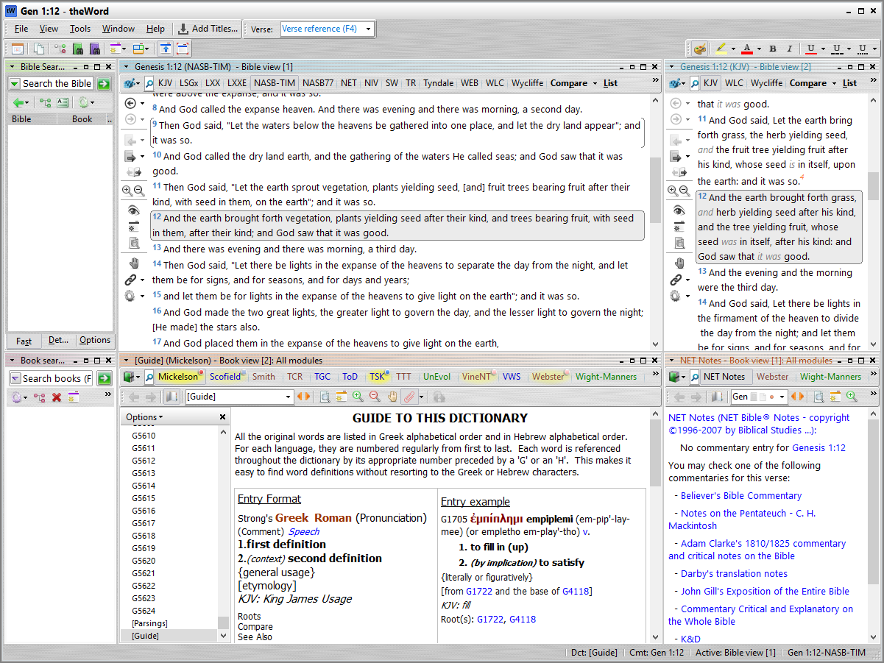
7.5 x 10
675 x 900
The Windows
TheWord's screen is made up of several different windows.
Bible Tree window
Bible window
Commentaries window
Dictionaries window
There are many more windows you can add to your screen, and each window is easy to change in every way for your preference.
A simple way to change the screen layout is to use a predefined layout. * Click on View|Layout|PredefinedLayouts. * Select #8.
Next, we will examine each of the different windows.
Bible
Commentaries
Dictionaries

Slide 3
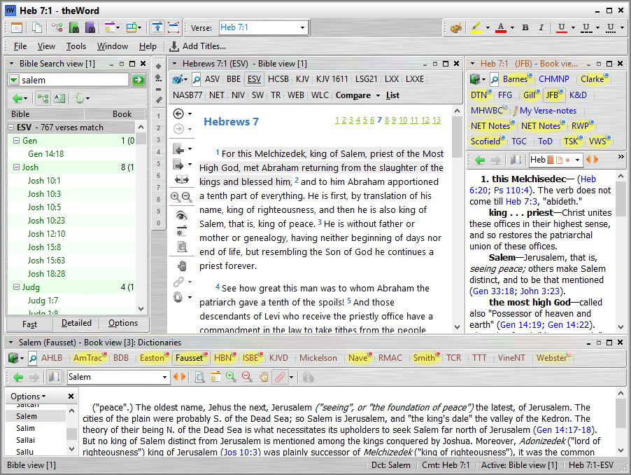
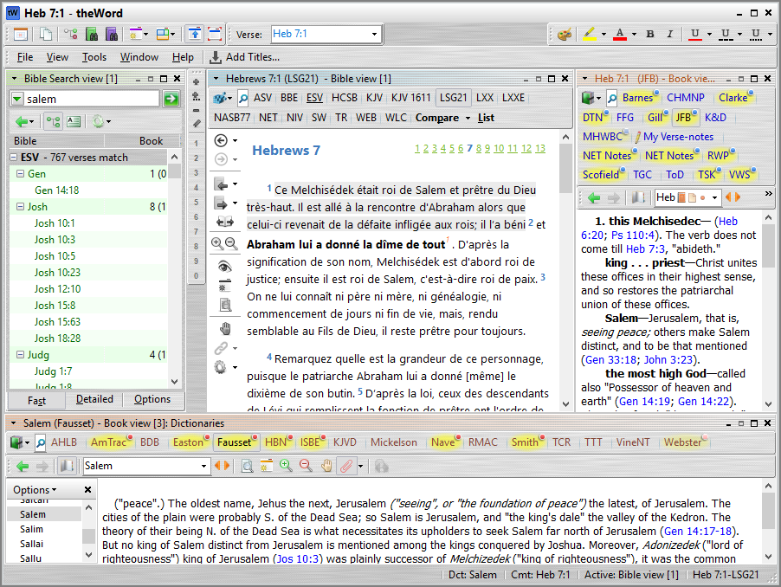
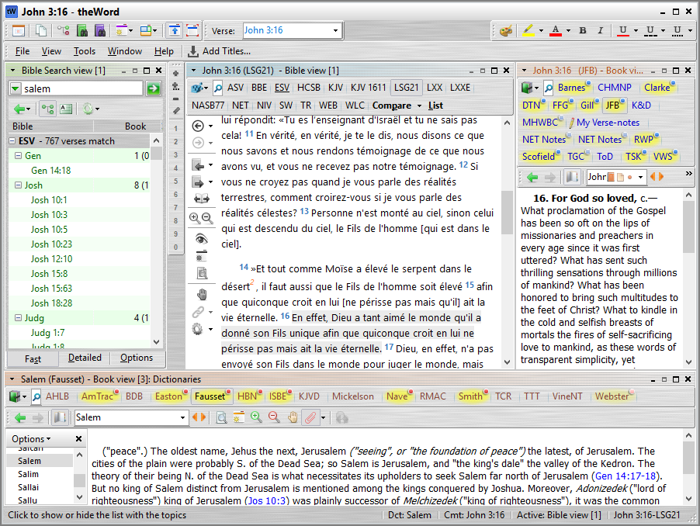
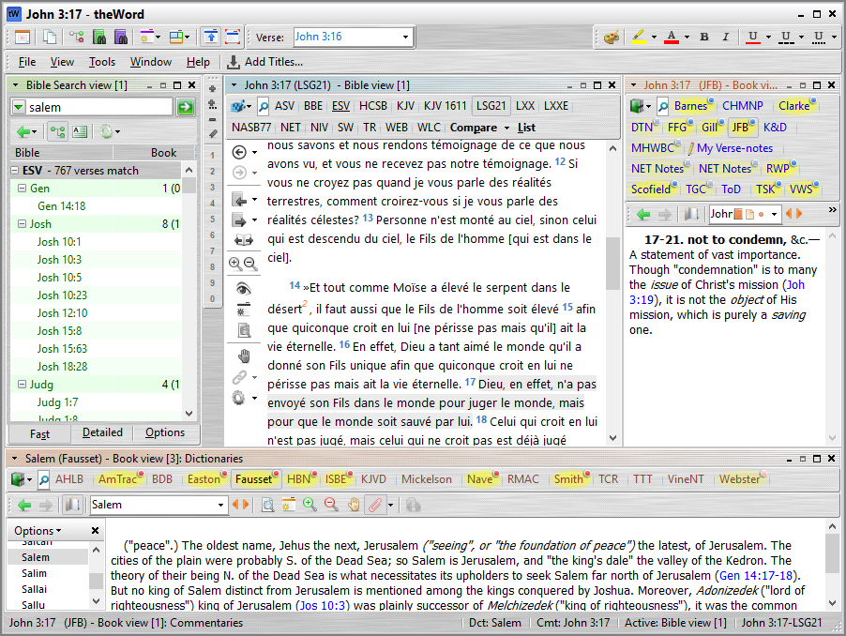
The Bible Window (1)
The Bible window has several features.
Bible versions (KJV, NIV, LSG, etc)
Chapter header
Bible reading options
Verses
You can read the Bible in many different vesions. To change versions, click on the version you want.
To go to a different passage, click on the Verse field and type the book, chapter and verse you wish to read, press ENTER, and TheWord will show you the verse.
To read the next verse, press your keyboard's DOWN arrow.
Press UP to go to the previous verse. Press LEFT and RIGHT to go to the previous or next chapter.
[Press ENTER -> ]

Slide 4
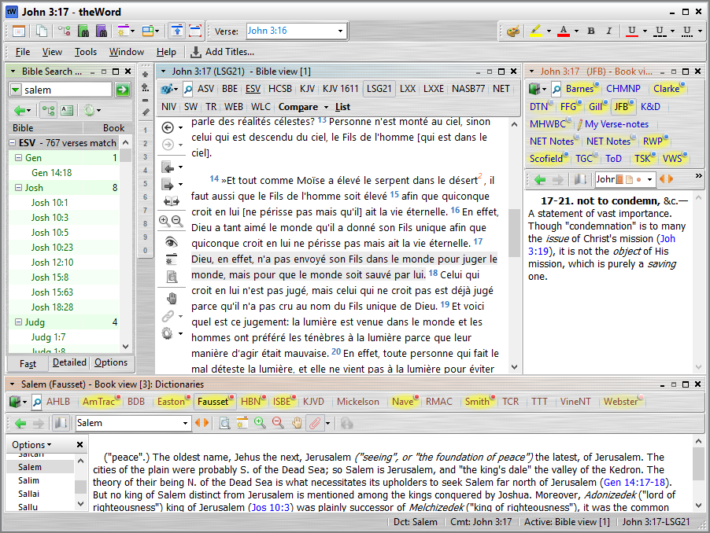
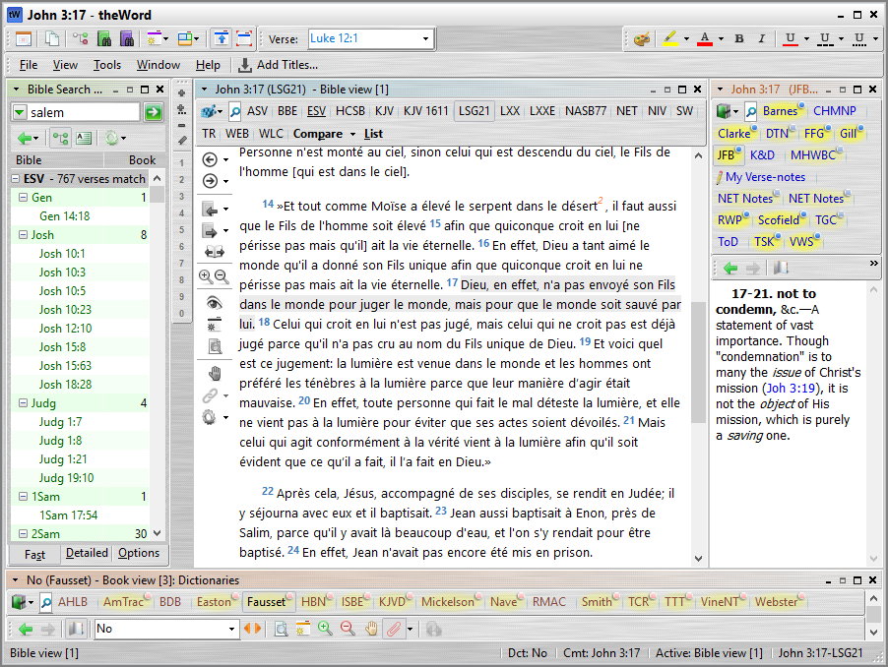
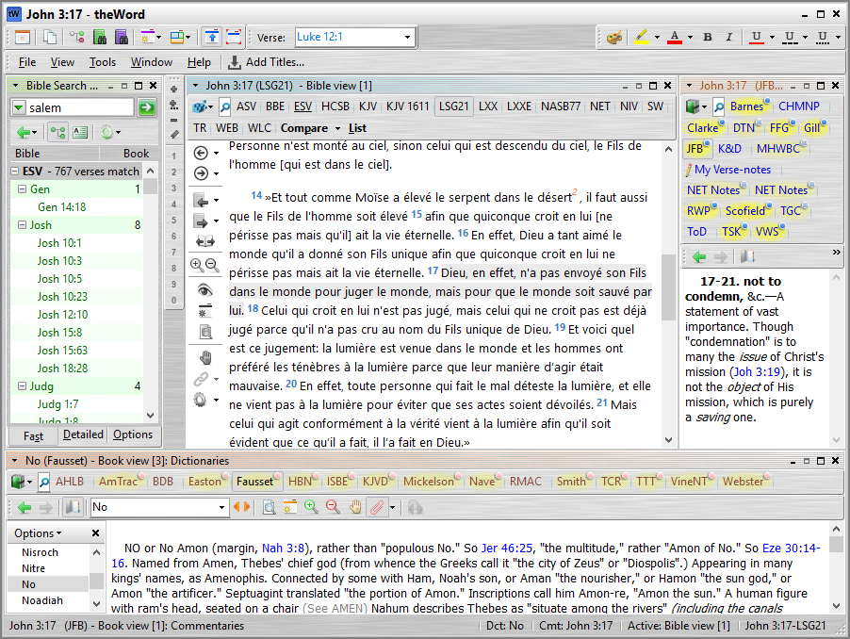
The Bible Window (2)
The size of the Bible window can be changed by dragging the edges.
[Press ENTER -> ]

Slide 5
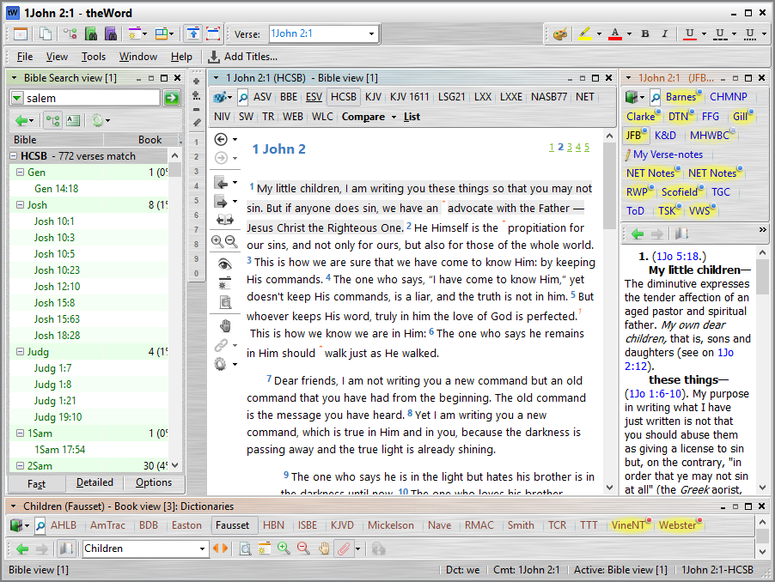
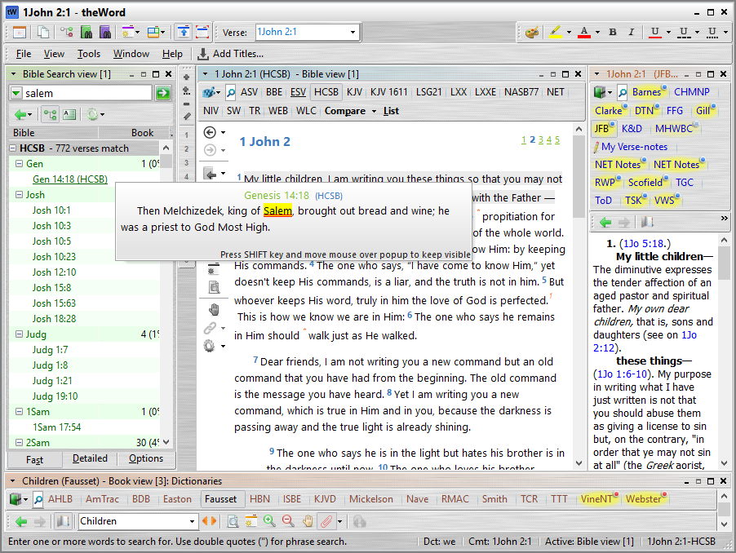
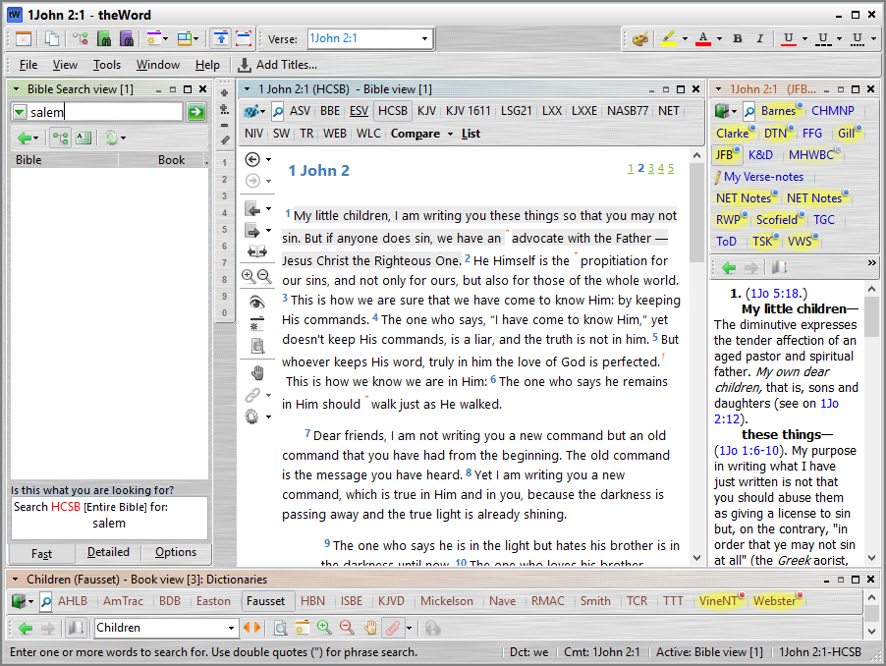
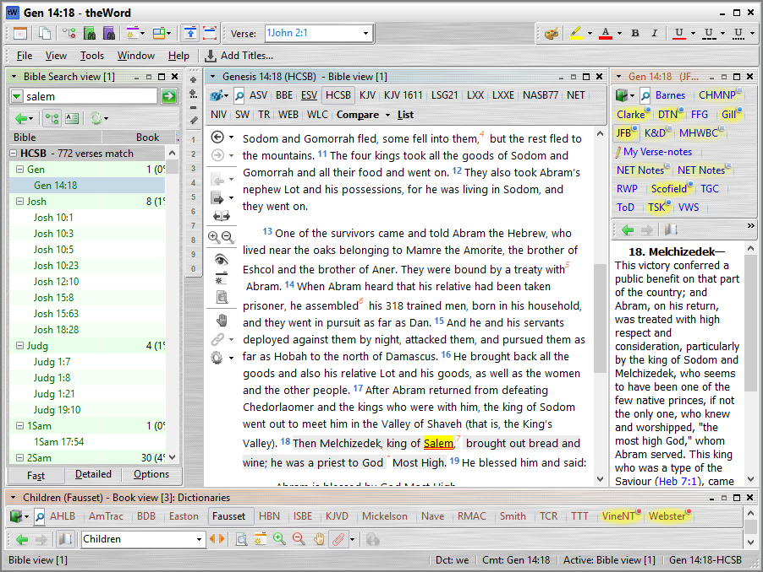
The Search Window
You can easily search the Bible for a special word or phrase.
To Search, press the [F3] button, or click on the Search field.
Type out the word(s) you wish to search, then press ENTER. You will see a list of verses that have the word you searched for.
If you hover the mouse over a verse in the search list, you can read the verse in a pop-up window.
If you click on the verse, the Bible Window will show the verse you have clicked on.
[Press ENTER -> ]

Slide 6
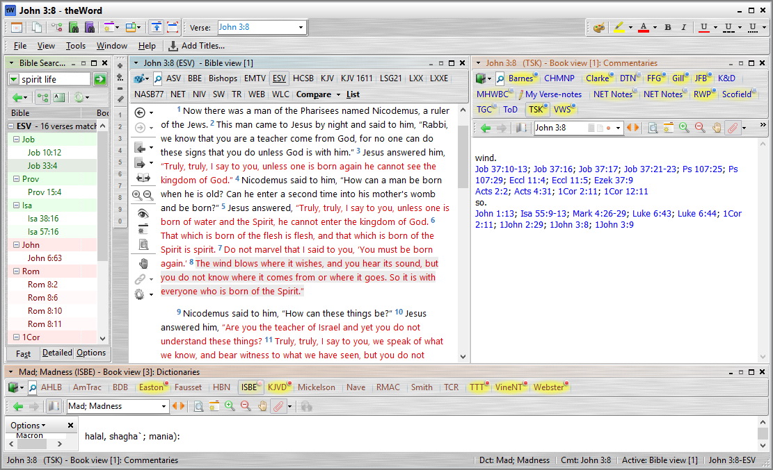
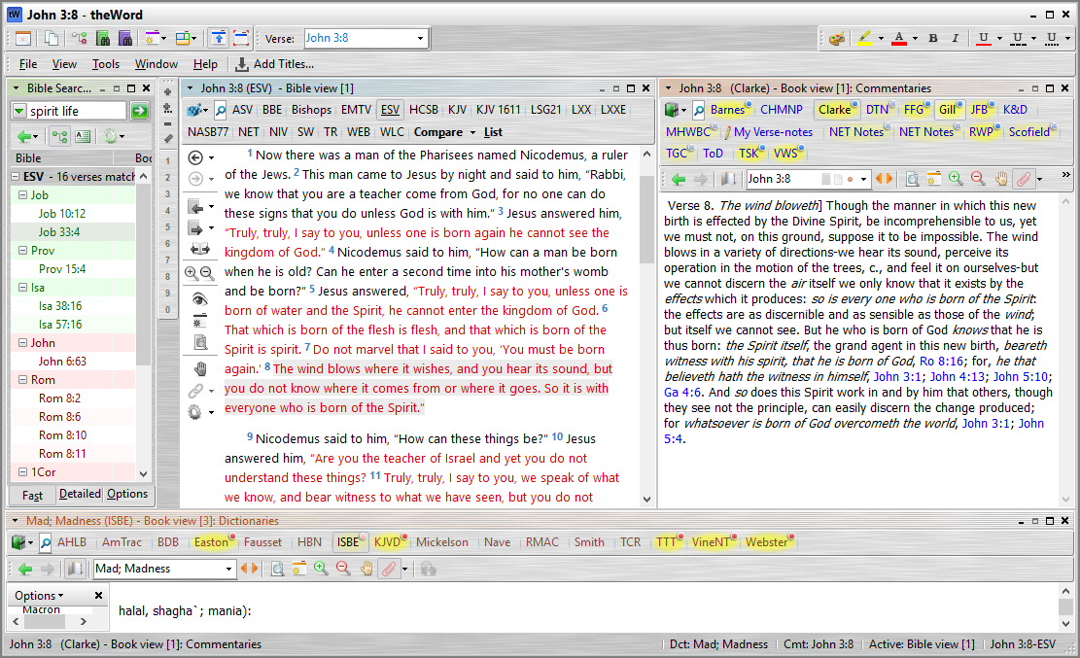
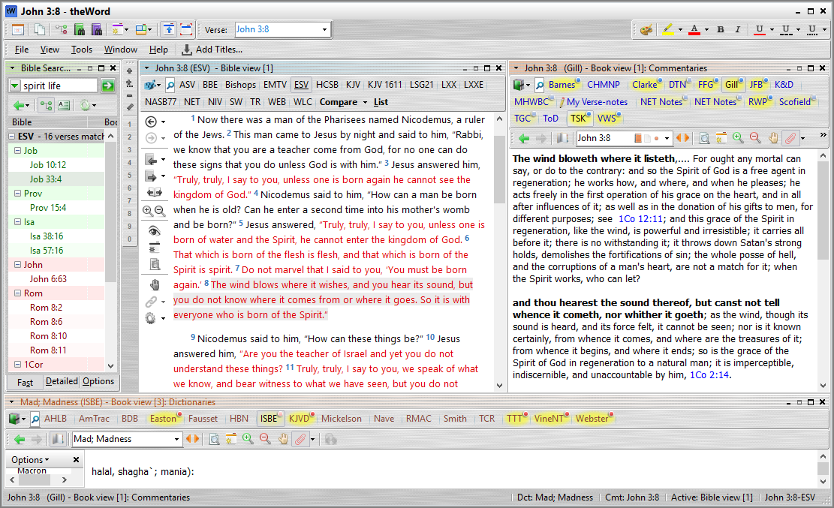
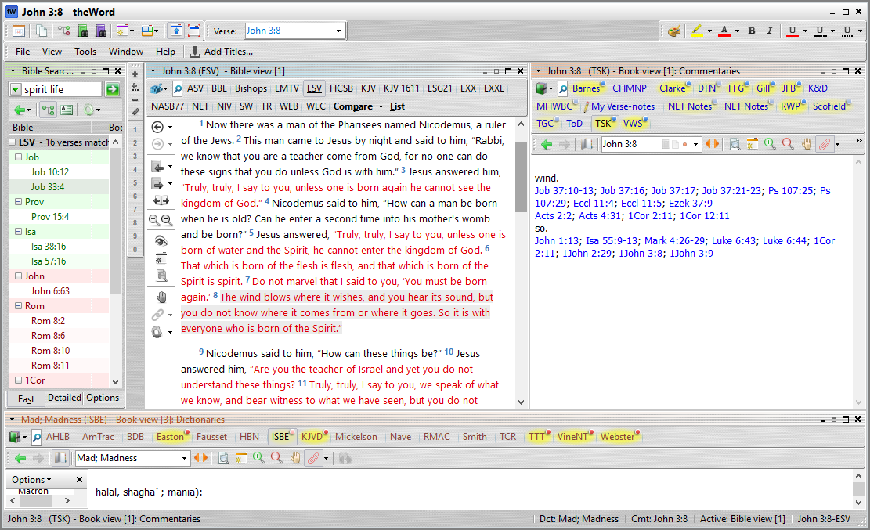
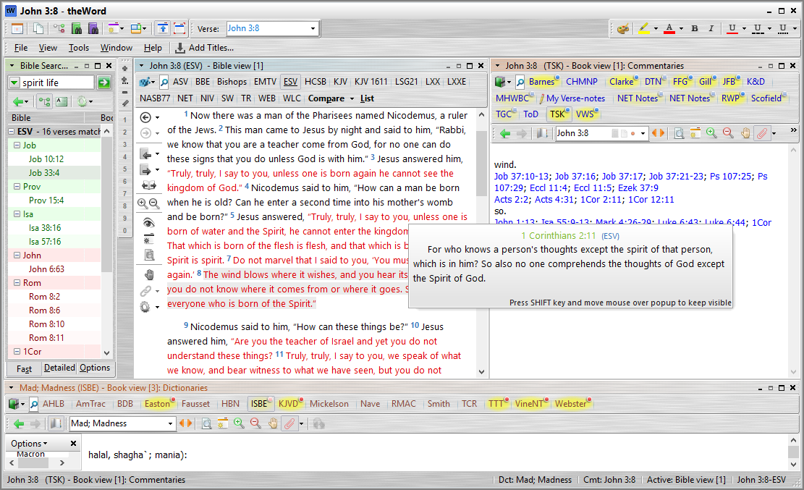
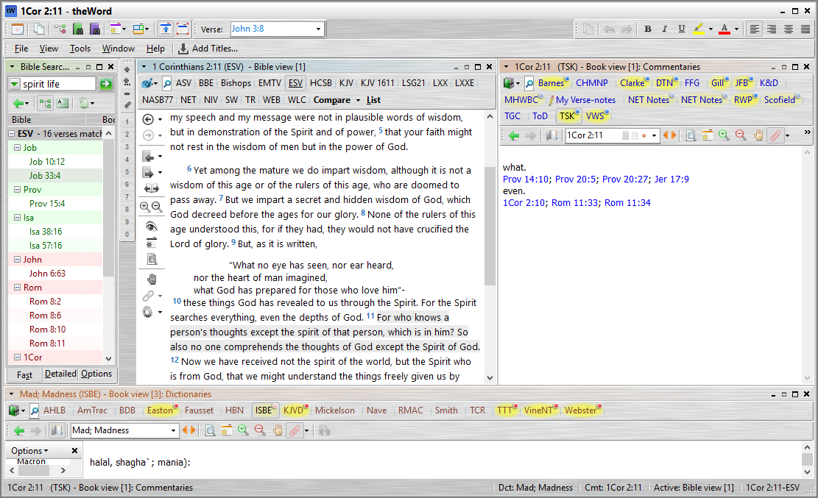
The Commentaries Window
The Commentaries windows is made of several parts:
Commentary titles
Navigation
Comments
The Commentaries window is linked to the Bible window. It shows comments for the verse in the Bible window. If you click on a verse in the Bible window, the Commentary window will change to that verse. Also, if you click on a link in the commentary window, the Bible window will change to that verse.
My favorite commentaries are Gill and TSK.
[Press ENTER -> ]

Slide 7
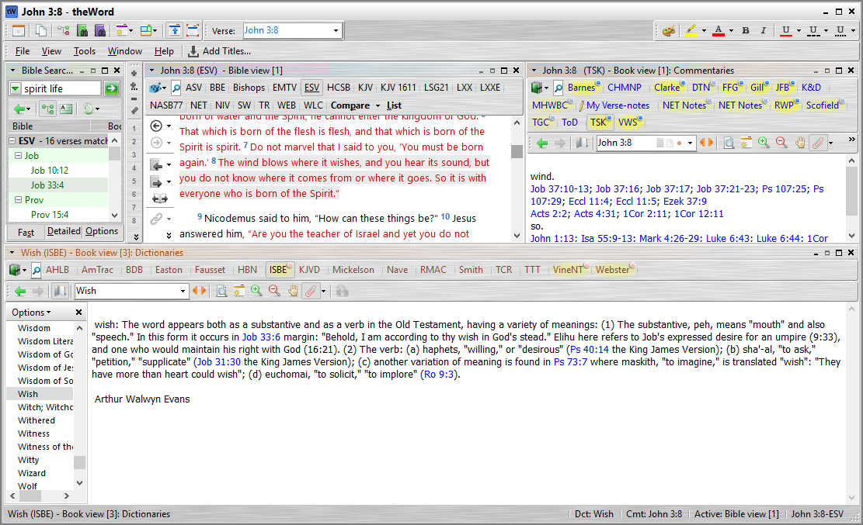
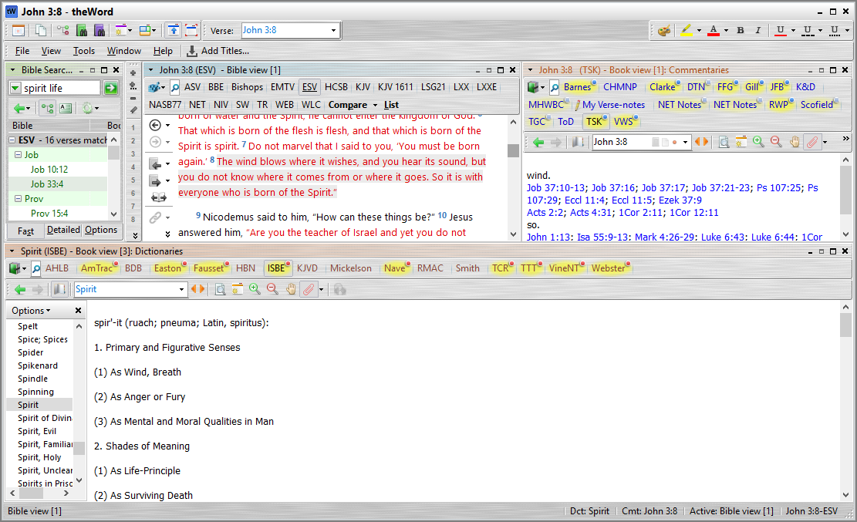
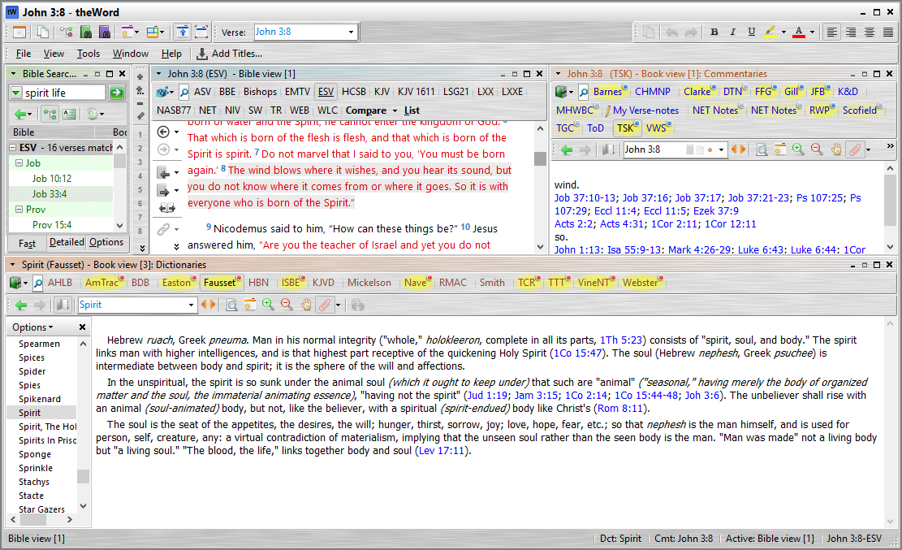
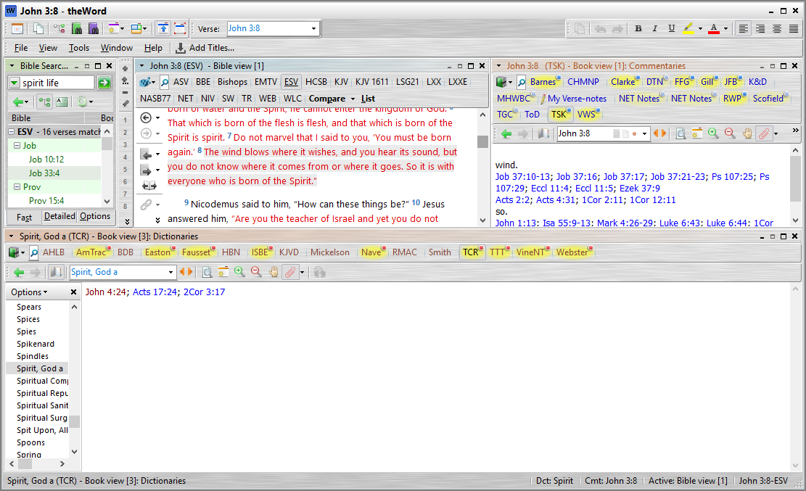
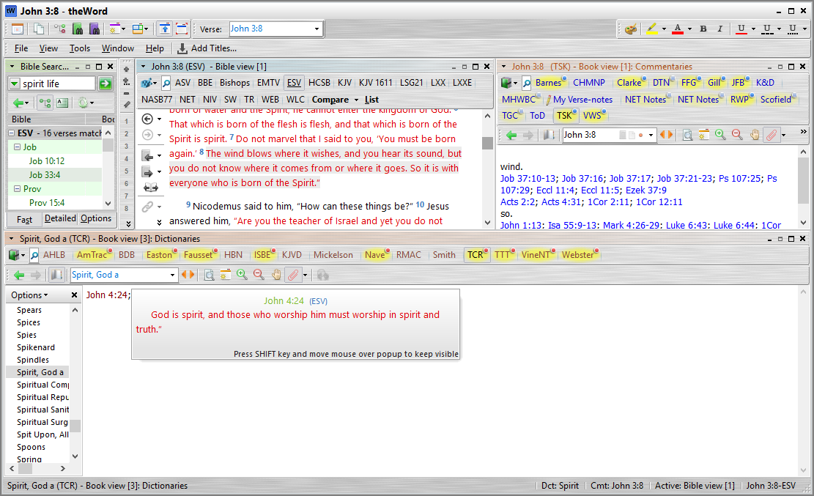
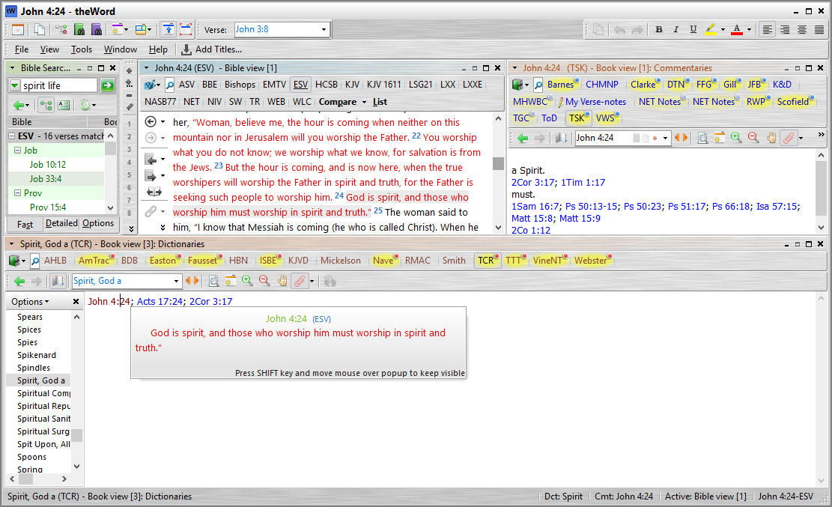
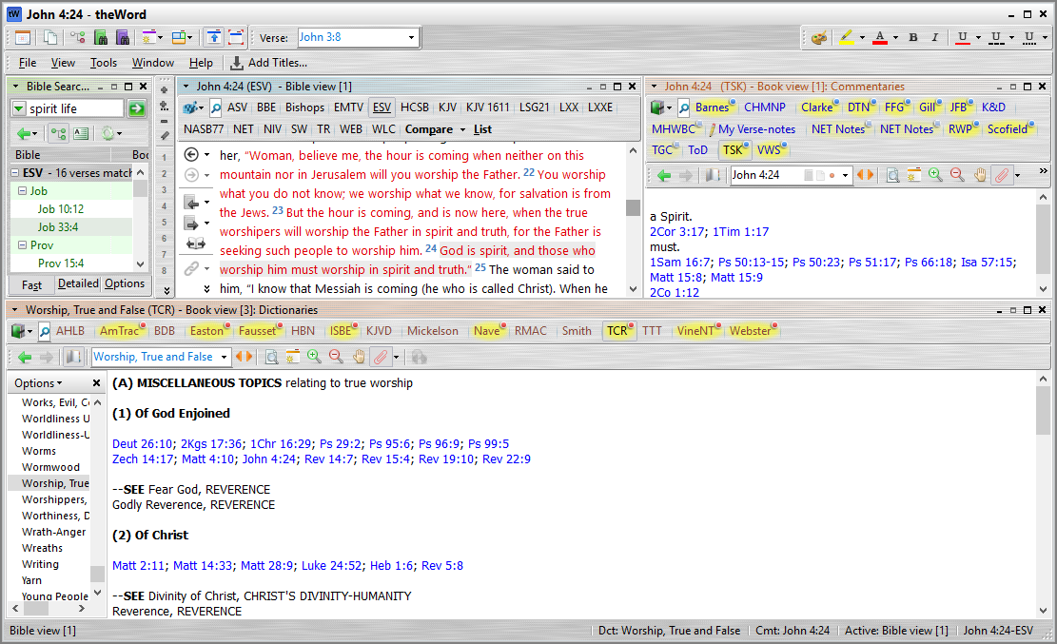
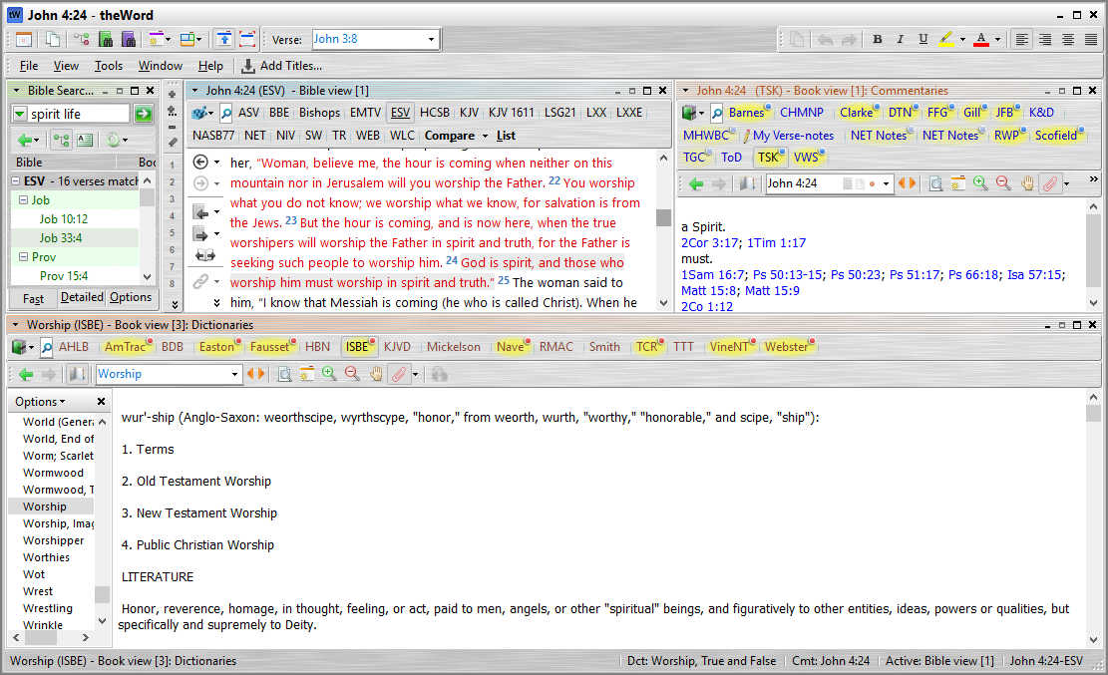
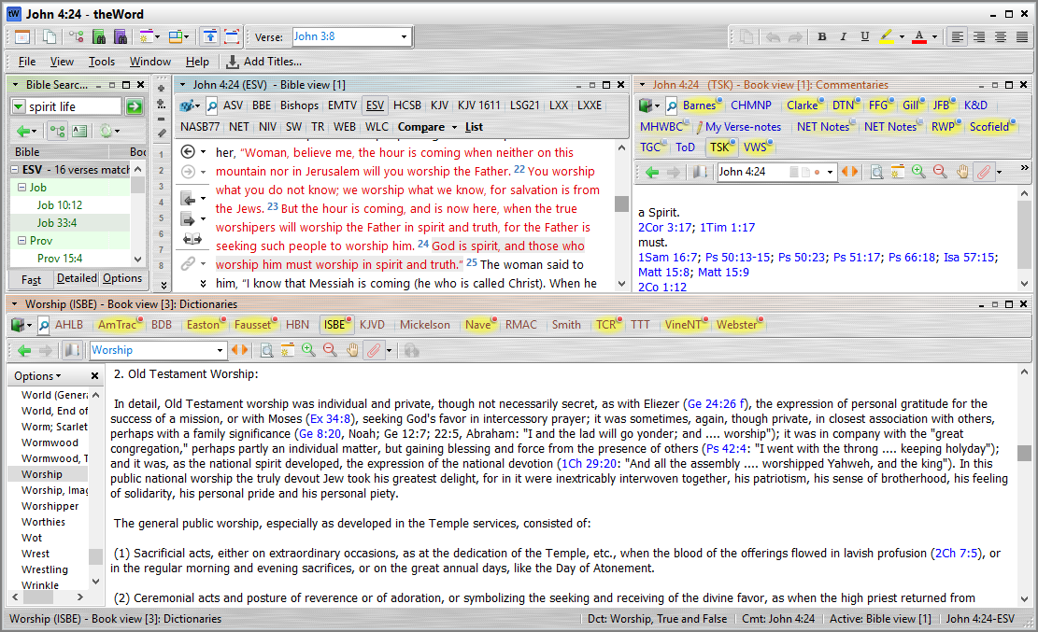
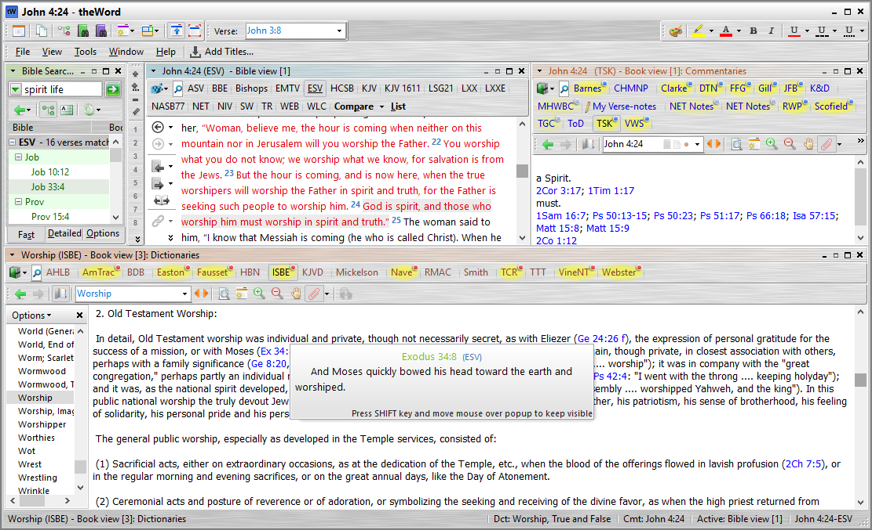
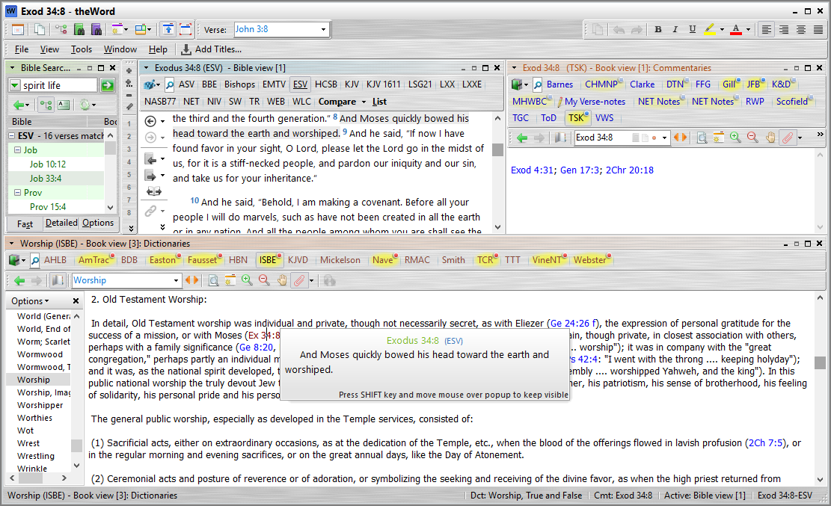
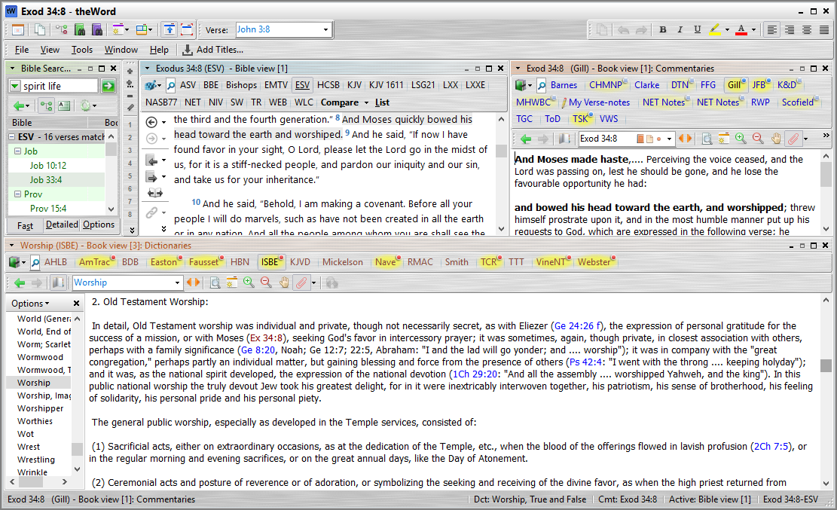
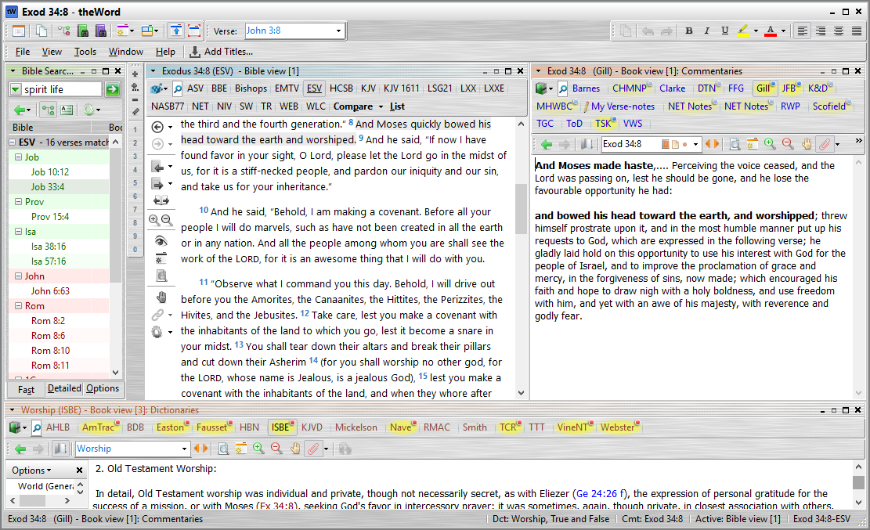
S
The Dictionaries Window
The Dictonaries windows is made of several parts: Dictionary titles, Navigation and Content
The Dictionaries window is linked to the Bible window. If you click on a word in the Bible window, the Dictionaries window will change to that word, and will allow you to study that word.
My favorite dictionary is the ISBE.
[Press ENTER -> ]

Slide 8
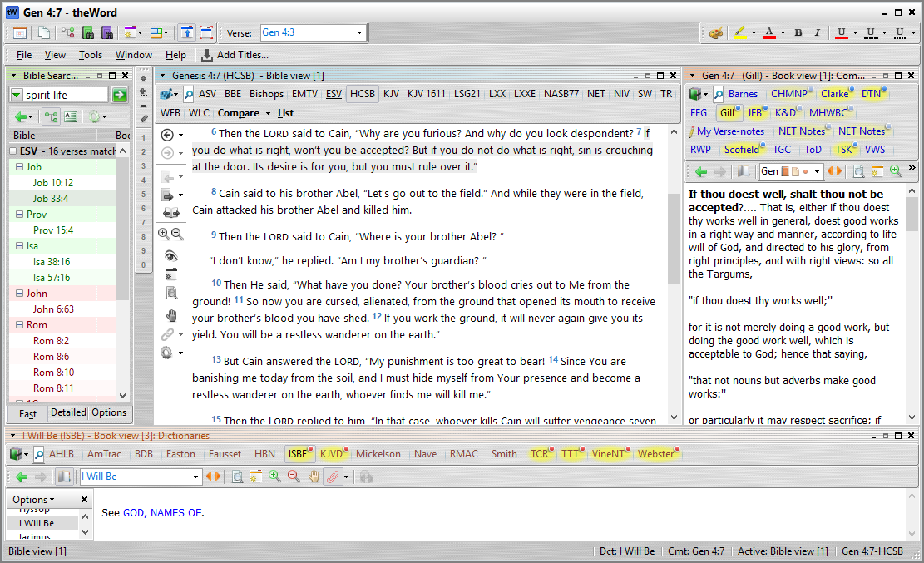
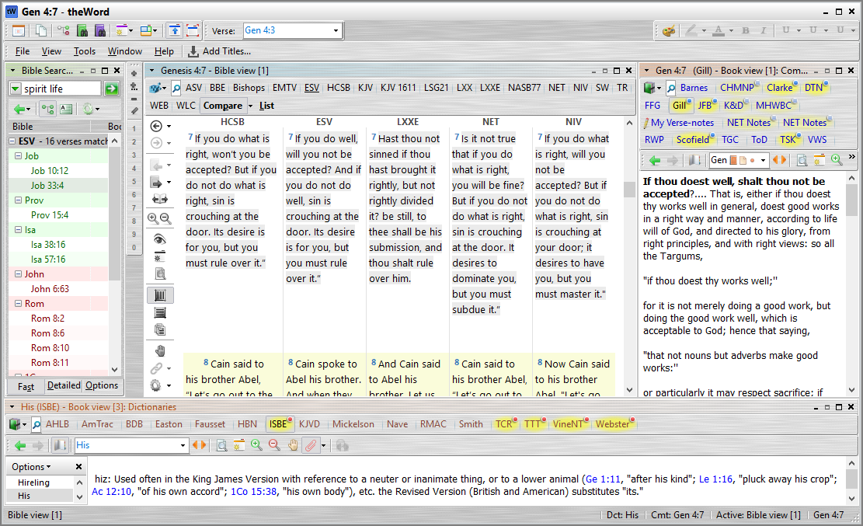
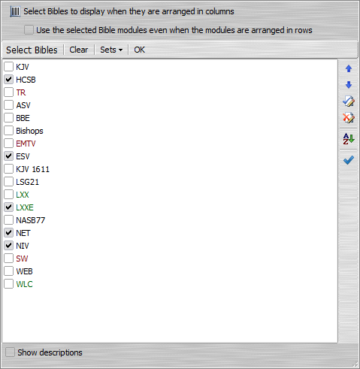
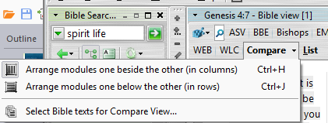
Compare Versions
TheWord can help you study the Bible by helping you compare Bible versions
Click on “Compare”
You can change which versions are shown by clicking on the Compare down-arrow.
[Press ENTER -> ]
Change the Bible versions

Slide 9
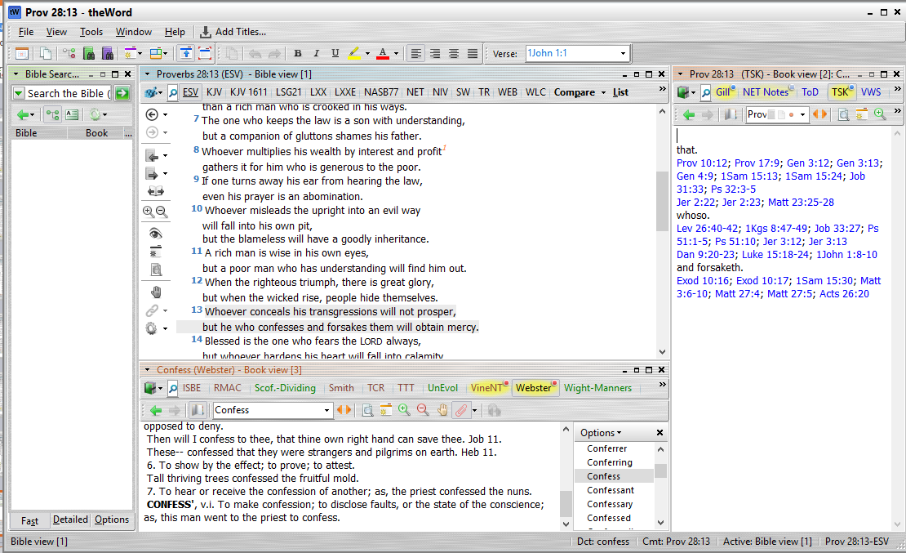
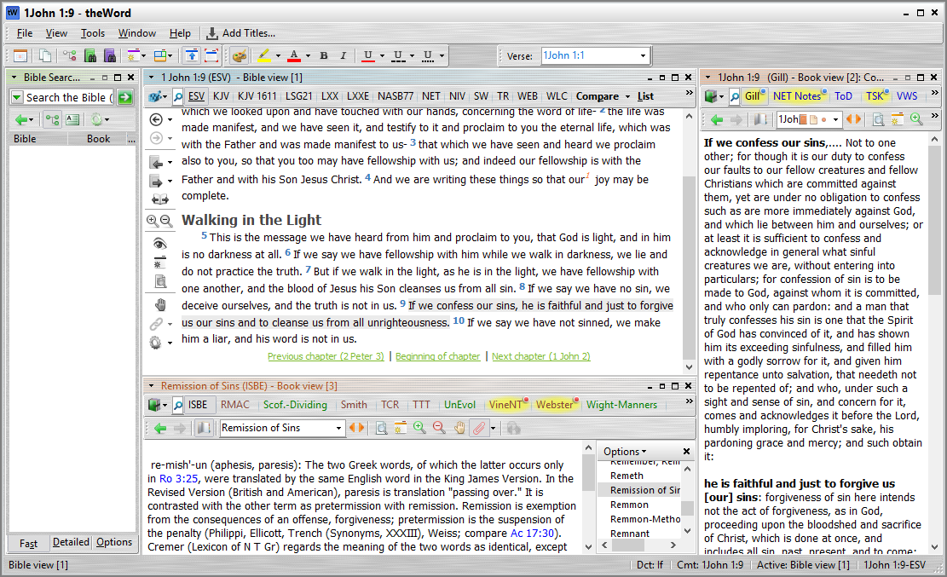
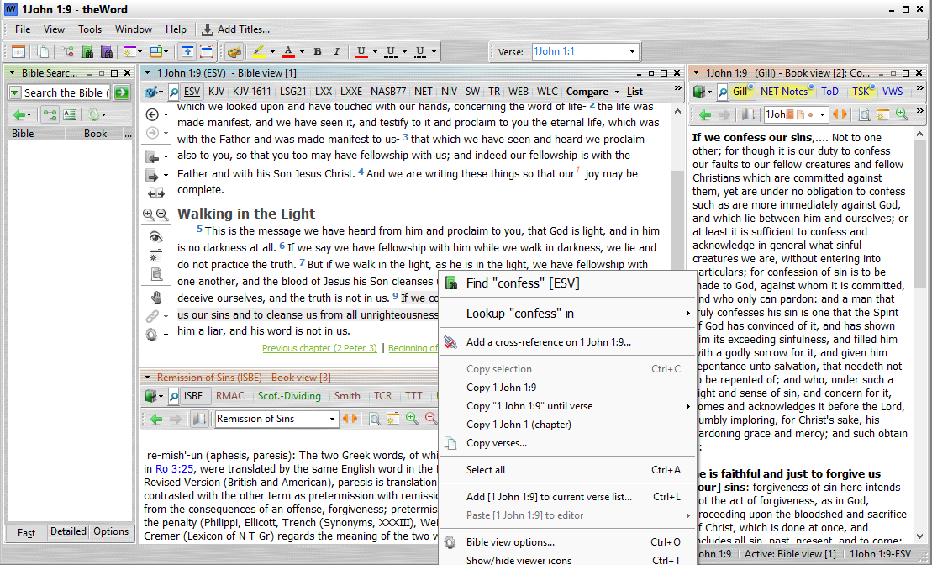
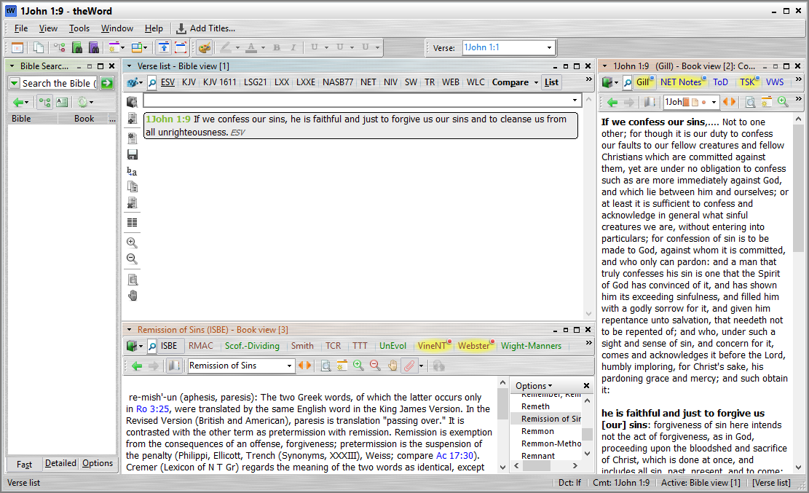
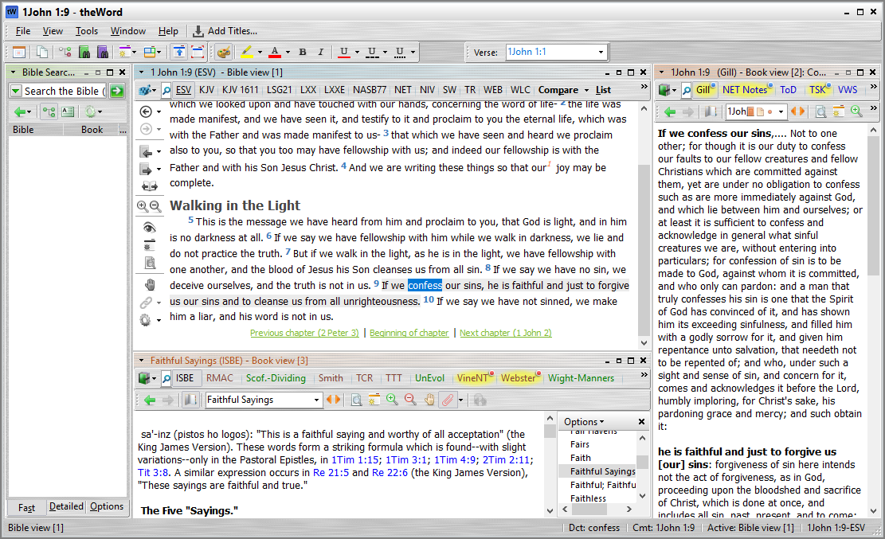
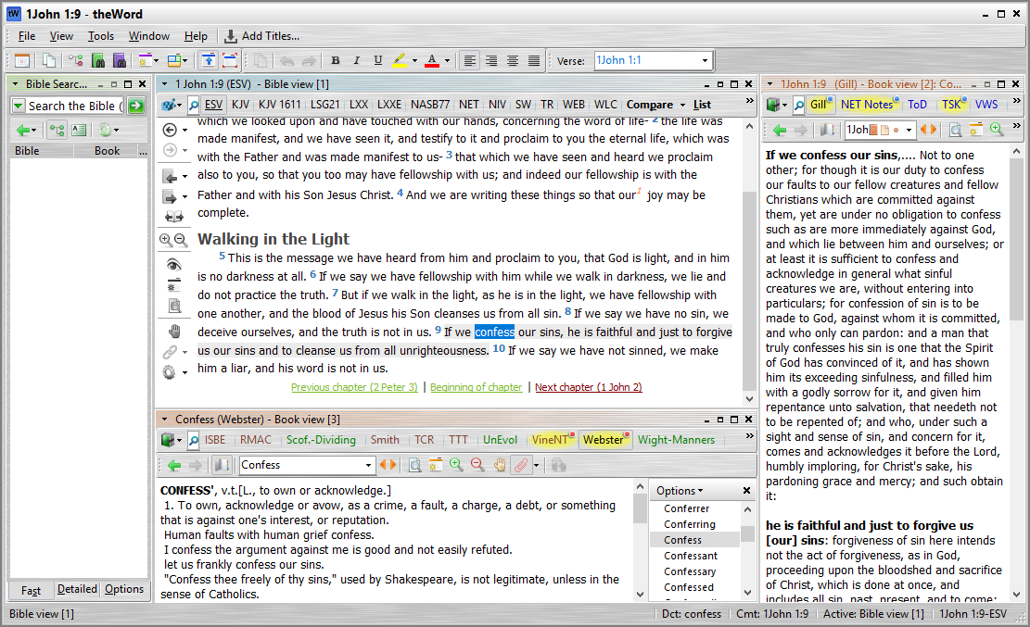
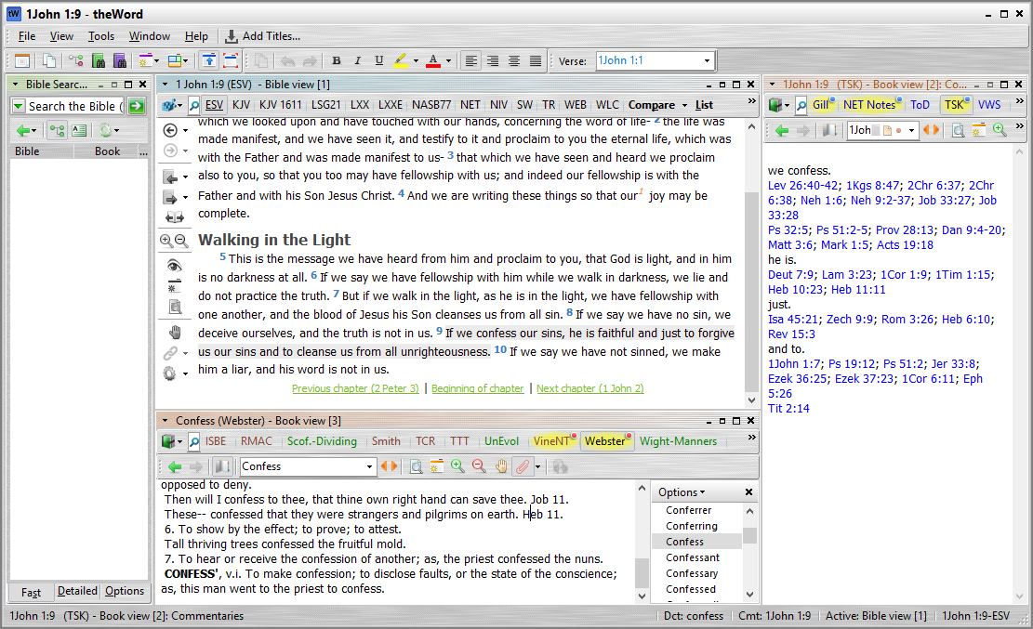
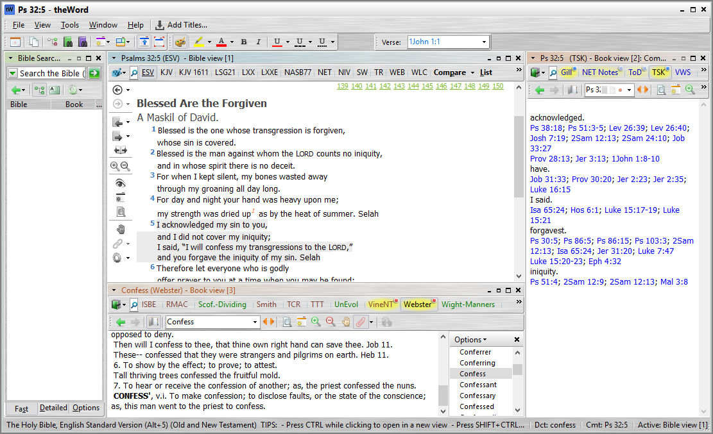
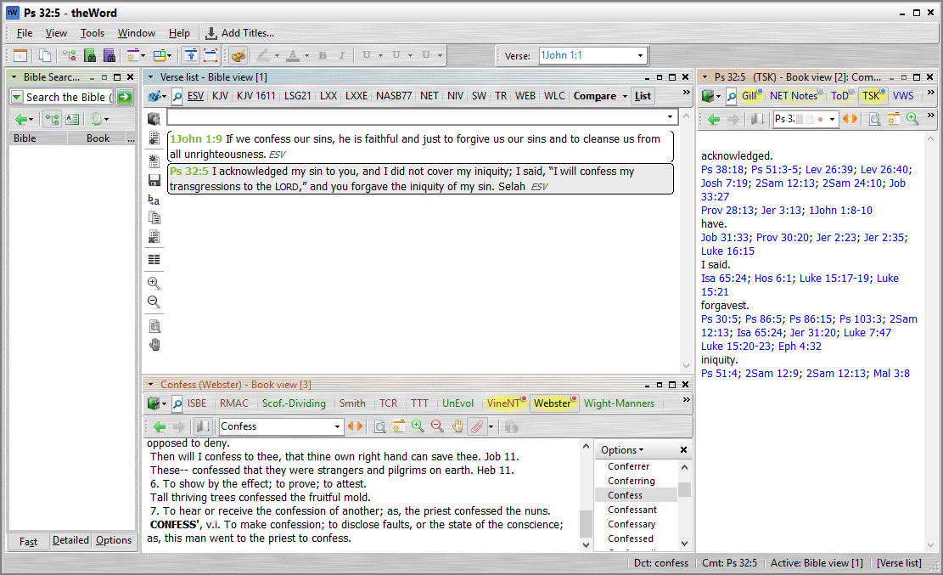
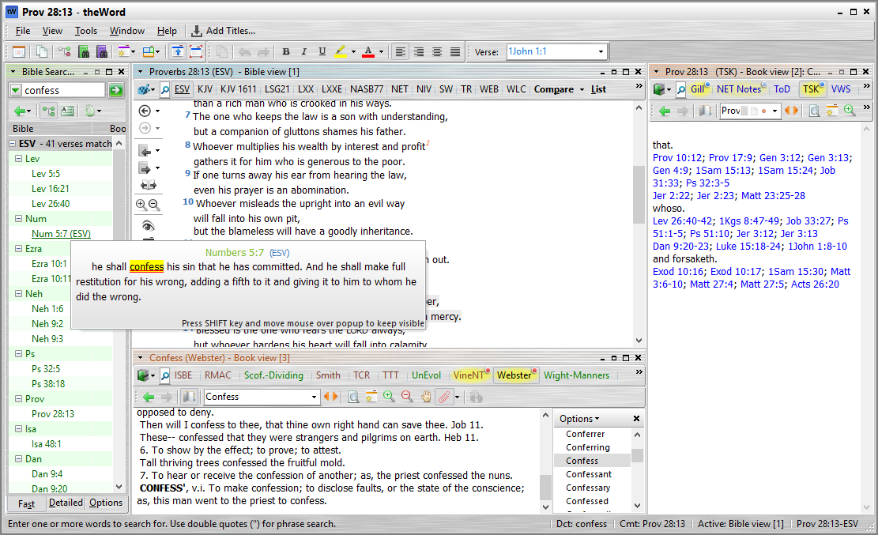
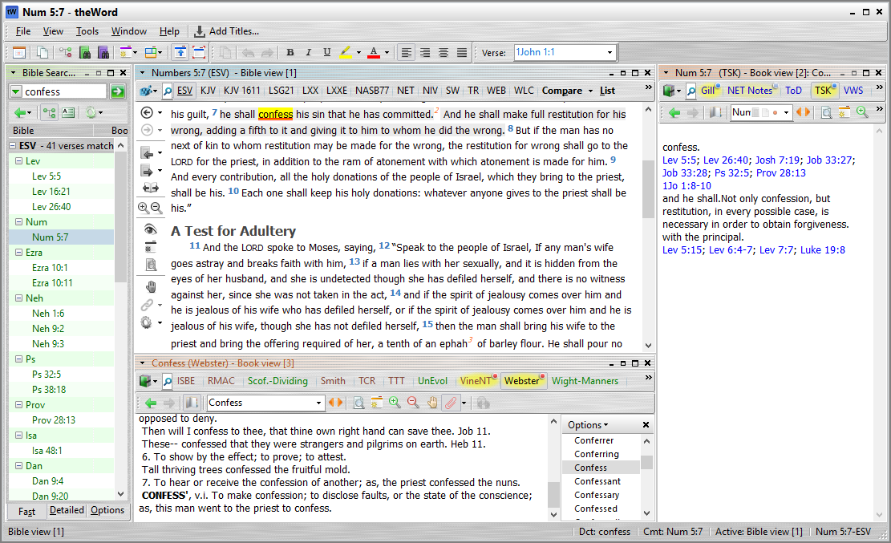
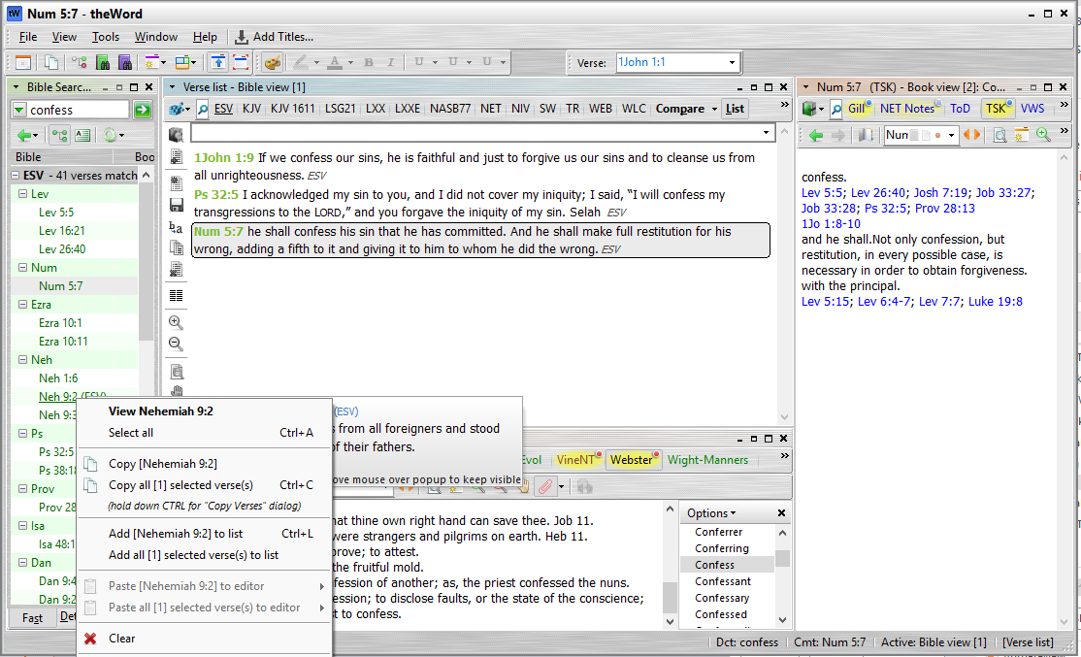
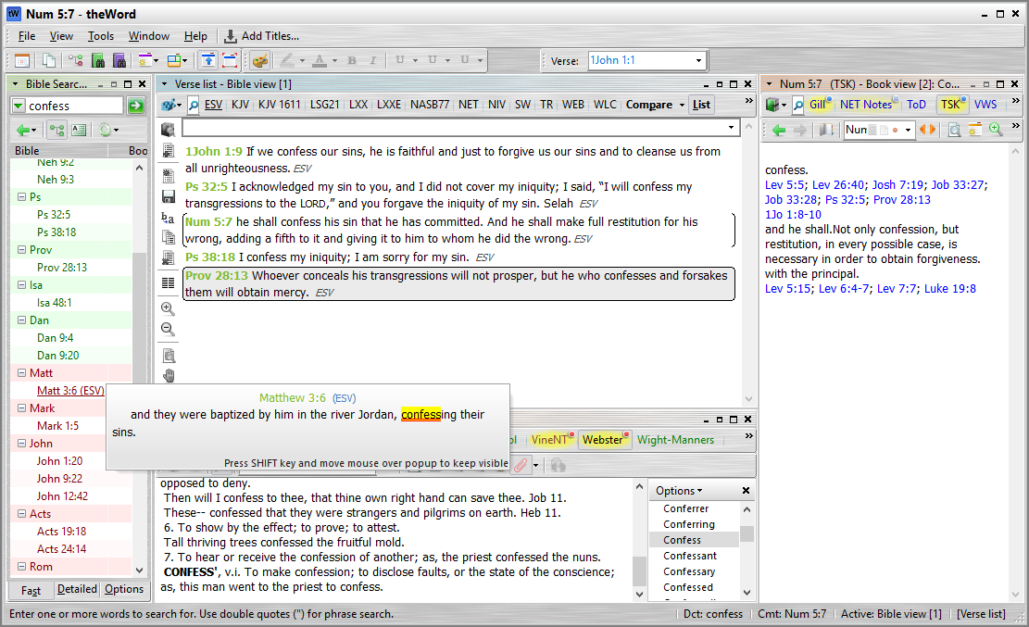
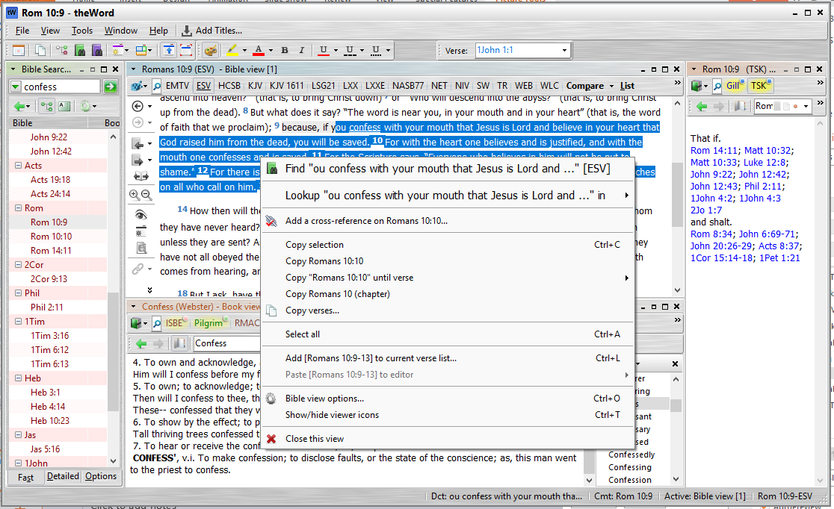
Make Lists of Verses
for study or preaching
TheWord can help you study the Bible by helping you make lists of Bible verses.
Click on a verse you want to remember
Press CTRL-L (or use your mouse's Right-button to click on the verse. Then select “Add to current verse lists”)
[Press ENTER -> ]
Search for the word “confess”
Read and learn COMMENTARIES about CONFESSION
Right-click on the verse and add it to your list
Right-Click
Highlight several verses and Right-Click to add the verses to your verse list. (or press CTRL-L)
Use TSK to find more verses about CONFESSION.
Click on Ps 32:5
Right-Click
Press CTRL-L to add this verse to your verse list.
Now you have a list of verses for studying or for preaching!
You can also copy these to Microsoft Word and print them to give them out to others.
Read and learn the DICTOIONARY meaning of CONFESSION

