Slide 1
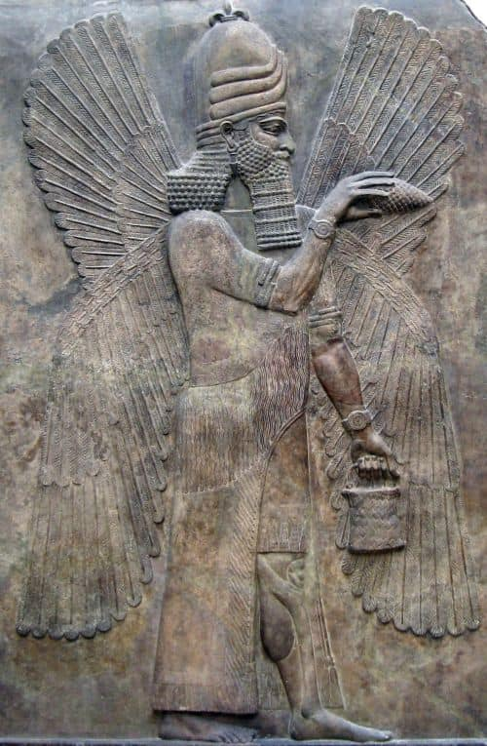
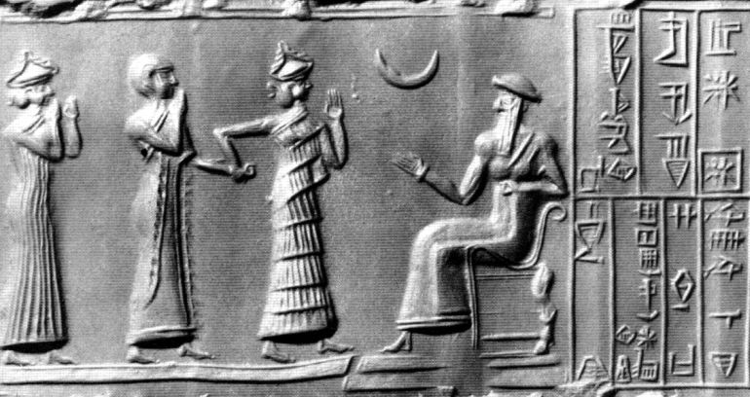
Gods and goddesses of Mesopotamia
Tiamat
Marduk
Sin
Noah
3,000 BC
Abraham
2,000 BC
King David
1,000 BC
Jesus Christ
0 BC
Crusades
1,000 AD
Adam
4,000 BC
Today
2,000 AD
Enoch
3,500 BC
Flood
2,500 BC
Moses
1,500 BC
Hagai Sophia
500 AD
Reformation
1,500 AD

Slide 2
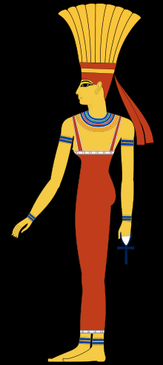
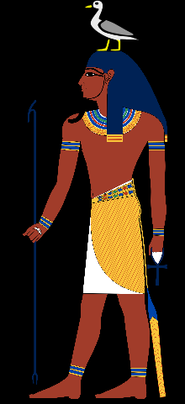
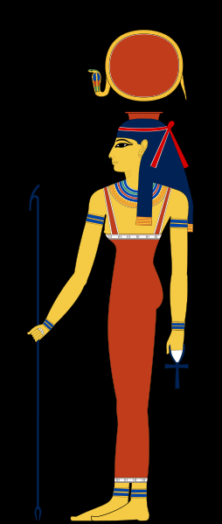
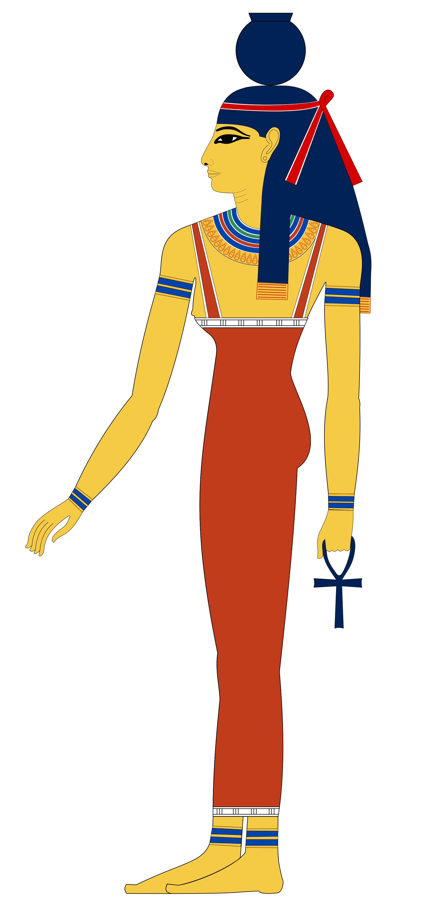
Gods and goddesses of Egypt
Anuket
Heqet
Geb
Hathor
Isis
Nut
Noah
3,000 BC
Abraham
2,000 BC
King David
1,000 BC
Jesus Christ
0 BC
Crusades
1,000 AD
Adam
4,000 BC
Today
2,000 AD
Enoch
3,500 BC
Flood
2,500 BC
Moses
1,500 BC
Hagai Sophia
500 AD
Reformation
1,500 AD

Slide 3
Heresies in the Church
Polytheism / Tri-theism
“There are many gods; there are three gods”
TRUTH: There is only one God (Deut 6:4-9; Is 44:6-8) Jesus said He was the “I AM”, same as God, yet God was His Father (John 8:49-58). The Gospels say that Jesus is the Word, and the Word was with God and was God (John 1:1-3)
Noah
3,000 BC
Abraham
2,000 BC
King David
1,000 BC
Jesus Christ
0 BC
Crusades
1,000 AD
Adam
4,000 BC
Today
2,000 AD
Enoch
3,500 BC
Flood
2,500 BC
Moses
1,500 BC
Hagai Sophia
500 AD
Reformation
1,500 AD

Slide 4
Heresies in the Church
Marcionism
“God in OT is cruel, loving in the NT”
Marcion of Sinope, 140AD
TRUTH: God never changes. God is the same yesterday, today and forever. (Ps 90:2; Isaiah 41:4; Isaiah 44:6; Malachi 3:6; James 1:17; )
Rejected by the church in 144AD
Marcion of Sinope, 140AD
Noah
3,000 BC
Abraham
2,000 BC
King David
1,000 BC
Jesus Christ
0 BC
Crusades
1,000 AD
Adam
4,000 BC
Today
2,000 AD
Enoch
3,500 BC
Flood
2,500 BC
Moses
1,500 BC
Hagai Sophia
500 AD
Reformation
1,500 AD

Slide 5
Heresies in the Church
Modalism
“One God, one Person but different names and modes”
Sabellius, 200AD
TRUTH: God is one Essence, three Persons Each Person of the Trinity has a different role: The Father sends the Son (Gal 4:4; 1 John 4:14); The Father sends the Holy Spirit (John 14:26; Gal 4:6); The Son speaks nor for Himself, but what the Father tells Him (John 8:28; 12:49); The Spirit speaks not for Himself, but for Jesus (John 16:13-15); The Father and Son are two witnesses, not one (John 5:31-37; 8:16-18); The Father loves the Son and the Son loves the Father (John 3:35; 5:20; 14:31); The Father glorifies the Son and the Son glorifies the Father (John 17:1-5), and the Spirit glorifies the Son (John 16:14); Jesus is not the Father, but the Son of the Father (2 John 1:3) The Son dies on the cross, not the Father (2 Cor 5:18-21)
Sabellius, 200AD
Noah
3,000 BC
Abraham
2,000 BC
King David
1,000 BC
Jesus Christ
0 BC
Crusades
1,000 AD
Adam
4,000 BC
Today
2,000 AD
Enoch
3,500 BC
Flood
2,500 BC
Moses
1,500 BC
Hagai Sophia
500 AD
Reformation
1,500 AD

Slide 6
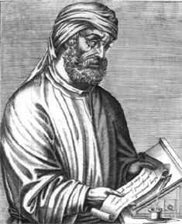
Heresies in the Church
Modalism
“Jesus was not in the Old Testament”
Sabellius, 200AD
TRUTH: God the Son is in the Old Testament in very many places. Often He is called the "Angel of the Lord," "Redeemer", "mediator," the "Son," etc. (Gen 16; Gen 18; Gen 19:24; Gen 22; Exod 3:2-6; Job 19:25-26; Job 33:23-24; Psalms 2;)
Sabellius, 200AD
Noah
3,000 BC
Abraham
2,000 BC
King David
1,000 BC
Jesus Christ
0 BC
Crusades
1,000 AD
Adam
4,000 BC
Today
2,000 AD
Enoch
3,500 BC
Flood
2,500 BC
Moses
1,500 BC
Hagai Sophia
500 AD
Reformation
1,500 AD

Slide 7
Heresies in the Church
Patripassinism
“The Father suffered on the cross” Sabellius, 200AD
TRUTH: The Father was not on the cross. The Father sent the Son to the cross and punished the Son on the cross. The Father did not punish Himself. (Is 53:10-12; 2 Cor 5:18-20)
Rejected by the Church in 220
Sabellius, 200AD
Noah
3,000 BC
Abraham
2,000 BC
King David
1,000 BC
Jesus Christ
0 BC
Crusades
1,000 AD
Adam
4,000 BC
Today
2,000 AD
Enoch
3,500 BC
Flood
2,500 BC
Moses
1,500 BC
Hagai Sophia
500 AD
Reformation
1,500 AD

Slide 8
Heresies in the Church
Arianism
“Jesus was created/begotten by the Father”
Arius of Alexander, 320AD
TRUTH: Jesus was never created. Jesus existed with God in eternity past. Begotten does not mean 'born', it means that Jesus is the same essence of God and always had the status of “Son”. Jesus cannot be created because He is eternal (John 1:1-3; John 17; Rev 1:17).
Refuted in 325 at the Council of Nicea
Arius of Alexander, 320AD
Noah
3,000 BC
Abraham
2,000 BC
King David
1,000 BC
Jesus Christ
0 BC
Crusades
1,000 AD
Adam
4,000 BC
Today
2,000 AD
Enoch
3,500 BC
Flood
2,500 BC
Moses
1,500 BC
Hagai Sophia
500 AD
Reformation
1,500 AD

Slide 9
Heresies in the Church
Docetism
“Jesus was not fully human; Jesus had a spirit body”
Early sect, 200AD
TRUTH: Jesus is both fully God AND fully man. Although the Son of God existed in eternity past, He also became both fully God and fully man when He was born of a woman. He grew in knowledge, He ate, slept, became tired. He was hungry and thirsty. He bled and died. After He rose, He ate food and His body and scars could be touched. This is how we know He was fully human AND fully God. (John 1:1-3; Luke 2:40,52; Matt 4:2; 8:24; Luke 22:44; John 4:6-7; 19:28-42; Luke 24:39-43; Jn 20:27-29; Acts 10:41)
Condemned at the Council of Chalcedon in 451
Noah
3,000 BC
Abraham
2,000 BC
King David
1,000 BC
Jesus Christ
0 BC
Crusades
1,000 AD
Adam
4,000 BC
Today
2,000 AD
Enoch
3,500 BC
Flood
2,500 BC
Moses
1,500 BC
Hagai Sophia
500 AD
Reformation
1,500 AD

Slide 10
Heresies in the Church
Pelagianism
“Man is not born with a sin nature”
Pelagius, 400AD
TRUTH: We are born in sin because of Adam’s sin (Romans 5:12; Eph 2:3; Ps 51:5). No one is righteous (Rom 3:10-12), and every human has fallen short of God’s glory (Rom 6:23).
Condemned at the Council of Carthage in 412AD
Pelagius, 400AD
Noah
3,000 BC
Abraham
2,000 BC
King David
1,000 BC
Jesus Christ
0 BC
Crusades
1,000 AD
Adam
4,000 BC
Today
2,000 AD
Enoch
3,500 BC
Flood
2,500 BC
Moses
1,500 BC
Hagai Sophia
500 AD
Reformation
1,500 AD

Slide 11
Heresies in the Church
Nestorianism
“Jesus was not fully God”
Nestorius, 400AD
TRUTH: Jesus shares all divine attributes with God the Father. Jesus taught that He was one with God. Jesus is both God and man in one Person. Jesus forgave sins. Only God can forgive sins. (Mark 2:5-12; Luke 5:21) Jesus performed special miracles that only God can do: control weather (Matt 8:23-27; 14:22,33), gives life to whom He pleases (John 5:19-23; Matt 11:27) Jesus accepted worship. Only God can accept worship. (Matt 14:33; 28:17-18; John 5:22-23; 9:38; 17:5) Jesus teaches us He is the divine Son of God, making Himself equal to God (John 5:17-18; John 10:30-33; John 19:7)
Condemned at the Council of Ephesus in 431AD
Nestorius, 400AD
Noah
3,000 BC
Abraham
2,000 BC
King David
1,000 BC
Jesus Christ
0 BC
Crusades
1,000 AD
Adam
4,000 BC
Today
2,000 AD
Enoch
3,500 BC
Flood
2,500 BC
Moses
1,500 BC
Hagai Sophia
500 AD
Reformation
1,500 AD

Slide 12
Heresies in the Church
Subordinationism
“Jesus is less than God”
JWs, Mormons, etc
TRUTH: Jesus is equal to God, and is one with God. (John 1:1-3, 14; John 5:18; John 20:28; Colossians 2:9;
Phil 2:5-8; Hebrews 1:8)
This teaching has always been rejected by the Church.
Mormon Elders (today)
Noah
3,000 BC
Abraham
2,000 BC
King David
1,000 BC
Jesus Christ
0 BC
Crusades
1,000 AD
Adam
4,000 BC
Today
2,000 AD
Enoch
3,500 BC
Flood
2,500 BC
Moses
1,500 BC
Hagai Sophia
500 AD
Reformation
1,500 AD

Slide 13
Heresies in the Church
Prosperity Gospel
“God wants you to be rich; poverty is the result of sin”
Word of Faith, etc
TRUTH: Many of God’s prophets were poor. Even Jesus Himself was poor. This false teaching encourages envy and jealousy, causing man to look at riches instead of God. (Matthew 8:20; Eph 5:5-7; 1 Timothy 3:3; Hebrews 13:5; Luke 12:15; Matthew 6:19; Matthew 6:24)
This teaching has always been rejected by the Church.
.
Word of Faith (today)
Noah
3,000 BC
Abraham
2,000 BC
King David
1,000 BC
Jesus Christ
0 BC
Crusades
1,000 AD
Adam
4,000 BC
Today
2,000 AD
Enoch
3,500 BC
Flood
2,500 BC
Moses
1,500 BC
Hagai Sophia
500 AD
Reformation
1,500 AD

Slide 14
Heresies in the Church
Semi-Pelagianism
“Salvation is a work of both God and man” Taught by many churches
TRUTH: Man is dead in his sins and cannot stir himself up to do righteousness or believe in God. To the natural man, the things of God seem as foolishness, and he cannot understand or accept them. The Bible teaches that man’s righteousness is as filthy rags, that he is a slave to sin, and that it is impossible for him to please God. (Isaiah 64:5; John 8:34; Romans 6:22; Rom 8:7; 1 Corinthians 2:14)
Condemned at the Council of Orange in 529AD
Noah
3,000 BC
Abraham
2,000 BC
King David
1,000 BC
Jesus Christ
0 BC
Crusades
1,000 AD
Adam
4,000 BC
Today
2,000 AD
Enoch
3,500 BC
Flood
2,500 BC
Moses
1,500 BC
Hagai Sophia
500 AD
Reformation
1,500 AD

