Slide 1
Biblical History: Textul Criticism
Nature of God's Word
If the Scriptures are Inspired, Inerrant and Infallible, then ...
Why are there “contradictions” in the Biblical narratives?
Why are there inconsistencies in order and number?
I've heard there are over 20,000 errors!
Why does it contradict science?
AlwaysBeReady.com
ReformedApologeticsMinistries.com
MichaelJKruger.com
The Big Book of Bible Difficulties by Geisler & Howe

Slide 2
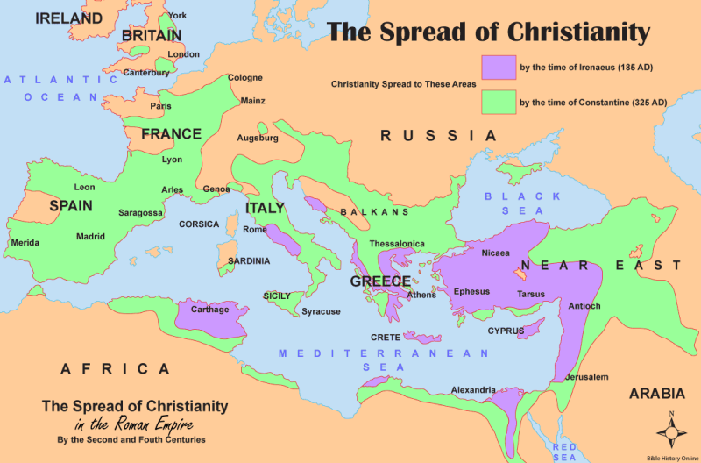
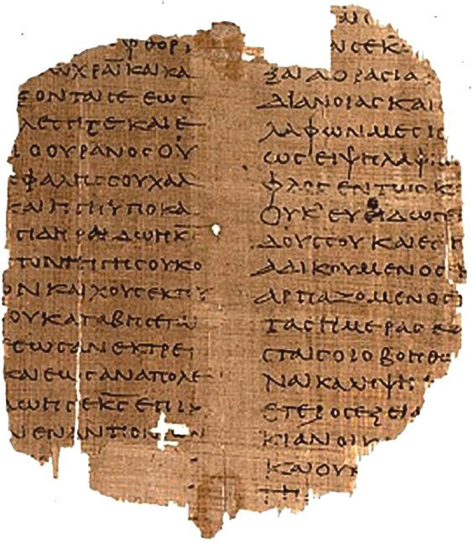
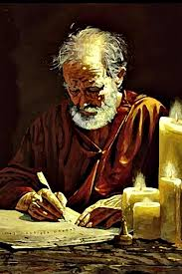
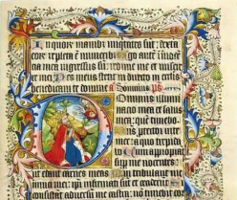
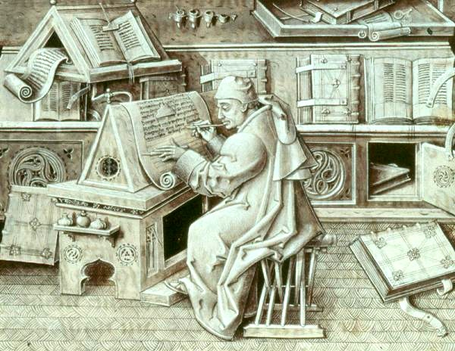
Testing Truth: Textual Inconsistencies
Lost In Translation?
Twinkle, Twinkle Little star, How I wonder what you are
Q, R, S, T, U, V, W, X, Y and Z
German
Funkel, funkel kleiner Stern, Wie ich mich frage, was du bist
Q, R, S, T, U, V, W, X, Y und Z
Chinese (iconographic)
一闪一闪亮晶晶，我多么想知道你是什么
Q，R，S，T，U，V, W，X，Y和Z
Nature of God's Word
I've heard there are over 20,000 errors in the manuscripts!
Is a copy still HOLY?
Rom 16:12
I, Tertius, who write this letter, greet you in the Lord.
1 Peter 5:12
Through Silvanus, our faithful brother (for so I regard him], I have written to you briefly, exhorting and testifying that this is the true grace of God. Stand firm in it!
Paul and Peter used amanuensis
Papyrus
Parchment
Inspired
Inerrant
Infallible

Slide 3
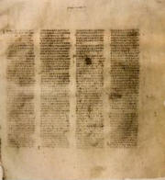
Biblical History: Textul Criticism
Nature of Scribal Errors
Examples of Transmission Errors
“.. we have have peace..”
xxxx = 4 errors!
“..Spirit in you...”
“..Spirit onto you...”
x xx = 3 errors!
“..in Christ Jesus our Lord.”
“..in Jesus Christ our Lord.”
xxxxxxxxxxxx = 12 errors!
Codex Vaticanus
325-340 AD
Codex Sinaticus
325-340 AD

Slide 4
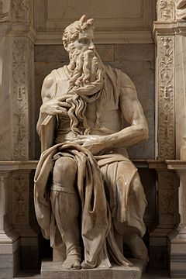
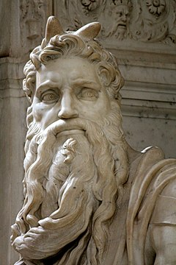
Biblical History: Textul Criticism
Resolving Scribal Errors
1. ..he is our DEDEEMFR
2. ..he is our RADEEEEG
3. ..he is our REDCEMER
4. ..he is our OEBEDMER
5. ..he is our REDEEMER
Types of Transmission Errors
Mistaken Letters - Confusion of similar letters
Homophony - Substitution of similar sounding words
Halpography - Omission of a letter/word due to similar letter/word in context
Dittography - Incorrect duplication of letter/word
Metathesis - Reversal in order of letters or words
Fusion - Incorrect joining of two words into one
Fission - Incorrect separation of one word into two
Homoioteleuton - Omission caused by words or phrases that end similarly
Homoioarchton - Omission caused by words or phrases that begin similarly
Other - Any other omissions or additions
Textual Criticism: Determining the best reading
1. Manuscripts must be weighed, not counted
2. Determine the reading that would most likely give rise to the others.
3. The more distinctive reading is usually preferable.
4. The shorter reading is generally favored.
5. Determine which reading is more appropriate in its context (examine literary contexts, grammatical or spelling errors, historical context).
6. Examine parallel passages for any differences and determine why they may appear.
Figuring out the right text
1. ..he is our DEDEEMFR
2. ..he is our RADEEEEG
3. ..he is our REDCEMER
4. ..he is our OEBEDMER
5. ..he is our REDEEMER
Moses
1513 AD
קָרַ֛ן vs קָ֫רֶן‬

Slide 5
Biblical History: Textul Criticism
Comma Johanneum
An Example of Resolving Textual 'errors'
KJV
For there are three that bear record in heaven, the Father, the Word, and the Holy Ghost: and these three are one. And there are three that bear witness in earth, the spirit, and the water, and the blood: and these three agree in one. (1John 5:7-8)
NASB
And it is the Spirit who bears witness, because the Spirit is the truth. For there are three that bear witness, the Spirit and the water and the blood; and the three are in agreement. (1John 5:7-8)
Dead Sea Scrolls - 150 BC
1948
Sinaitic Syriac - 150-350 AD
1892
Codex Sinaiticus - 350 AD
1830
KJV - 1611
Jesus Christ
0 BC
Crusades
1000 AD
Today
2000 AD
St. Catherine's Monastery
Matthew 1:11

Slide 6
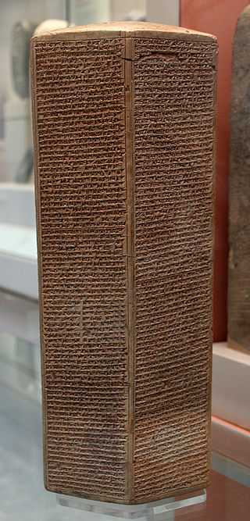
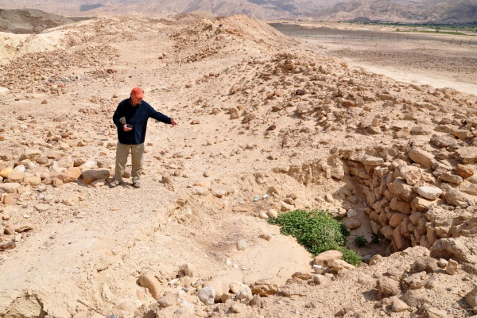
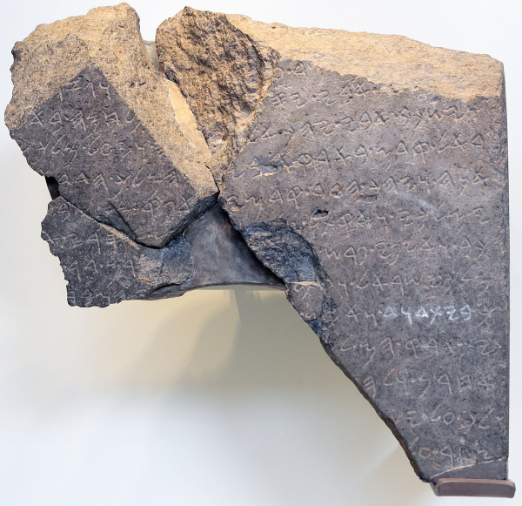
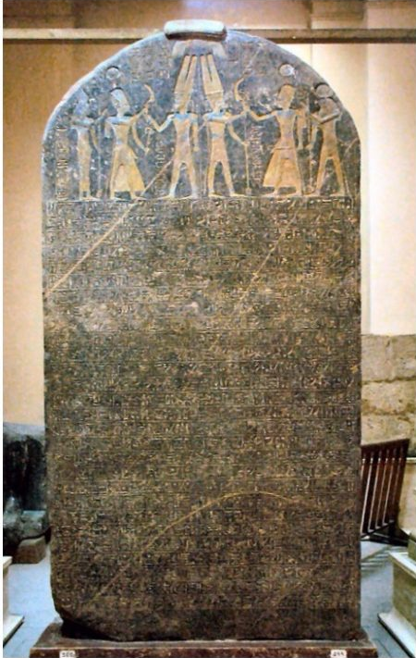
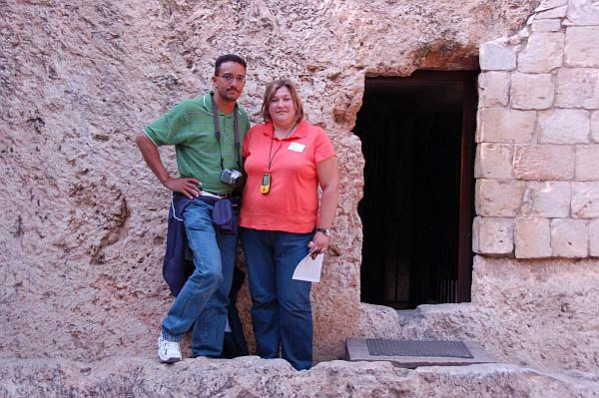
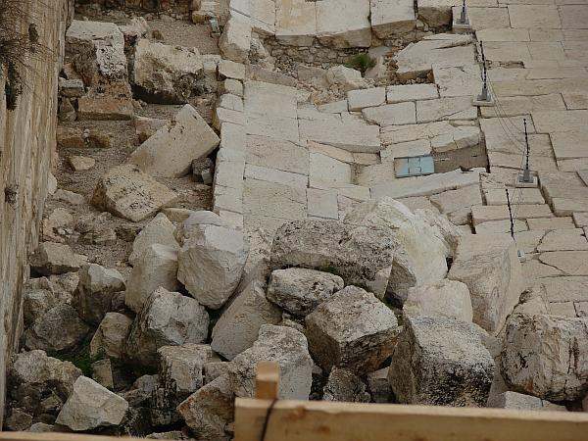
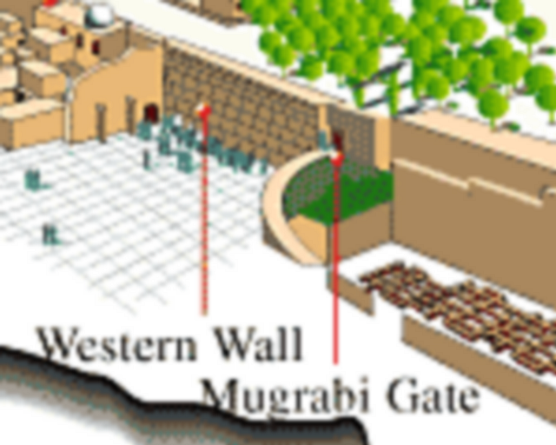
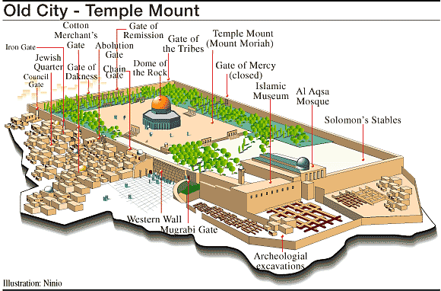
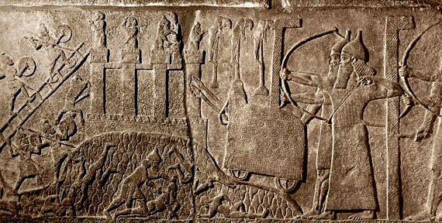
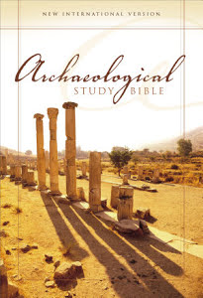
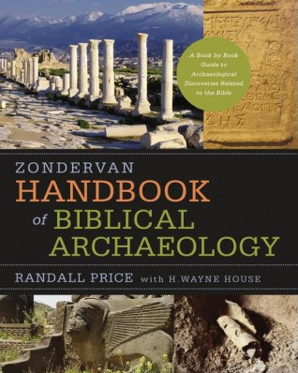
Biblical History: Textul Criticism
Significant Biblical Artifacts (partial) | Date
Autobiography of Weni | c.2280 BC
Sebek-khu Stele | c.1860 BC
Statue of Idrimi | c.1500 BC
Merneptah Stele | c. 1209 BC
Bubastite Portal | c. 925 BC
Mesha stele | c.850 BC
Kurkh Monoliths | c.850 BC
Black Obelisk of Shalmaneser III | c.825 BC
Saba'a Stele | c.800 BC
Tel Dan Stele | c.800 BC
Nimrud Slab | c.800 BC
Nimrud Tablet K.3751 | c.733 BC
Sargon II's Prism A | c.710 BC
Siloam inscription | c.701 BC
Lachish relief | c.700 BC
LMLK seals | c.700 BC
Azekah Inscription | c.700 BC
Sennacherib's Annals | c.690 BC
Esarhaddon's Treaty with Ba'al of Tyre | c.675 BC
Ekron inscription | c.650 BC
Cylinders of Nabonidus | c.550 BC
Nebuchadnezzar Chronicle | c.500 BC
Cylinder of Cyrus | c.530 BC
Nabonidus Chronicle | c. 200 BC
Temple Warning inscription | c.23 BC – 70 AD
Trumpeting Place inscription | c.1st century
Arch of Titus | c.82 AD
Biblical Accuracy
The Bible describes real people in real places doing real things
BiblicalArcheology.org
Bible And Spade
Not Ron Wyatt, Bob Cornuke
Museums
Israel Museum - Jerusalem, Israel
Bible Lands Museum - Jerusalem, Israel
Hecht Museum - Haifa, Israel
Oriental Institute - Chicago, USA
British Museum - London, England
The Louvre, Paris - France
Cairo Museum - Cairo, Egypt
Museum of Biblical Art - Dallas, TX
Siege of Lachish - Is 36-37
Sennacherib Prism
Tel Dan Inscription
Mark 13:1-2
Sodom Gate - Gen 19
Merneptah Stele
Noah
3,000 BC
Abraham
2,000 BC
King David
1,000 BC
Jesus Christ
0 BC
Crusades
1,000 AD
Adam
4,000 BC
Today
2,000 AD
Enoch
3,500 BC
Flood
2,500 BC
Moses
1,500 BC
Hagai Sophia
500 AD
Reformation
1,500 AD

