Slide 1
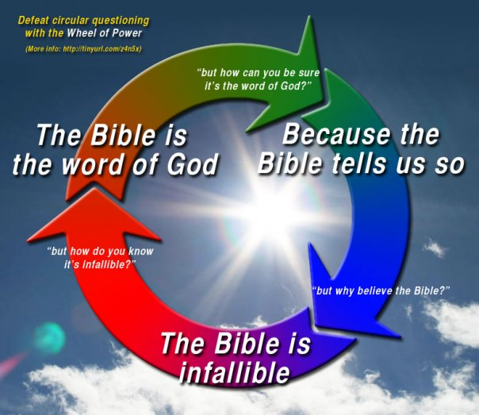
How do we know Truth?
TRUTH That which corresponds to reality
Truth will claim to be truth
Truth is...
Internally consistent
Externally accurate

Slide 2
Testing Truth: Understanding Truth
“What about all the errors in the Bible??
We must first understand the differences between Paradox, Mystery and Contradiction
PARADOX
MYSTERY
TRUTH
ERROR
The Bible affirms the law of non-contradiction

Slide 3
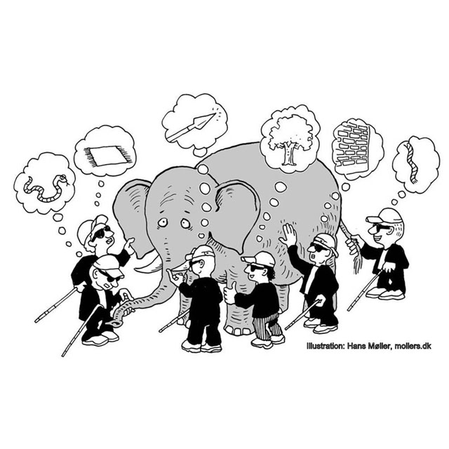
Testing Truth: Understanding Truth
Paradox
A Paradox is an apparent contradiction that under closer scrutiny yields resolution.

Slide 4
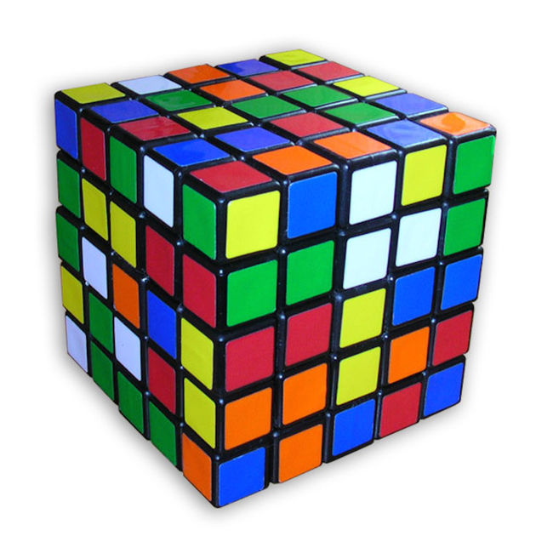
Testing Truth: Understanding Truth
Mystery
A Mystery is something unknown to us now, but which may be resolved.
Maybe.
25
5, -5
5 X 5 =
√25 =
Hinderances
1. Information
2. Aptitude
3. Intelligence

Slide 5
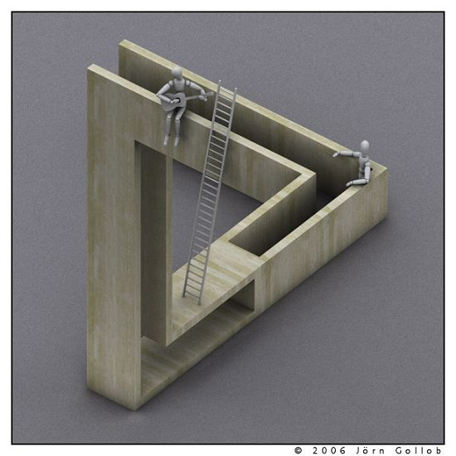
Testing Truth: Understanding Truth
Contradiction
A Contradiction is a violation of the law of noncontradiction. It is impossible to resolve, either by mortals or God, either in this world or the next.
Ever!
The
Green Button is
TRUE
Chuck Norris can...
Win a game of Connect Four in only three moves
Befriend a married bachelor
Strangle a burglar with a cordless phone
Win at poker using Uno cards
Slam a revolving door
Divide by zero
Make 2+2=5
Videotape himself inventing the first video camera
Count to infinity in 30 seconds. Twice.
The
Red Button is
FALSE

