Slide 1
HOW TO CREATE A BIBLE TIMELINE
Noah
3,000 BC
Abraham
2,000 BC
King David
1,000 BC
Jesus Christ
0 BC
Crusades
1,000 AD
Adam
4,000 BC
Today
2,000 AD

Slide 2
HOW TO CREATE A BIBLE TIMELINE
Noah
3,000 BC
Abraham
2,000 BC
King David
1,000 BC
Jesus Christ
0 BC
Crusades
1,000 AD
Adam
4,000 BC
Today
2,000 AD
Enoch
3,500 BC
Flood
2,500 BC
Moses
1,500 BC
Babylon & Persia
500 BC
Hagai Sophia
500 AD
Reformation
1,500 AD

Slide 3
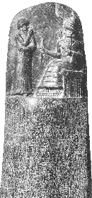
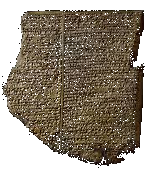
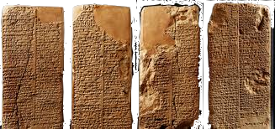
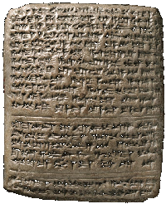
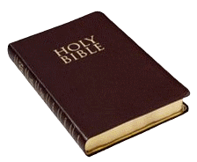
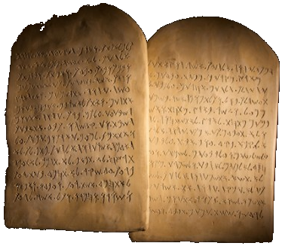
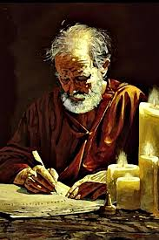
History of the Canon
Enuma Elish
1500 - 1100 BC
Hammurabi
1800 BC
Nuzi Tablets
1800 - 1100 BC
Mosaic Covenant
Gilgamesh
2200 BC
Noah
3,000 BC
Abraham
2,000 BC
King David
1,000 BC
Jesus Christ
0 BC
Crusades
1,000 AD
Adam
4,000 BC
Today
2,000 AD
Enoch
3,500 BC
Flood
2,500 BC
Moses
1,500 BC
Babylon & Persia
500 BC
Hagai Sophia
500 AD
Reformation
1,500 AD
SILENCE
Job
2,200 BC
Ten Commandments
1446 BC
1 Peter 1:20-21

Slide 4
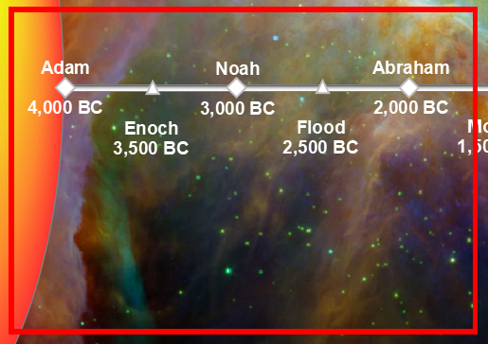
History of the Canon
Genesis 1 - 11
Mosaic Covenant
Noah
3,000 BC
Abraham
2,000 BC
King David
1,000 BC
Jesus Christ
0 BC
Crusades
1,000 AD
Adam
4,000 BC
Today
2,000 AD
Enoch
3,500 BC
Flood
2,500 BC
Moses
1,500 BC
Babylon & Persia
500 BC
Hagai Sophia
500 AD
Reformation
1,500 AD
SILENCE
When Adam had lived 130 years, he fathered a son in his own likeness, after his image, and named him Seth. The days of Adam after he fathered Seth were 800 years; and he had other sons and daughters. Thus all the days that Adam lived were 930 years, and he died.
When Seth had lived 105 years, he fathered Enosh. Seth lived after he fathered Enosh 807 years and had other sons and daughters. Thus all the days of Seth were 912 years, and he died. (Gen 5:3-8)

Slide 5
History of the Canon
FLOOD
Adam
Seth
Enos
Cainan
Mahalalel
Jared
Enoch
Methuselah
Lamech
Mosaic Covenant
Noah
Noah
3,000 BC
Abraham
2,000 BC
King David
1,000 BC
Jesus Christ
0 BC
Crusades
1,000 AD
Shem
Adam
4,000 BC
Arpachshad
Today
2,000 AD
Salah
Reformation
1,500 AD
Enoch
3,500 BC
Flood
2,500 BC
Moses
1,500 BC
Babylon & Persia
500 BC
Hagai Sophia
500 AD
Eber
SILENCE
Peleg *
Reu
Serug
Nahor
Terah
Abram
Isaac

Slide 6
History of the Canon
Ezra Copies Scriptures (Ez 7:6) - 516 BC
Jewish Commentaries - 400 BC
Greek and Latin Translation - 250 BC
Essenes of Qumran - 150 BC
Mosaic Covenant
Noah
3,000 BC
Abraham
2,000 BC
King David
1,000 BC
Jesus Christ
0 BC
Crusades
1,000 AD
Adam
4,000 BC
Today
2,000 AD
Enoch
3,500 BC
Flood
2,500 BC
Moses
1,500 BC
Babylon & Persia
500 BC
Hagai Sophia
500 AD
Reformation
1,500 AD
SILENCE
Ten Commandments
1446 BC

Slide 7
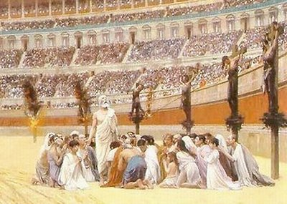
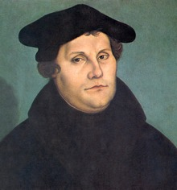
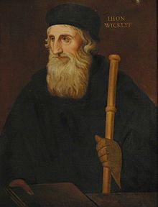
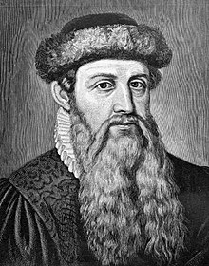
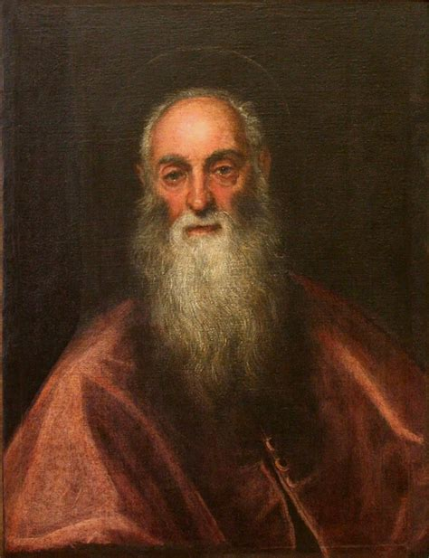
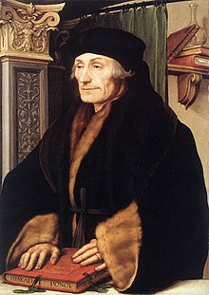
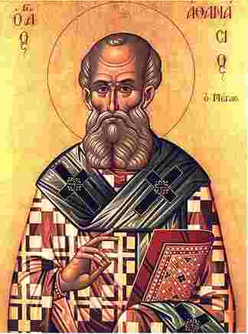
History of Bible Authorship
Augustine philosopher.
Preached against the Pope, indlgences,etc.
Main figure in the Protestant Reformation
Insisted the Bible should be in the common language.
First German Bible.
German Bible based on Erasmus' Greek Bible, not Latin.
Greek scholar
Wrote Greek/Latin interlinear Bible
German Goldsmith
Inventor of the moveable type printing press
Started the Printing Revolution (mass communication), and ushered in the modern period of human history
Produced the first printed Bible, the Gutenberg Bible (based on Latin Vulgate)
Apostles write Inspired, Inerrant, Infallible Scriptures
(2 Peter 1:20-21, 2 Tim 3:16, Acts 3:18)
Imprisonment of the NT Apostles led to the martyr of Stephen in Acts 7 and the orders to Saul to round up Christians. When Rome caught fire in 64AD, Nero blamed the Christians and began systematiccally persecuting them across the Roman empire. The height of persecution was around 300AD under Emperor Diocletian.
Oxford theologian & scholastic philosopher.
Preached against the abuses of the Pope and clergy, the veneration of saints, purgatory, transubstantiation, indulgences, etc.
Strong advocate of having the Bible in the common man's language (instead of Latin).
Wrote the first English NT.
Predecessor to the Protestant Reformation.
Post-humously declared a heretic, exhumed, burned and ashes cast into the River Swift
His writings, including the first English Bible, were burned
Prominent theologian and scholar 4th century.
Wrote the Latin Vulgate, the first complete OT+NT+Apocrypha Bible. It eventually became the primary Bible for what would become the Roman Catholic Church.
Affirrmed all 27 books of the NT as we know it today.
Translated the OT from Hebrew to Latin. Previous works were from Greek (Septuagint) to Latin.
One of the most influential writers of the 4th century
Staunch defender of Trinitarianism and the deity of Christ against the Arians
Coptic bishop of Alexandria, Egypt
Compiled the earliest full list of the NT canon
Erasmus of Rotterdam
1466-1536
Jerome
347 - 420
Johann Gutenberg
1400-1468
Athanasius
296 - 373
John Wycliffe
1320-1384
Martin Luther
1483 - 1546
KJV - 1611
Geneva Bible - 1560
Abraham
2,000 BC
Jesus Christ
0 BC
Great Bible - 1539
Noah
3,000 BC
King David
1,000 BC
Crusades
1,000 AD
Adam
4,000 BC
New Testament
45 - 70 AD
Coverdale - 1535
Today
2,000 AD
Tyndale English NT - 1526
Reformation
1,500 AD
Enoch
3,500 BC
Flood
2,500 BC
Moses
1,500 BC
Babylon & Persia
500 BC
Hagai Sophia
500 AD
Luther Bible - 1522
Latin Vulgate - 382
ErasmusGreek/Latin Bible - 1516
Council of Nicea - 325
Gutenberg Press - 1450
Constantine & Edict of Milan - 312 AD
Wycliff Bible - 1382
Jesus Christ
0 BC
Crusades
1000 AD
Today
2000 AD
Hagai Sophia
500 AD
Reformation
1500 AD

Slide 8
We Believe the Bible is...
1. Inspired
Inspiration refers to the way in which God divinely moved and influenced the human authors of Scripture as they wrote the Word of God. God used their intellect, will, resources and personality in such a way that they worked in accordance with His will, writing out the Word of God. It is not the same as dictation.
2. Inerrant
Inerrancy refers to the way in which the Bible is without error and contains no mistakes. An excellent explanation of the nature of the inerrancy of Scripture can be found in the Chicago Statement of Inerrancy (Short Statement)
3. Infallible
Infallibility refers to the way in which the Bible is incapable of error. If something is infallible, it will always be true in what it claims, whether in the past, present or future. Because the Bible is God’s Word, and because God cannot lie, then we know that God’s Word has no errors.
1. God, who is Himself Truth and speaks truth only, has inspired Holy Scripture in order thereby to reveal Himself to lost mankind through Jesus Christ as Creator and Lord, Redeemer and Judge. Holy Scripture is God's witness to Himself.
2. Holy Scripture, being God's own Word, written by men prepared and superintended by His Spirit, is of infallible divine authority in all matters upon which it touches: it is to be believed, as God's instruction, in all that it affirms: obeyed, as God's command, in all that it requires; embraced, as God's pledge, in all that it promises.
3. The Holy Spirit, Scripture's divine Author, both authenticates it to us by His inward witness and opens our minds to understand its meaning.
4. Being wholly and verbally God-given, Scripture is without error or fault in all its teaching, no less in what it states about God's acts in creation, about the events of world history, and about its own literary origins under God, than in its witness to God's saving grace in individual lives.
The authority of Scripture is inescapably impaired if this total divine inerrancy is in any way limited or disregarded, or made relative to a view of truth contrary to the Bible's own; and such lapses bring serious loss to both the individual and the Church.
https://en.wikipedia.org/wiki/Chicago_Statement_on_Biblical_Inerrancy

Slide 9
Biblical Support for the 3 “I”s
Num 16:28
Ps 12:6
Ps 19:7
Ps 119:89
Prov 30:5
Matt 5:18
Luke 1:69-70
1Cor 2:12-13
Heb 4:12
Heb 6:17-18
2 Tim 3:16-17
1 Pet 1:10-11
1 Pet 1:24-25
2 Pet 1:19-21
Every word that comes from God is true, pure and perfect and will stand forever. The Bible is the only place where we can find God’s Word and what He says about Himself, His will, humans and salvation. As God’s infallible Word, the Bible is inspired, inerrant, infallible, authoritative, reliable, and sufficient to meet our needs.

