Slide 1


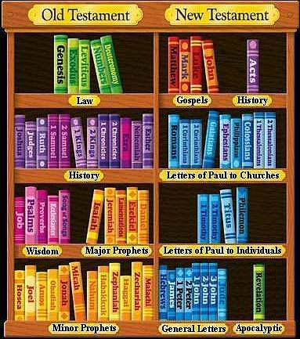
Overview of the Bible
OLD TESTAMENT
1. Law
Genesis
Exodus
Leviticus
Numbers
Deuteronomy
OLD TESTAMENT
39 books
30 authors
1450BC - 430BC
Hebrew, Aramaic
NEW TESTAMENT
27 books
10 authors
40AD - 70AD
Greek
What is in the Bible?

Slide 2
Overview: What Is In The Bible?
OLD TESTAMENT
39 books
30 authors
1450BC - 430BC
Hebrew, Aramaic
NEW TESTAMENT
27 books
10 authors
40AD - 70AD
Greek

Slide 3
Overview: What Is In The Bible?
OLD TESTAMENT
1. Law
Genesis
Exodus
  Leviticus
  Numbers
  Deuteronomy
Written by Moses
Explains Creation, Fall, Noah's Flood, Life of the Patriarchs, Sojourn in Egypt, Birth of the Nation of Israel, Exodus from Egypt, Wilderness Wanderings

Slide 4
Overview: What Is In The Bible?
OLD TESTAMENT
2. History
Joshua
Judges
Ruth
1,2 Samuel
1,2 Kings
1,2 Chronicles
Ezra
Nehemiah
Esther
Written by Joshua, Samuel, Gad, Nathan and others
Explains the Israelite Entry into Canaan, rise and fall of different leaders of Israel, continuous idolatry in Israel, banishment and exile, restoration to land of Canaan.

Slide 5
Overview: What Is In The Bible?
OLD TESTAMENT
3. Wisdom/Poetry
Job
Psalms
Proverbs
Ecclesiastes
Song of Solomon
Written by Moses, David, Asaph, Solomon and others
Stories and restoration to land of Canaan.

