Slide 1
Christian Mission for the Deaf
YOU MUST READ ALL THE NOTES PAGES OF THIS PRESENTATION BEFORE USING IT TO TEACH OTHERS. To see the Notes Pages, click on “View -> Notes Page”
The Notes Pages for this presentation has been written in English, for an English/French audience. It uses a lower vocabulary, and therefore less grammatical precision than what is typically found in formal English.
This is an animated PowerPoint presentation. Do not view it in “Edit” mode. You must view it in “Play” mode. To start the Play mode, press F5 on your computer.

Slide 2
Ten Questions About The
240801
Gospel
Notes:
This presentation serves as an introduction to soteriology, the doctrione of salvation.
It was developed for audiences in east Africa, many of whom have a low education and speak a mixture of English, French and Swahili.
In this study, we will ask ten questions about the Gospel.

Slide 3
What does ‘Gospel’ mean? Que signifie « Évangile » ? Je, ‘Injili’ inamaanisha nini?
1
Appears 90+ times in the Bible
Notes:
The word “gospel” simply means “good news”. This will be the topic of study. We want to study several points:
What does “Gospel” mean?
Why is it called “good news”?
What is the bad news?
What is sin? Three kinds of sin:
Personal Sins (sins of comission and sins of omission)
Original Sin
Imputed Sin
Who has sin?
What is the consequence of sin?
Wrong ideas about sin and judgment
Right ideas about sin and judgment
Spiritual death
How do I remove my sin?
Why must I believe in the death and resurrection of Jesus?
How Jesus forgives our sins
What does it mean to believe?
What is “Saving Faith”?
Essential parts of saving faith: notitia, assensus, and fiducia
True faith and true repentance
What is “True Repentance”?
How does Jesus remove my sin?
Substitutionary atonement
And finally, Do YOU believe in the Gospel of Jesus Christ?

Slide 4
Gospel means “Good News”
Generally, it refers to everything God says Généralement, cela fait référence à tout ce que Dieu dit Kwa ujumla, inazungumzia kila kitu ambacho Mungu anasema
Specifically, it refers to salvation in Jesus Christ Plus précisément, il fait référence au salut en Jésus-Christ Hasa, inazungumzia wokovu katika Yesu Kristo
Notes:
In the Bible, the word gospel refrs to everything that God says. God always speaks truth (John 14:6; Heb 6:18), so everything He says is True, Good, and Beautiful.
[NEXT] Specifically, in the Bible, the word gospel refers to the salvation that Jesus Christ offers to us.

Slide 5
Gospel means “Good News”
“Gospel” appears 90+ times in the English Bible «Évangile» apparaît plus de 70 fois dans la Bible française "Injili" inaonekana Zaidi ya mara 90 katika Biblia
It comes from the Greek word "euaggelion" Il vient du mot grec « euaggelion » Inatoka katika neno la Kigiriki "euaggelion"
Notes:
The word “Gospel” appears many times in the Bible. In the English Bible, it is there at 90 times or more. In the French Bible, it is there 70 times. And in the Swahili Bible, it is there 90 times. So we can see that it is very important.
But what is this word? What does it mean?
If we study the history of the word itself, this is what we learn: it comes from the Greek word ‘uaggelion”, which is also where we get the word “evangelist”. The original word refers to a good news that a person declares to other people.
But in the Bible, the word ‘gospel’ has special meaning.

Slide 6
Why is it called ‘Good News’? Pourquoi s’appelle-t-il «Bonne Nouvelle»? Kwa sababu gani inaitwa ‘Habari Njema’?
2
Appears 90+ times in the Bible
Notes:
It is important that we understand why the message of Jesus Christ is indeed Good News.

Slide 7
Gospel means “Good News”
Salvation in Jesus Christ includes 1) His death, 2) burial, 3) resurrection, and 4) return for His saints.
Le salut en Jésus-Christ comprend 1) sa mort, 2) son enterrement, 3) sa résurrection, et 4) son retour pour ses saints.
Wokovu katika Yesu Kristo unajumuisha 1) kifo chake, 2) kuzikwa, 3) ufufuo, na 4) kurudi kwa watakatifu wake.
1 Corinthians 15
1
Notes:
What is this good news of salvation that Jesus Christ offers to us?
It is the death, burial, resurrection, and return of Jesus Christ.
We can read more of this in 1 Corinthians 15. The first part of the chapter (v3-9) tells us that the Gospel is about how Jesus died for our sins according to Scripture, how He was raised on the 3rd day according to Scriptures, and how He appeared to many disciples before ascending to heaven.
Then the last part of the chapter (v50-58) tells us about how Jesus will return again, raise us from the dead, and will destroy sin and death. His victory will be given to us, and we will share in His resurrection and victory over sin and death.
Indeed, this is good news!
But we’ll need to ask: does this good news apply to everyone automatically?

Slide 8
Why is it called “Good News”
To understand the Good News, we must first understand the Bad News
Pour comprendre la Bonne Nouvelle, il faut d’abord comprendre la Mauvaise Nouvelle
Ili kuelewa Habari Njema, ni lazima kwanza tuelewe Habari Mbaya
Notes:
To understand why it is called “Good news”, we must first understand what the ‘bad news’ is. The Bible has much to say about the ‘bad news’, so we must learn it.

Slide 9
The “Bad News”
All have sinned...
Tous ont péché...
Wote wamefanya zambi...
2
Job 15:14; Psalms 53:2-3; Romans 3:10-12; Romans 3:23; Romans 5:12
Notes:
The “bad news” starts with this truth: All people have sinned.
[+]What is man, that he should be pure, or one born of woman, that he should be righteous? (Job 15:14)
[+]God looks down from heaven on the human race to see if there is one who is wise, one who seeks God. All have turned away; all alike have become corrupt. There is no one who does good, not even one. (Ps 53:2-3)
[+]as it is written: There is no one righteous, not even one. There is no one who understands; there is no one who seeks God. All have turned away; all alike have become useless. There is no one who does what is good, not even one. (Rom 3:10-12)
[+]For all have sinned and fall short of the glory of God. (Rom 3:23)
[+]Therefore, just as sin entered the world through one man, and death through sin, in this way death spread to all men, because all sinned. (Rom 5:12)

Slide 10
What is sin? Qu'est-ce que le péché? Zambi ni nini?
3
Appears 90+ times in the Bible
Notes:
When we understand that all people have sin, the next qustion follows immediately: What is sin?

Slide 11
The “Bad News”: What is sin?
Any thought, word, desire, action, or omission of action, contrary to the law of God is sin.
Toute pensée, parole, désir, action ou omission d’action contraire à la loi de Dieu est un péché.
Wazo lolote, neno, tamaa, kutenda, ao kutotenda, kinyume na sheria ya Mungu ni zambi.
1 John 3:4; 1 Samuel 15:24; Daniel 9:11; 1 John 5:17
Notes:
In a dictionary, we see that the definition of sin is any thought, word, desire, action, or omission of action (absence of action) that contradicts the law of God. This is also what the Bible teaches us about sin. Sin is any failure to meet the glorious requirements of God; anything that is out of compliance with God’s word and will.
[+]Everyone who commits sin also breaks the law; sin is the breaking of law. (1John 3:4)
[+]Saul answered Samuel, “I have sinned. I have transgressed the LORD’s command and your words. Because I was afraid of the people, I obeyed them. (1Sam 15:24)
[+]All Israel has broken Your law and turned away, refusing to obey You. The promised curse written in the law of Moses, the servant of God, has been poured out on us because we have sinned against Him. (Dan 9:11)
[+]All unrighteousness is sin, and there is sin that does not bring death. (1John 5:17)

Slide 12
The “Bad News”: Three kinds of sin
1. Personal Sins: comission & omission
Péchés personnels: commission et omission
Zambi za Kibinafsi: kutenda na kutotenda
Notes:
God is perfect and will not tolerate any sin. All sin separates us from God. It is important that we understand what sin is.
There are three categories of sins that we must discuss.
The first category of sin is Personal Sin. These are the sinful actions that we do (or don’t do) with our heart, mind, mouth, or hands.

Slide 13
The “Bad News”: Three kinds of sin
a. Comission
Lusting, Hatred, Pride, Idolatry, ... Cursing, Lying, ... Stealing, Murdering, ...
Luxure, Haine, Arrogance, ... Malédiction, Idolatrie, Mensonge... Vol, Meurtre, ...
Tamaa, Chuki, Kiburi, Kuabudu ,... Kulaani, kusema uongo, ... kuiba, kuuwa, ...
b. Omission
Unguarded thoughts, ... Silence in the face of evil, ... Disobedience, ...
Pensées incontrôlées, ... Silence face au mal, ... Désobéissance, ...
Mawazo mabaya, ... Kunyamaza mbele ya uovu, ... Kutotii, ...
Ex 20:4; Pro 16:18; Ex 20:12-17
1 Pet 1:13; Phil 4:8; Lev 19:17; Eze 33:1-6; 1 Sam 15:23
Notes:
The category of Personal Sins can be divided into two groups: 1) Sins of Commission and 2) Sins of Omission.
A sin of Commission is when we DO something that we must NOT DO.
A sin of Omission is when we DO NOT do something that we must DO.
Here are some examples of sins of commission:
Heart: lusting, hatred, pride, idolatry, etc
Mouth: Cursing, lying, gossiping, etc
Hands and Feet: Stealing, murdering, etc
Exod 20:4; Lev 19:17; Prov 16:18; Exod 20:12-17
Exod 20: 4 "You shall not make for yourself an idol, or any likeness of what is in heaven above or on the earth beneath or in the water under the earth.
Lev 19:17- 'You shall not hate your fellow countryman in your heart; you may surely reprove your neighbor, but shall not incur sin because of him.
Prov 16:18 - Pride [goes] before destruction, And a haughty spirit before stumbling.
Exod 20:12-17 - "Honor your father and your mother, that your days may be prolonged in the land which the LORD your God gives you. "You shall not murder. "You shall not commit adultery. "You shall not steal. "You shall not bear false witness against your neighbor. "You shall not covet your neighbor's house; you shall not covet your neighbor's wife or his male servant or his female servant or his ox or his donkey or anything that belongs to your neighbor."
Here are some examples of sins of omission:
Heart: Unuarded thoughts, etc
Mouth: Silence when we see evil and we should speak out, but we refuse
Hands and Feet: Disobedience
1 Peter 1:13; Phil 4:8; Ezek 33:1-6; 1 Sam 15:23
1 Peter 1:13 - Therefore, gird your minds for action, keep sober [in spirit,] fix your hope completely on the grace to be brought to you at the revelation of Jesus Christ.
Phil 4:8 -Finally, brethren, whatever is true, whatever is honorable, whatever is right, whatever is pure, whatever is lovely, whatever is of good repute, if there is any excellence and if anything worthy of praise, let your mind dwell on these things.
Ezek 33:1-6 - And the word of the LORD came to me saying, "Son of man, speak to the sons of your people, and say to them, 'If I bring a sword upon a land, and the people of the land take one man from among them and make him their watchman; and he sees the sword coming upon the land, and he blows on the trumpet and warns the people, then he who hears the sound of the trumpet and does not take warning, and a sword comes and takes him away, his blood will be on his [own] head. 'He heard the sound of the trumpet, but did not take warning; his blood will be on himself. But had he taken warning, he would have delivered his life. 'But if the watchman sees the sword coming and does not blow the trumpet, and the people are not warned, and a sword comes and takes a person from them, he is taken away in his iniquity; but his blood I will require from the watchman's hand.'
1 Sam 15:23 - "For rebellion is as the sin of divination, And insubordination is as iniquity and idolatry. Because you have rejected the word of the LORD, He has also rejected you from [being] king."

Slide 14
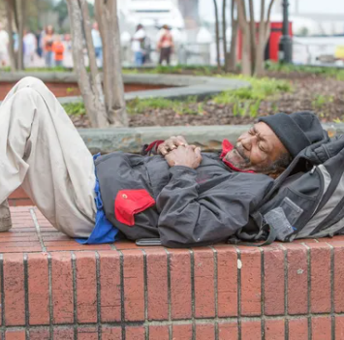
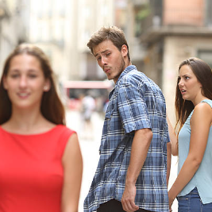
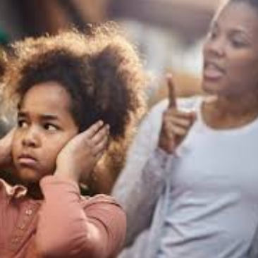
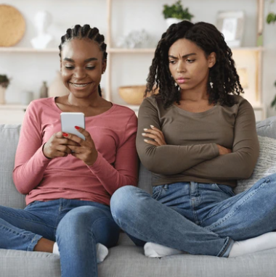
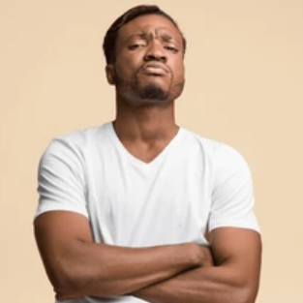
What are YOUR sins??
Commérages
Boire
Paresse
Luxure
Désobéissance
Envie
Orgueil
Rom 1:28-32
Notes:
It is easy to talk about the sins of others. But it is more important to talk about your own sins. Remember the verse: [+]Why do you look at the speck in your brother’s eye but don’t notice the log in your own eye? Or how can you say to your brother, ‘Let me take the speck out of your eye,’ and look, there’s a log in your eye? Hypocrite! First take the log out of your eye, and then you will see clearly to take the speck out of your brother’s eye. (Matt 7:3-5)
You must always ask God to help you search out your own heart to find your sins:
[+]​​​​​​​​Search me, O God, and know my heart! ​​​​​​​Try me and know my thoughts! ​​​ ​​​​​​​​And see if there be any grievous way in me, ​​​​​​​and lead me in the way everlasting! ​​​ (Ps 139:23-24)
Do you gossip?
Do you drink in ways that dishonor God?
Are you lazy?
Do you lust after women? Do you lust after riches?
Are you disobedient?
Do you have envy for the things that belong to others?
Do you have pride? Do you look down on others?
Read Romans 1:28-32 And just as they did not see fit to acknowledge God any longer, God gave them over to a depraved mind, to do those things which are not proper, being filled with all unrighteousness, wickedness, greed, evil; full of envy, murder, strife, deceit, malice; [they are] gossips, slanderers, haters of God, insolent, arrogant, boastful, inventors of evil, disobedient to parents, without understanding, untrustworthy, unloving, unmerciful; and, although they know the ordinance of God, that those who practice such things are worthy of death, they not only do the same, but also give hearty approval to those who practice them.

Slide 15
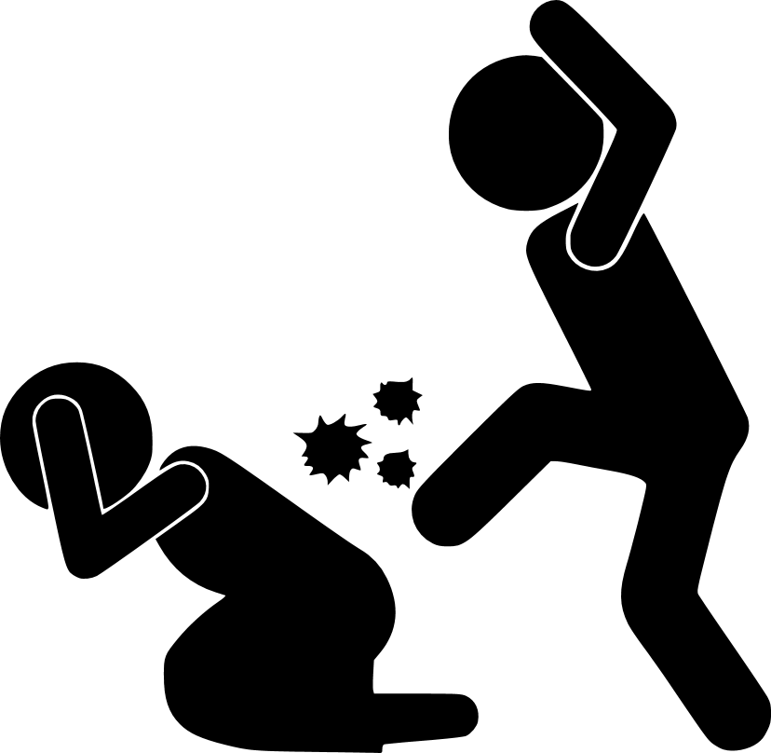
Quels sont VOS péchés ?
Or, les oeuvres de la chair sont manifestes, ce sont l'impudicité, l'impureté, la dissolution, l'idolâtrie, la magie, les inimitiés, les querelles, les jalousies, les animosités, les disputes, les divisions, les sectes, l'envie, l'ivrognerie, les excès de table, et les choses semblables. Je vous dis d'avance, comme je l'ai déjà dit, que ceux qui commettent de telles choses n'hériteront point le royaume de Dieu.
Gal 5:19-21
OUI!
»Tu auras un endroit prévu à l’extérieur du camp et c'est là dehors que tu iras pour tes besoins. Dans ton équipement tu auras un outil dont tu te serviras pour faire un creux et recouvrir tes excréments quand tu voudras aller dehors.
Deut 23:12-13
Est-ce un péché de battre sa femme ?
Est-ce un péché d’utiliser les toilettes et de refuser de les nettoyer ?
Notes:
Here is a question for my friends:
When you use the WC, do you refuse to flush or use the bucket afterwards?
Is this a sin to refuse to use the bucket?
YES! It is a sin.
[+]“You shall have a place outside the camp, and you shall go out to it. And you shall have a trowel with your tools, and when you sit down outside, you shall dig a hole with it and turn back and cover up your excrement. (Deut 23:12-13)
In the same way that the people of Israel must cover their excrement, so you too must be sure to clean the toilet after you have done your dirty work. God sees you, and He is not pleased to see you leave things dirty.
Also, when you refuse to flush, you are disrespecting the next person who uses the WC. This next person is also made in the image of God and you should respect him by cleaning up your dirtywork.
[NEXT]
Do you beat your wives? This ought not to be done.
[+]Now the works of the flesh are evident: sexual immorality, impurity, sensuality, idolatry, sorcery, enmity, strife, jealousy, fits of anger, rivalries, dissensions, divisions, envy, drunkenness, orgies, and things like these. I warn you, as I warned you before, that those who do such things will not inherit the kingdom of God. (Gal 5:19-21)
When we love our wives as Christ loved the church, we will treat our wives as we treat our own selves.
[+]In the same way husbands should love their wives as their own bodies. He who loves his wife loves himself. (Eph 5:28)

Slide 16
The “Bad News”: Three kinds of sin
Original Sin
Because of Adam’s sin, ALL his sons and daughters are born with a sin nature.
À cause du péché d’Adam, TOUS ses fils et filles sont nés avec une nature pécheresse. Kwa sababu ya Zambi ya Adamu, vijana na wasichana WOTE wa Adamu wamezaliwa na zambi ya asili.
2. Original sin
Péché originel
Zambi ya asili
Eph 2:3
“..by nature...” "...par notre condition même..."
“...Kwa asili yetu...”
Ps 51:5; Is 48:8; Rom 5:12; Eph 2:3
Notes:
The second category of sin is called “Original Sin”. It is not an action that we do; it is a condition of our fallen humanity. We receive this from Adam’s sin. This condition begins before we are born.
Because Adam sinned in the Garden of Eden, all his sons and daughters are born with a sin nature. This means that we have the ability - and often the desire - to sin. It also means that we are born fallen in this condition of sin because we are Adam’s children.
[+]Indeed, I was guilty when I was born; I was sinful when my mother conceived me. (Ps 51:5)
[+]You have never heard; you have never known; For a long time your ears have not been open. For I knew that you were very treacherous, and were known as a rebel from birth. (Isa 48:8)
[+]Therefore, just as sin entered the world through one man, and death through sin, in this way death spread to all men, because all sinned. (Rom 5:12)
[+]We too all previously lived among them in our fleshly desires, carrying out the inclinations of our flesh and thoughts, and we were by nature children under wrath as the others were also. (Eph 2:3)
Because we are children of Adam, it is our nature to be sinners. This is known as “Original Sin”

Slide 17
The “Bad News”: Three kinds of sin
Imputed Sin
Because of Adam’s sin, his guilt is spread to all his sons and daughters.
À cause du péché d’Adam, sa culpabilité s’étend à tous ses fils et filles. Kwa sababu ya zambi ya Adamu, hatia yake imeenea kwa wana wake wote. Wanaume na wanawake wote.
3. Imputed sin
Péché imputé
Kuhesabiwa zambi
Rom 5:12; Rom 5:18-19
Notes:
The third category of sin is called “Imputed Sin”. This describes the guilt that we have before God, because we are born under Adam’s sin. The guilt of Adam is spread to all his children. This condition begins before we are born.
Imputed Sin is somewhat different from Original Sin.
Original Sin is about the sin nature we inherit due to Adam’s fall. It is about the condition of our heart, mind, and soul.
Imputed Sin is about the guilt that we have because of Adam’s fall. It is about our standing of guilt before a Holy God.
[+]Therefore, just as sin entered the world through one man, and death through sin, in this way death spread to all men, because all sinned. (Rom 5:12)
[+]So then, as through one trespass there is condemnation for everyone, so also through one righteous act there is life-giving justification for everyone. For just as through one man’s disobedience the many were made sinners, so also through the one man’s obedience the many will be made righteous. (Rom 5:18-19)

Slide 18
The “Bad News”: Three kinds of sin
1. Personal sins: comission & omission Péchés personnels: commission et omission Zambi za Kibinafsi: kutenda na kutotenda
2. Original sin Péché originel zambi ya asili
3. Imputed sin Péché imputé Kuhesabiwa zambi
3
Notes:
So let us review the three different kinds of sin that affect us all:
Personal Sins - the sins that we do (comission & omission)
Original Sin - The fallen nature we receive from Adam
Imputed Sin - The guilt we have before God because of Adam’s sin
Additional note:
It is important to understand that Jesus was born of a virgin and did not have a human father. Therefore, He was not born from a man. He was born from a woman (Mary). He does not carry the stain of Adam’s sin. He does not have Original Sin or Imputed Sin. Also, we know that He did no sins, so He has no Personal Sins. Jesus truly is without sin. We will talk more about this later.

Slide 19
Who has sin? Qui a le péché ? Nani ana zambi?
4
Appears 90+ times in the Bible
Notes:
What does the Bible have to say about who has sin?

Slide 20
The “Bad News”: Who has sin?
Ecclesiastes 7:20 There is certainly no righteous man on the earth who does good and never sins.
Non, il n'y a sur la terre aucun homme juste qui fasse le bien et qui ne pèche jamais.
Bila shaka hakuna mwanadamu mwenye haki hapa duniani, ambaye anafanya mema, na hafanyi zambi.

Slide 21
The “Bad News”: Who has sin?
Romans 3:10 ... There is no one righteous, not even one.
... Il n'y a pas de juste, pas même un seul;
... Hakuna mwenye haki hata mmoja.
Notes:
..not even one

Slide 22
The “Bad News”: Who has sin?
Romans 3:12 There is no one who does what is good, not even one.
Personne ne fait le bien, pas même un seul.
Hakuna mtenda mema, la! Hata mmoja.
Notes:
..not even one.

Slide 23
The “Bad News”: Who has sin?
Romans 3:23 For all have sinned and fall short of the glory of God.
Tous ont péché et sont privés de la gloire de Dieu
Kwa sababu wote wamefanya zambi, na kupungukiwa na utukufu wa Mungu
Notes:
..ALL have sinned. ALL fall short of God’s glorious holy standard..

Slide 24
The “Bad News”: Who has sin?
Romans 5:12 Just as sin entered the world through one man, and death through sin, in this way death spread to all men, because all sinned.
De même que par un seul homme le péché est entré dans le monde, et par le péché la mort, de même la mort a atteint tous les hommes parce que tous ont péché.
Kwa njia ya mtu mmoja zambi iliingia ulimwenguni, nayo ikasababisha kifo. Hivyo kifo kimeenea katika jumuiya yote ya binadamu, kwa maana wote wametenda zambi.
Notes:
..death spreas to ALL, because ALL sinned

Slide 25
The “Bad News”: Who has sin?
1 John 1:8 If we say, “We have no sin,” we are deceiving ourselves, and the truth is not in us.
Si nous disons que nous n’avons pas de péché, nous nous trompons nous-mêmes et la vérité n'est pas en nous.
Tukisema kwamba hatuna zambi, twajidanganya wenyewe, wala kweli haimo mwetu.
Notes:
Who among us wants to live without truth?

Slide 26
The “Bad News”: Who has sin?
Psalms 130:3 Psalms 143:2
Proverbs 20:9 Isaiah 53:6
Isaiah 64:6 Job 14:14-15
Psalms 53:1-3 Mark 10:18
Romans 5:12 Ephesians 2:3
Notes:
[+] If you, O Lord, kept a record of sins, O Lord, who could stand? (Ps 130:3)
[+]If a wise man goes to court with a fool, there will be ranting and raving but no resolution. (Prov 29:9)
[+]All of us have become like one who is unclean, and all our righteous acts are like filthy rags; we all shrivel up like a leaf, and like the wind our sins sweep us away. (Isa 64:6)
[+]The fool says in his heart, “God does not exist.” They are corrupt, and they do vile deeds. There is no one who does good. God looks down from heaven on the human race to see if there is one who is wise, one who seeks God. All have turned away; all alike have become corrupt. There is no one who does good, not even one. (Ps 53:1-3)
[+]Do not bring Your servant into judgment, for no one alive is righteous in Your sight. (Ps 143:2)
[+]We all went astray like sheep; we all have turned to our own way; and the LORD has punished Him for the iniquity of us all. (Isa 53:6)
[+]When a man dies, will he come back to life? If so, I would wait all the days of my struggle until my relief comes. You would call, and I would answer You. You would long for the work of Your hands. (Job 14:14-15)
[+]“Why do you call Me good? ” Jesus asked him. “No one is good but One — God. (Mark 10:18)
[+]We too all previously lived among them in our fleshly desires, carrying out the inclinations of our flesh and thoughts, and we were by nature children under wrath as the others were also. (Eph 2:3)

Slide 27
The “Bad News”: Who has sin?
Conclusion:
Adam sinned; Therefore, ALL sons and daughters of Adam have sin
Adam a péché; Par conséquent, TOUS les fils et filles d’Adam ont du péché
Adamu alifanya zambi; Kwa hiyo, wana WOTE wa Adamu walifanya zambi
Job 15:14; Psalms 53:2-3; Romans 3:10-12; Romans 3:23; Romans 5:12
Notes:
The conclusion from Scripture is clear: Because Adam sinned, and because we are all sons and daughters of Adam, we carry Adam’s sin and guilt. We are sinners. And thereofre, because we are sinners, we do sin.
[+]as it is written: There is no one righteous, not even one. There is no one who understands; there is no one who seeks God. All have turned away; all alike have become useless. There is no one who does what is good, not even one. (Rom 3:10-12)

Slide 28
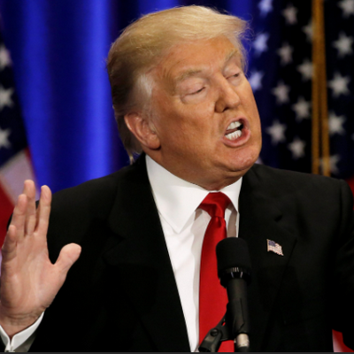
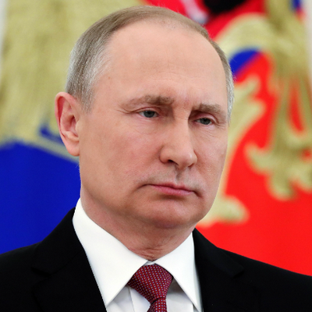
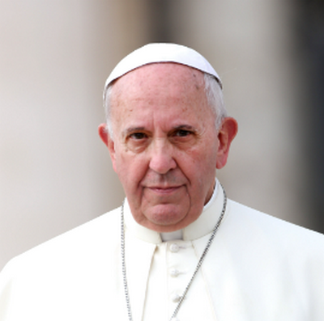
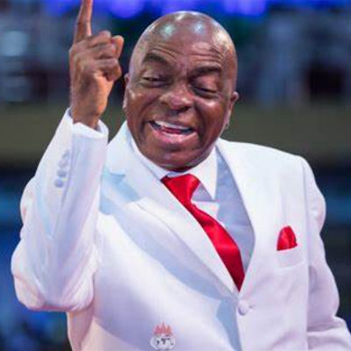
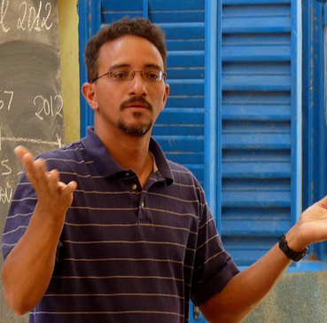
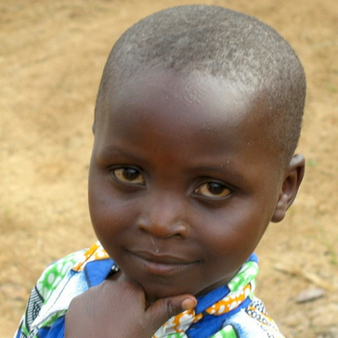
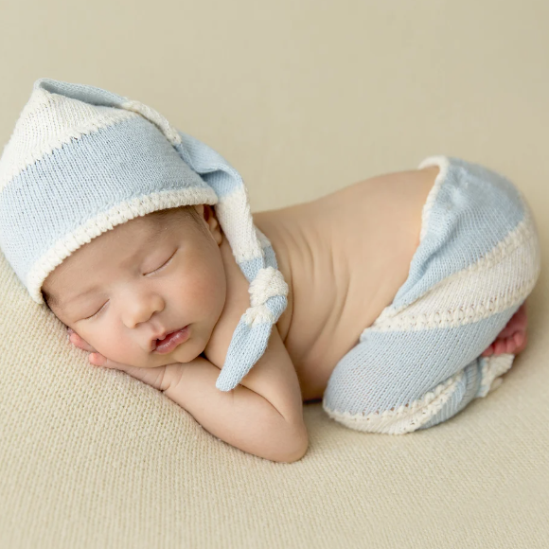
The “Bad News”: Who has sin?
Rom 3:10, 23
There is none righteous, no not one. ...All have sinned...
Il n'y a pas de juste, pas même un seul. ... tous ont péché
Hakuna mwenye haki, hata mmoja. ...Wote wamefanya zambi...
4
Notes:
There is none righteous, NO NOT ONE!
[NEXT]
Ask:Who has sin?
[NEXT] Does Donald Trump have sin?
[NEXT] Does Vladimir Putin have sin?
[NEXT] Does the Pope have sin?
[NEXT] Does Bishop Oyedepo (Nigerian prosperity gospel preacher) have sin?
[NEXT] Does Tim Foster, missionary to deaf Africans, have sin?
[NEXT] Does a little child have sin?
[NEXT] Does a little baby have sin?
The Bible is clear: Whether its through Imputed Sin, Original Sin, or Personal Sin (comission & omission), ALL have sin.
We ALL have sin.

Slide 29
The “Bad News”: Who has sin?
Passons en revue
Adam sinned; Therefore, ALL sons and daughters of Adam have sin
Adam a péché; Par conséquent, TOUS les fils et filles d’Adam ont du péché
Adamu alifanya zambi; Kwa hiyo, wana WOTE wa Adamu walifanya zambi
Job 15:14; Psalms 53:2-3; Romans 3:10-12; Romans 3:23; Romans 5:12
Notes:
REVIEW
The conclusion from Scripture is clear: Because Adam sinned, and because we are all sons and daughters of Adam, we carry Adam’s sin and guilt. We are sinners. And thereofre, because we are sinners, we do sin.
[+]as it is written: There is no one righteous, not even one. There is no one who understands; there is no one who seeks God. All have turned away; all alike have become useless. There is no one who does what is good, not even one. (Rom 3:10-12)

Slide 30
The “Bad News”: Three kinds of sin
Passons en revue
1. Personal sins: a) comission & b) omission Péchés personnels: a) commission et b) omission Zambi za Kibinafsi: a) kutenda na b) kutotenda
2. Original sin Péché originel zambi ya asili
3. Imputed sin Péché imputé Kuhesabiwa zambi
Revue
Notes:
REVIEW:
So let us review the three different kinds of sin that affect us all:
Personal Sins - the sins that we do (comission & omission)
Original Sin - The fallen nature we receive from Adam
Imputed Sin - The guilt we have before God because of Adam’s sin
It is important to note that Jesus was not born from a man. He was born from a woman (Mary). Therefore, He does not carry the stain of Adam’s sin. He does not have Original Sin or Imputed Sin. Also, we know that He did no sins, so He has no Personal Sins. Jesus truly is without sin. We will talk more about this later.

Slide 31
What is the consequence of sin? Quelle est la conséquence du péché? Nini matokeo ya zambi?
5
Notes:
Since we now know that we all have sin, what is the consequence of sin?

Slide 32
The “Bad News”: Wrong ideas
Notes:
First, let us look at a very popular WRONG idea of sin.
[NEXT]
Some people say that God will weigh your good deeds against your bad deeds.
[NEXT] If your good deeds are more than your bad deeds, then you will go to heaven.

Slide 33
The “Bad News”: Wrong ideas
Notes:
But this idea is FALSE! This false idea is “salvation by works”. The Bible rejects this idea.

Slide 34
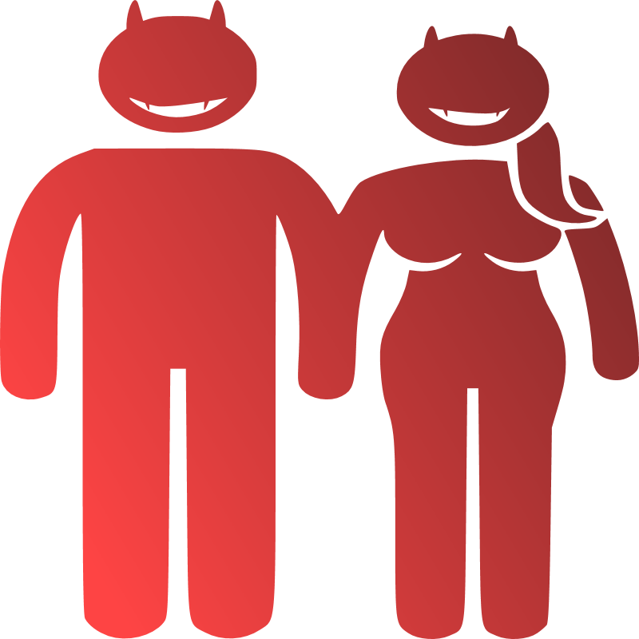
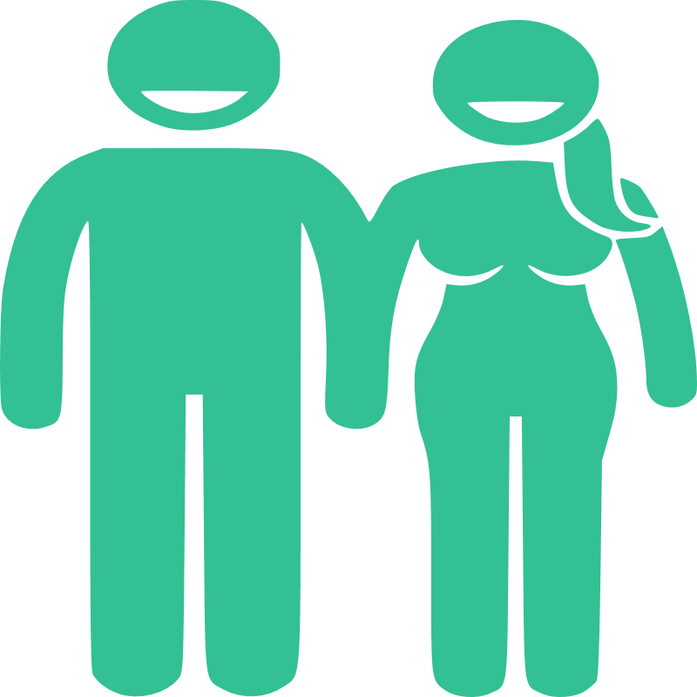
The “Bad News”: Right ideas
Notes:
Here is the right explanation of how God judges our sin.
Adam and Eve were created “very good” (Genesis 1). Their hearts were clean.
[NEXT] But when they were tempted,
[NEXT] ...Adam and Eve rejected God’s word and moved towards the forbidden fruit.
[NEXT] ...and ate the fruit
Thus, they were stained with sin. Their hearts became evil. They were still in the image of God, but that image was broken.
They died spiritually that day and were now slaves of sin.
[+]For when you were slaves of sin, you were free in regard to righteousness. But what fruit were you getting at that time from the things of which you are now ashamed? For the end of those things is death. But now that you have been set free from sin and have become slaves of God, the fruit you get leads to sanctification and its end, eternal life. For the wages of sin is death, but the free gift of God is eternal life in Christ Jesus our Lord. (Rom 6:20-23)

Slide 35
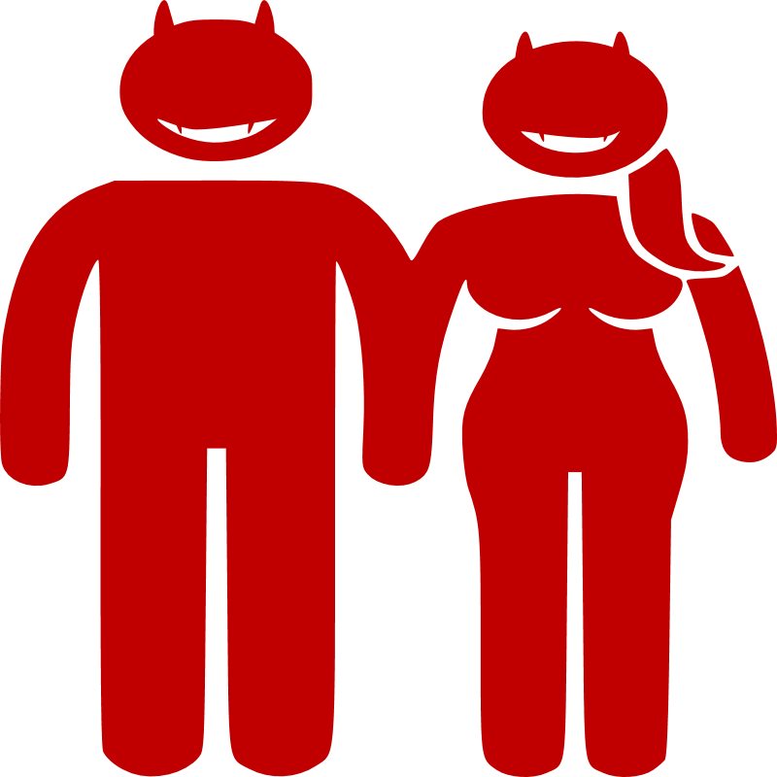
The “Bad News”: Right ideas
Notes:
All Adam’s offspring have Original Sin, inherited from Adam. We were born in iniquity:
[NEXT] And all generations of their offspring were born spiritually dead; we were all born slaves of sin.
[+] Indeed, I was guilty when I was born; I was sinful when my mother conceived me. (Psalms 51:5)
If you are a son or daughter of Adam, then you are born with sin.
[+] We too all previously lived among them in our fleshly desires, carrying out the inclinations of our flesh and thoughts, and we were by nature children under wrath as the others were also. (Ephesians 2:3)
(NOTE: Jesus was not born of a man, so He did not have Personal Sin, Original Sin or Imputed Sin)

Slide 36
The “Bad News”: Death
Genesis 2:17
For on the day you eat from it, you will certainly die.
Car le jour où tu en mangeras, tu mourras, c’est certain.
Maana siku utakapokula matunda ya mti huo utakufa hakika.
Notes:
In the day that Adam and Eve ate of the fruit, they 1) died spiritually. They became separated from God
2) they became slaves to sin 3) they began to die physically
4) they began their slow march towards hell
They needed a Messiah to save them.

Slide 37
The “Bad News”: Death
Romans 5:12
Therefore, just as sin entered the world through one man, and death through sin, in this way death spread to all men, because all sinned.
En C'est pourquoi, de même que par un seul homme le péché est entré dans le monde, et par le péché la mort, de même la mort a atteint tous les hommes parce que tous ont péché.
Kwa njia ya mtu mmoja zambi iliingia ulimwenguni, nayo ikasababisha kifo. Hivyo kifo kimeenea katika jumuiya yote ya binadamu, kwa maana wote wametenda zambi.
Notes:
Death and sin spread from Adam to ALL men (except Jesus).

Slide 38
The “Bad News”: Death
Jeremiah 17:9
The heart is more deceitful than anything else, and incurable — who can understand it?
Le coeur est tortueux par-dessus tout, et il est méchant: Qui peut le connaître?
Moyo huwa mdanganyifu kuliko vitu vyote, una ugonjwa wa kufisha; nani awezaye kuujua?
Notes:
Many of us think that we have no sin or maybe just a little sin. But what does Scripture tell us? Our hearts deceive us! We cannot understand it.
(It is for t his reason that David asks God to search his heart. He knows that he cannot trust himself to honestly search his heart.
[+]Search me, God, and know my heart; test me and know my concerns. See if there is any offensive way in me; lead me in the everlasting way. (Ps 139:23-24) )

Slide 39
The “Bad News”: Death
Romans 6:23
For the wages of sin is death, but the gift of God is eternal life in Christ Jesus our Lord.
En effet, le salaire du péché, c'est la mort, mais le don gratuit de Dieu, c'est la vie éternelle en Jésus-Christ notre Seigneur.
Kwa maana mshahara wa zambi ni kifo; lakini zawadi anayotoa Mungu ni uzima wa milele katika Yesu Kristo, Bwana wetu.
Notes:
And because we have sin in our heart/mind/soul, God promises us this one thing: we must be punished with death!
But this is not the end of the story. God has a special gift for us through Jesus Christ. It is the gift of eternal life. We will learn more of this later.

Slide 40
The “Bad News”: Death
Sins against an infinite Person requires infinite punishment
Les péchés contre une Personne infinie nécessitent une punition infinie
Zambi zidi ya Mtu asiye na mwisho zinahitaji azabu isiyo na mwisho
God is HOLY!
Dieu est SAINT !
Mungu ni MTAKATIFU!
Why did God punish them with death for one small fruit?
Pourquoi Dieu les a-t-il punis de mort pour un petit fruit ?
Kwa nini Mungu aliwaadhibu kwa kifo kwa ajili ya tunda moja dogo?
Notes:
Let us ask an important question: Why did God punish them with death for one small fruit? How can we understand the fact that a “small” sin, such as eating forbidden fruit, would deserve death and eternal hell? Why did God give such a big punishment for such a small sin??
[NEXT] It is because God is holy!
Why is God’s holiness important for understanding the punishment?
Imagine this:
[NEXT] - If a child slapped another child, we would punish him with a light spanking.
[NEXT] - If a child slapped his father, we would punish him with a large spanking.
[NEXT] - If a child slapped the president of the country, we would give him a great spanking.
[NEXT] - Imagine, then, what we would do if the child slapped the eternal holy God? He would surely receive the most harsh punishment!
Why the difference? The amount of punishment changes depending on who is offended. When a small child is offended, the punishment is small. But when a great person is offended, the punishment the punishment is great. And so it is with God.
[NEXT] Sins against a small person requires small punishment. But sins against an infinite person require infinite punishment!

Slide 41
The “Bad News”: Death
James 1:15
Then after desire has conceived, it gives birth to sin, and when sin is fully grown, it gives birth to death.
Puis le désir, lorsqu'il est encouragé, donne naissance au péché et le péché, parvenu à son plein développement, a pour fruit la mort.
Tamaa ikiiva huzaa zambi; nayo zambi ikikomaa huzaa kifo.
Notes:
Oftentimes, we think that sinful desires come from satan. They do not. Those sinful desires come from our own heart. And satan uses them to try to tempt us to sin.
When we fall to the temptation and sinful desires, we continue further down the path of Adam, on our way to death.

Slide 42
The “Bad News”: Death
Matthew 15:18-19
But what comes out of the mouth comes from the heart, and this defiles a man. For from the heart come evil thoughts, murders, adulteries, sexual immoralities, thefts, false testimonies, blasphemies.
Mais ce qui sort de la bouche vient du cœur, et c'est ce qui rend l'homme impur. En effet, c'est du cœur que viennent les mauvaises pensées, les meurtres, les adultères, l'immoralité sexuelle, les vols, les faux témoignages, les calomnies.
Bali vitokavyo kinywani vyatoka moyoni; navyo ndivyo vimtiavyo mtu unajisi. Kwa maana moyoni hutoka mawazo mabaya, uuaji, uzinzi, uasherati; wivi, ushuhuda wa uongo, na matukano
5
Notes:
Jesus taught us that these sinful desires come from our own heart.

Slide 43
How do I remove my sin? Comment puis-je supprimer mon péché ? Ninawezaje kuondoa zambi yangu?
6
Appears 90+ times in the Bible
Notes:
Now comes an important question: How do I remove my sin?
Can I bathe 7 times?
Can I pray to the pope and say “hail Mary” and make confessions?
Can I travel to Jerusalem and pray at the temple?
What will wash away my sins?

Slide 44
The Good News: Your sins can be removed!
John 1:29
The next day John saw Jesus coming toward him and said, “Here is the Lamb of God, who takes away the sin of the world!”
Le lendemain, il vit Jésus s’approcher de lui et dit: «Voici l'Agneau de Dieu qui enlève le péché du monde.
Kesho yake, Yohane alimwona Yesu akimjia, akasema, "Huyu ndiye Mwana-kondoo wa Mungu aondoaye zambi ya ulimwengu!”
Notes:
John the Baptist knew this important truth: Only Jesus can take away our sins.
He came as the Lamb of God. Why is this “lamb” important for taking away sins??

Slide 45
The Good News: Your sins can be removed!
Hebrews 9:22
According to the law almost everything is purified with blood, and without the shedding of blood there is no forgiveness.
Or, d'après la loi, presque tout est purifié avec du sang et, s’il n’y a pas de sang versé, il n'y a pas de pardon.
Kufwatana na Sheria karibu kila kitu chaweza kutakaswa kwa damu, na zambi nazo zaondolewa tu ikiwa damu imemwangwa.
Notes:
The removal of sin is called ‘forgiveness’. This can only happen when there is death (shedding of blood).
If we die for our own sins, it is not enough. Our blood cannot save us for eternity. We will go to hell.
What we need is a holy substitute to die for our sins. We need Jesus’ blood. He is eternal. He has no earthly father to connect Him to Adam’s sin. Therefore, He is without sin, and His blood will save us eternally.
The infinite sin against a holy God requires the infinite punishment of His infinte Son.

Slide 46
The Good News: Your sins can be removed!
1 John 1:9
If we confess our sins, He is faithful and righteous to forgive us our sins and to cleanse us from all unrighteousness.
Si nous confessons nos péchés, il est fidèle et juste pour nous les pardonner, et pour nous purifier de toute iniquité.
Tukiomba msamaha kwa zambi zetu, Yeye ni mwaminifu na wa haki ili atuondolee zambi zetu, na kutusafisha na ubaya wote.
Notes:
(This is an important verse to memorize)

Slide 47
The Good News: Your sins can be removed!
Acts 4:12
And there is salvation in no one else, for there is no other name under heaven given among men by which we must be saved.
Il n’y a de salut en aucun autre, car il n'y a sous le ciel aucun autre nom qui ait été donné parmi les hommes, par lequel nous devions être sauvés.
Wokovu haupatikani kwa mtu mwingine yeyote, kwa maana duniani pote, binadamu hawakupewa jina la mtu mwingine ambaye sisi tunaweza kuokolewa naye.
Notes:
Whose name is the Name by which we must be saved??

Slide 48
The Good News: Your sins can be removed!
Proverbs 28:13
The one who conceals his sins will not prosper, but whoever confesses and renounces them will find mercy.
Celui qui cache ses transgressions ne réussira pas, mais on aura compassion de celui qui les reconnaît et les abandonne.
Afichaye zambi zake hatafanikiwa; Bali yeye aombae msamaha na kuziacha zambi zake atapata rehema.
Notes:
This truth of confession to God and forgiveness by God is not only in the New Testament. It is also in the Old Testament.
[+]The one who conceals his sins will not prosper, but whoever confesses and renounces them will find mercy. (Prov 28:13)
All of Psalms 51 is David’s confession after his sin with Bathsheeba. He confesses and is forgiven by God. (We should read Ps 51)

Slide 49
The Good News: Your sins can be removed!
John 8:24
Therefore I told you that you will die in your sins. For if you do not believe that I am He, you will die in your sins.”
C’est pourquoi je vous ai dit que vous mourrez dans vos péchés. Car si vous ne croyez pas ce que je suis, vous mourrez dans vos péchés»
Kwa hiyo nimewaambiya kuwa mtakufa katika zambi zenu. Kwa maana msipoamini ya kwamba Mimi Ndiye,mtakufa katika zambi zenu "
Notes:
Believing in Jesus is the only way to escape hell forever. If we do not believe that Jesus is the Messiah to take away our sins, we will keep our sins and die in our sins and go to hell. This is true for all people everywhere, regardless of their religion.

Slide 50
The Good News: Your sins can be removed!
Romans 10:13
For everyone who calls on the name of the Lord will be saved.
Car quiconque invoquera le nom du Seigneur sera sauvé.
Maana Maandiko Matakatifu yasema: "Kila mtu atakayeomba kwa jina la Bwana, ataokolewa."
6
Notes:
“Call on the Name of the Lord” means to Understand His salvation, Believe in His salvation, Repent of our sins that offended His holy glory, and Call on Him to save us.

Slide 51
Why must I believe Jesus died and rose from the dead? Pourquoi dois-je croire que Jésus est mort et ressuscité des morts ? Kwa nini ni lazima niamini Yesu alikufa na kufufuka kutoka kwa wafu?
7
Appears 90+ times in the Bible
Notes:
Jesus did many things when He was here on the earth. He was born of a virgin, He healed many people. He fed many people. He taught many people. etc, etc, etc. And He died before Pilate and the Jews. And He rose again.
But why is it important that we must believe in His death and resurrection? Why is His death and resurrection important for our forgiveness of sins??

Slide 52
The Good News: Jesus can forgive our sins
Genesis 2:17
You must not eat from the tree of the knowledge of good and evil, for on the day you eat from it, you will certainly die.
Tu ne mangeras pas le fruit de l'arbre de la connaissance du bien et du mal, car le jour où tu en mangeras, tu mourras, c’est certain.
Usikule matunda ya mti wa ujuzi wa mema na mabaya, kwa maana siku utakapokula matunda ya mti huo utakufa hakika.
Notes:
Before we answer this important question from the previous slide, let us remember that death was the punishment for eating from the Tree of the Knowledge of Good and Evil. That punishment began the *day* Adam and Eve ate. They died spiritually that day, and they began their physical death that day.

Slide 53
The Good News: Jesus can forgive our sins
Ezekiel 18:4
Look, every life belongs to Me. The life of the father is like the life of the son — both belong to Me. The person who sins is the one who will die.
En effet, toutes les vies m’appartiennent; la vie du fils m’appartient aussi bien que celle du père. Celui qui pèche, c'est celui qui mourra.
Tazama, maisha zote ni zangu; kama vile maisha ya baba ni mali yangu, ndivyo roho ya mwana mali yangu piya; mtu yule atendaye zambi ndie atakufa.
Notes:
We must also understand that all lives belong to God! God’s rules for His world is this: each soul that has sin WILL die! Because He owns every soul (person), He has the right to execute judgment on every person.

Slide 54
The Good News: Jesus can forgive our sins
Isaiah 53:5-6
But He was pierced because of our transgressions, crushed because of our iniquities; punishment for our peace was on Him, and we are healed by His wounds. We all went astray like sheep; we all have turned to our own way; and the LORD has punished Him for the iniquity of us all.
Mais lui, il était blessé à cause de nos transgressions, brisé à cause de nos fautes: la punition qui nous donne la paix est tombée sur lui, et *c'est par ses blessures que nous sommes guéris. Nous étions tous comme des brebis égarées: chacun suivait sa propre voie, et l'Eternel a fait retomber sur lui nos fautes à tous.
Bali alijeruhiwa kwa makosa yetu, Alichubuliwa kwa maovu yetu; Adhabu ya amani yetu ilikuwa juu yake, Na kwa kupigwa kwake sisi tumepona. Sisi sote tulikuwa kama kondoo ambazo zimepoteya; Kila mmoja wetu aligeukia njia yake mwenyewe; Na Bwana aliweka juu yake Maovu yetu sisi sote.
Notes:
Jesus is the Messiah. It was the plan of God from before the foundation of the earth (1 Peter 1:18-21) for Jesus to take our sins on His back, to be punished by God for our sins, and to die for our sins. But He did not stay dead! Death did not have full victory over Him. He claimed full victory over sin and death by rising from the dead! (AMEN!)
Through His righteous victory over sin and death, He has now shown us all that He is indeed the true Lord! And He gives to us - His believers - life and victory over sin and eternal death.
In this way, we are “healed” by His wounds on the cross.

Slide 55
The Good News: Jesus can forgive our sins
Romans 5:6,8
For while we were still helpless, at the appointed moment, Christ died for the ungodly... But God proves His own love for us in that while we were still sinners, Christ died for us!
En effet, alors que nous étions encore sans force, Christ est mort pour des pécheurs au moment fixé... Mais voici comment Dieu prouve son amour envers nous: alors que nous étions encore des pécheurs, Christ est mort pour nous.
Tulipokuwa bado wanyonge, Kristo, wakati ulipotimia, alikufa kwa ajili yetu sisi waovu... Lakini Mungu amethibitisha kwamba anatupenda, maana wakati tulipokuwa bado wenye zambi, Kristo alikufa kwa ajili yetu.
Notes:
Amen!

Slide 56
The Good News: Jesus can forgive our sins
1 Corinthians 15:20-22
But now Christ has been raised from the dead, the firstfruits of those who have fallen asleep. For since death came through a man, the resurrection of the dead also comes through a man. For as in Adam all die, so also in Christ all will be made alive.
Mais en réalité, Christ est ressuscité, précédant ainsi ceux qui sont morts. En effet, puisque la mort est venue à travers un homme, c'est aussi à travers un homme qu'est venue la résurrection des morts. Et comme tous meurent en Adam, de même aussi tous revivront en Christ.
Lakini ukweli ni kwamba Kristo amefufuliwa kutoka wafu, limbuko lao wale waliolala katika kifo. Maana kama vile kifo kilivyoletwa duniani na mtu mmoja, vivyo hivyo nako kufufuka kutoka wafu kumesababishwa na mtu mmoja. Kama vile watu wote walikufa katika Adamu, vivyo hivyo watu zote watafufuliwa katika Kristo.
Notes:
In the same way that Adam’s sin brought sin and death to all humans, Christ’s victory over sin brings resurrection and eternal life to all who believe.
Jesus was the first to rise eternally from the dead; then all who believe will also rise eternally one day. When He calls our name, we will follow our Lord and Master up from the grave and into heaven!
When Jesus called Lazarus’s name, he came out of the tomb. He lived 5, 10, perhaps 20 years, and then he died again. He had a small resurrection.
But when Jesus comes for us and calls our name, indeed, we will truly rise. Not for 5, 10 or 20 years, but forever! (Amen!)

Slide 57
The Good News: Jesus can forgive our sins
1 Peter 1:3
Praise the God and Father of our Lord Jesus Christ. According to His great mercy, He has given us a new birth into a living hope through the resurrection of Jesus Christ from the dead
Béni soit Dieu, le Père de notre Seigneur Jésus-Christ! Conformément à sa grande bonté, il nous a fait naître de nouveau à travers la résurrection de Jésus-Christ pour une espérance vivante,
Asifiwe Mungu na Baba wa Bwana wetu Yesu Kristo! Kwa huruma yake kuu alitufanya tuzaliwe upya kwa kumfufua Yesu kutoka wafu. Ametujalia tumaini lenye uzima
7
Notes:
(amen!!)
All of these precious spiritual gifts are for us who TRULY believe.

Slide 58
What does it mean to ‘believe’? Que signifie « avoir la foi » et « croire » ? ‘kuwa na imani’ na ‘kuamini’ inamaanisha nini ?
8
Appears 90+ times in the Bible
Notes:
We now explore the meaning of “believe”.

Slide 59
True Belief?
?
Matthew 7:21-23
Not everyone who says to Me, ‘Lord, Lord! ’ will enter the kingdom of heaven, but only the one who does the will of My Father in heaven.
»Ceux qui me disent: ‘Seigneur, Seigneur!’ n'entreront pas tous dans le royaume des cieux, mais seulement celui qui fait la volonté de mon Père céleste.
Si kila mtu aniambiaye, Bwana, Bwana, atakayeingia katika ufalme wa mbinguni; bali ni yeye afanyaye mapenzi ya Baba yangu aliye mbinguni.
Notes:
Let us consider the full paragraph.
[+]“Not everyone who says to Me, ‘Lord, Lord! ’ will enter the kingdom of heaven, but only the one who does the will of My Father in heaven. On that day many will say to Me, ‘Lord, Lord, didn’t we prophesy in Your name, drive out demons in Your name, and do many miracles in Your name? ’ Then I will announce to them, ‘I never knew you! Depart from Me, you lawbreakers!’ (Matt 7:21-23)
These people believe several things rightly.
They believe that Jesus is Lord.
They call Him Lord
They prophesy in His name
They drive out demons in His name
They do many miracles in His name
They come to Him on Judgment Day
But look at what Jesus says to them:
1) Depart from Me (Go to hell)
2) I never knew you (He does not say “I used to know you, but now you went away”)
3) Everything they did was lawlessness (He does not say “you did some good and some bad”. All of it was bad)
Despite the many things they believed and did, they did not have true belief.
They believed wrongly.

Slide 60
True Belief?
?
John 5:39-40
You study the scriptures thoroughly because you think in them you possess eternal life, and it is these same scriptures that testify about Me, but you are not willing to come to Me so that you may have life.
Vous étudiez les Ecritures parce que vous pensez avoir par elles la vie éternelle. Ce sont elles qui rendent témoignage à mon sujet, et vous ne voulez pas venir à moi pour avoir la vie!
Mwayachunguza maandiko, kwa sababu mnadhani kwamba ninyi mna uzima wa milele ndani yake; na hayo ndiyo yanayonishuhudia. Wala hamtaki kuja kwangu mpate kuwa na uzima.
Notes:
The religious people of Jesus’ day studied the Scriptures throughly and knew it well. But they did not believe the Scriptures properly, otherwise they would have recognized Jesus when He came before them, and they would have quickly been His followers.
They believed wrongly.

Slide 61
True Belief?
?
James 2:19
You believe that God is one. You do well; the demons also believe, and shudder.
Tu crois qu'il y a un seul Dieu? Tu fais bien; les démons aussi le croient, et ils tremblent.
Unaamini kwamba kuna Mungu mmoja. Unafanya vizuri! Lakini hata pepo huamini hilo, na hutetemeka kwa hofu.
Notes:
If the demons believe and are in fear of God, why are they not saved? Remember the things they said to Jesus and how they were afraid of Him?
[+]Suddenly they shouted, “What do You have to do with us, Son of God? Have You come here to torment us before the time? ” (Matt 8:29)
[+]Just then a man with an unclean spirit was in their synagogue. He cried out, “What do You have to do with us, Jesus — Nazarene? Have You come to destroy us? I know who You are — the Holy One of God! ” (Mark 1:23-24)
The demons believe that Jesus is Lord. They believe Jesus is one with God. They know that they will be tormented and destroyed by Jesus one day, and they fear accordingly. They have great belief - yet they are not saved.
Can it be true that some people believe God is true, and fear Him, but like the demons, they will not see eternal life? Can this be? Yes! It is possible for a person to believe the right things, but believe it in a wrong way. This is the problem of demons: they believe the truth about God, but their belief does not save them.
Let us study right belief and wrong belief.

Slide 62
saving faith
Essential parts of saving faith
Éléments essentiels de la foi salvatrice
Sehemu muhimu za imani inayookoa
SAVING FAITH
Notes:
The faith that saves us has 3 important parts. Let us examine these three part.

Slide 63
notitia
1
The content of faith; the things that we believe.
Le contenu de la foi; les choses auxquelles nous croyons.
Maudhui (yaliyo ndani) ya imani; mambo ambayo tunaamini.
Notes:
The first part of saving faith is called “notitia”. This is a latin word that means “knowledge”. It is the idea of collecting a list of things known about a person or thing. For saving faith, notitia is the list of facts that we know are true about how God saves us. It includes facts like...
- God is One
- Jesus is the eternal Son of God
- Jesus is God
- Jesus was born of a virgin
- Jesus died for sins
- Jesus is the only way to the Father
- etc
Christians must have notitia about the truths of God.
- - -
Demons also have notitia about the Christian faith. They know that these facts are what God requires all people to believe, and they believe these facts are true. But that belief does not save them.

Slide 64
assensus
2
Conviction that the content of our faith is true.
Convinction que le contenu de notre foi est vrai.
Kusadiki kwamba yaliyo katika imani yetu ni kweli.
Notes:
The second essential component of saving faith is called “assensus”. This is also a Latin word. It is the conviction that the content of our faith (the notitia) is true. It is the belief in our mind and heart that the facts of our faith are true.
So we can say that notitia is the list of things that Christians believe, and assensus is our personal conviction that this list is true. Not only do we know that Christians believe those things, but we agree that those things are true.
Christians must have assensus about the list of facts for the Christian faith.
- - -
Demons also have assensus about these things. Demons know that God’s people believe these things, and demons also believe that these things are true (they shudder at the thought of Jesus coming to torment them).
But that knowledge and belief does not save them.

Slide 65
fiducia
3
Personal trust and reliance. Commitment.
Confiance et confiance personnelles. Engagement.
Kuamini na kujiamini mwenyewe. Kujitolea.
Notes:
The third essential component of saving faith is the Latin word fiducia. It is where we get the English word for ‘finances’ and ‘purchase’. It refers to our joyful personal trust and reliance on what God says about Himself and our salvation. Demons do not have fiducia trust in God.
We use all three forms of faith when we buy something at a marketplace. Consider this example.
Notitia: “I saw a smartphone at the market. The seller says it takes beautiful photos, has a strong battery that lasts 2 days, the glass is not easily broken, it has 128GB of RAM, it is better than an iPhone.”
Assensus: “I have examined the smartphone, and I truly belive the seller is speaking the truth about the abilities and features of the phone.”
Fiducia: “I bought the smartphone, and now I enjoy a fast smartphone with beautiful photos and video, a strong battery, and strong glass. I am a happy man! I will go and show my friends so they can also get a wonderful smartphone!”
NOTE: You cannot buy God with money. We use the word ‘buy’ here to explain the idea of personal acceptance and commitment to God.

Slide 66
notitia, assensus, fiducia
Personal trust and reliance
Confiance et confiance personnelles
Uaminifu na utegemezi wa kibinafsi
Demons have ‘notitia’ and ‘assensus’. But they do not have ‘fiducia’.
Les démons ont une « notitia » et un « assensus ». Mais ils n’ont pas de « fiducia ».
Mashetani wana ‘notitia’ na ‘assensus’. Lakini hawana ‘fiducia’.
Notes:
Demons know and believe that God is true. But they don’t “buy” God in their hearts. They reject and hate Him.
So it is with many people: they know and believe God is true. But they don’t “buy” God in their hearts. They do not commit their lives to Him and they do not personally trust Him to save them. We must not be like this. We must have notitia (know what the Bible teaches), assensus (believe that God and the Bible are true), and fiducia (personally trust in Him; ‘buy’ Him with our hearts).
This third step is what the demons and false believers do not have.

Slide 67
notitia, assensus, fiducia
Personal trust and reliance
Confiance et confiance personnelles
Uaminifu na utegemezi wa kibinafsi
True faith produces true works.
La vraie foi produit de vraies œuvres.
Imani ya kweli huzaa matendo ya kweli.
Notes:
Now that we understand true belief, we must understand True Works!
Faith without works is ______??_____
True believers were created for good works in Christ. Our works do not save us; but they are the product of saving faith. If we ware truly saved, we will truly work for His kingdom. If we see a man who does not work for the kingdom of God, we must ask him: Are you a child of God? Why are you slow and lazy about working for His kingdom?
[+] For you are saved by grace through faith, and this is not from yourselves; it is God’s gift — not from works, so that no one can boast. For we are His creation, created in Christ Jesus for good works, which God prepared ahead of time so that we should walk in them. (Eph 2:8-10)

Slide 68
notitia, assensus, fiducia
Personal trust and reliance
Confiance et confiance personnelles
Uaminifu na utegemezi wa kibinafsi
True faith produces true repentance.
La vraie foi produit la vraie repentance.
Imani ya kweli huzaa toba ya kweli.
8
Notes:
True believers also pursue true repentance.
Every day, we must humble ourselves and search our hearts to find sin in our lives. If we find sin, we confess it before God and man, we repent, and we continue in our growth.
[+] If we say, “We have no sin,” we are deceiving ourselves, and the truth is not in us. If we confess our sins, He is faithful and righteous to forgive us our sins and to cleanse us from all unrighteousness. If we say, “We don’t have any sin,” we make Him a liar, and His word is not in us. (1John 1:8-10)

Slide 69
What is true repentance? Qu'est-ce que la véritable repentance? Toba ya kweli ni nini?
9
Appears 90+ times in the Bible
Notes:
We now explore the meaning of “Repentance”.
What is True Repentance? What is false repentance?
How can we know the difference?

Slide 70
true repentance
Personal trust and reliance
Confiance et confiance personnelles
Uaminifu na utegemezi wa kibinafsi
Cain? Genesis 4:8-14
Esau? Hebrews 12:15-17
Judas? Matthew 27:3-5
Notes:
Let us look at some people who had false repentance.
Some of them had remorse (Cain, Gen 4:13-14)
Some of them had tears (Esau wept).
Some of them made corrections (Judas returned the money).
Did their ‘repentance’ benefit them?
They had the posture of repentance and the words of repentance, but not the heart of repentance.

Slide 71
true repentance
Personal trust and reliance
Confiance et confiance personnelles
Uaminifu na utegemezi wa kibinafsi
Sight of sin
Vue du péché
Mtazamo wa zambi
Notes:
So what does True Repentance look like? It begins with the Sight of Sin.
The first step of true repentance begins with us seeing the sin and recognizing it as sin. If we cannot see the sin, how can we know what to confess? How can we know what to change? We must begin by understanding God’s word and what He says about our actions, words, and thoughts.
For example, if a man is married, but he spends many hours talking with another woman on WhatsApp, is this a sin? Some will say “no, because he has not touched her and he is not lusting after her”.
But remember that sins are not only what we do with our hands. It is also what we do with our mouth and with our minds. Jesus said “what God has joined together, let no man put apart”. When a man texts with another woman all day, he is not divorcing himself from his wife with his hands, but he is truly separating himself from his wife with his mind and with his heart. When a married man invests too much time, effort, and energy to emotionally build up a woman, he is emotionally separating himself from his wife. This is against the law of God. And we are not able to repent until we realize that the action is sin.
We cannot continue to rely on our understanding. We must lean on God and His word and trust what He says about sin.
If He says that adultery is a sin, we must believe it.
If He says that lusting is a sin, we must believe it.
If He says that pornography is a sin, we must believe it.
If He says that disobedience to our husband is a sin, we must believe it.
If He says that woman must not preach or have authority over men, we must believe it.
If He says that children must obey their parents, we must believe it.
Etc.
[+]Because if anyone is a hearer of the word and not a doer, he is like a man looking at his own face in a mirror. For he looks at himself, goes away, and immediately forgets what kind of man he was. But the one who looks intently into the perfect law of freedom and perseveres in it, and is not a forgetful hearer but one who does good works — this person will be blessed in what he does. (Jas 1:23-25)

Slide 72
true repentance
Personal trust and reliance
Confiance et confiance personnelles
Uaminifu na utegemezi wa kibinafsi
Sorrow for sin
Chagrin pour le péché
Huzuni kwa ajili ya zambi
Notes:
The second step for True Repentance is Sorrow for Sin.
We must understand that all sin - even small sins - are an offense against our Holy Father and grieve the Holy Spirit. Therefore, we must respond with sorrow for our sin.
[+] Now I rejoice, not because you were grieved, but because your grief led to repentance. For you were grieved as God willed, so that you didn’t experience any loss from us. For godly grief produces a repentance not to be regretted and leading to salvation, but worldly grief produces death. (2Cor 7:9-10)

Slide 73
true repentance
Personal trust and reliance
Confiance et confiance personnelles
Uaminifu na utegemezi wa kibinafsi
Confession for sin
Confession de péché
Kuungama zambi
Notes:
The third step for True Repentance is the Confession of Sin.
When we confess our sin, we are bringing it out in the open so that we can be corrected. If we do not confess our sin, how can God improve our heart and mind?
Consider these verses:
[+]“Do not judge, so that you won’t be judged. For with the judgment you use, you will be judged, and with the measure you use, it will be measured to you. Why do you look at the speck in your brother’s eye but don’t notice the log in your own eye? Or how can you say to your brother, ‘Let me take the speck out of your eye,’ and look, there’s a log in your eye? Hypocrite! First take the log out of your eye, and then you will see clearly to take the speck out of your brother’s eye. Don’t give what is holy to dogs or toss your pearls before pigs, or they will trample them with their feet, turn, and tear you to pieces. (Matt 7:1-6)
When we FIRST take the beam from our own eye, we are sharing with trusted and mature Brothers (or Sisters) our need for their spiritual wisdom to help improve our situation. If they are mature Brothers (or Sisters), they will understand that we all help each other to improve our sanctification. Then together, we can all share to help each other with our beams and specs.
But if someone does not wish to be part of the group and does not wish to confess sins, then we know that he is not deserfing of God’s holy word. Do not continue to give God’s holy word to dogs and pigs. They will abuse His gifts and will turn and attack you.
Confession must be made to the right people: the people we offend, and spiritual helpers. Confession must not be made to everyone everywhere, for they cannot help the situation.

Slide 74
true repentance
Personal trust and reliance
Confiance et confiance personnelles
Uaminifu na utegemezi wa kibinafsi
Shame for sin
Honte au péché
Aibu kwa zambi
Notes:
The fourth part of True Repentance is Shame for our Sin.
When we understand the offense that our sin is to a holy God, if we love the Lord our God, then we will have shame for our sin. Adam and Eve understood this shame. But they used the shame wrongfully. They should have used their shame to run to God and ask forgiveness. Instead, the shame made them hide from God and try to cover themselves..
How can a person sin and boast and continue with pride? This is not of God. God gives us shame with our sin so that we know something is wrong in our hearts. We must use this shame to motivate us to pursue forgiveness from those we have offended - both God and man. And after the time of our confession and repentance, then we can rejoice in the forgiveness that God gives us.
Read Ps 51, all verses.

Slide 75
true repentance
Personal trust and reliance
Confiance et confiance personnelles
Uaminifu na utegemezi wa kibinafsi
Hatred for sin
La haine du péché
Kuchukia zambi
Notes:
The fifth step of True Repentance is the Hatred for Sin.
When we see the true damage that our sin does to our fellow man; when we see the damage that our sin does to our relationship with God, we must learn to have God’s attitude for sin, and like Him, we must hate sin. Like shame, this hatred for sin must motivate us to quickly seek repentance and confession. We must hate the sin in ourselves, and when we see the sin in other people, we must hate that sin in them for their sakes too.
If we neglect sin in ourselves and do not hate it, truly, we are hating ourselves! If we love ourselves properly, we will love pure fellowship with God and His people. In this way, we will see that sin harms our relationship with God and with His people, and therefore, we must hate sin.

Slide 76
true repentance
Personal trust and reliance
Confiance et confiance personnelles
Uaminifu na utegemezi wa kibinafsi
Turning from sin
Se détourner du péché
Kugeuka kutoka kwa zambi
Notes:
The sixth step of True Repentance is to Turn Away from Sin.
When we properly hate sin and the effect sin has on us, by the grace of God and the power of the Holy Spirit, we will turn away from sin and put it behind us! Then we can sing to Him from a pure heart of the forgiveness He has given us.
There is no sin that His blood cannot remove from our hearts. There is no blackness in our lives that He cannot clean. All sins are able for Him to remove!
[+]Don’t you know that the unrighteous will not inherit God’s kingdom? Do not be deceived: No sexually immoral people, idolaters, adulterers, or anyone practicing homosexuality, no thieves, greedy people, drunkards, verbally abusive people, or swindlers will inherit God’s kingdom. And some of you used to be like this. But you were washed, you were sanctified, you were justified in the name of the Lord Jesus Christ and by the Spirit of our God. (1Cor 6:9-11)
Amen! Praise God that He can turn us away from our sin!

Slide 77
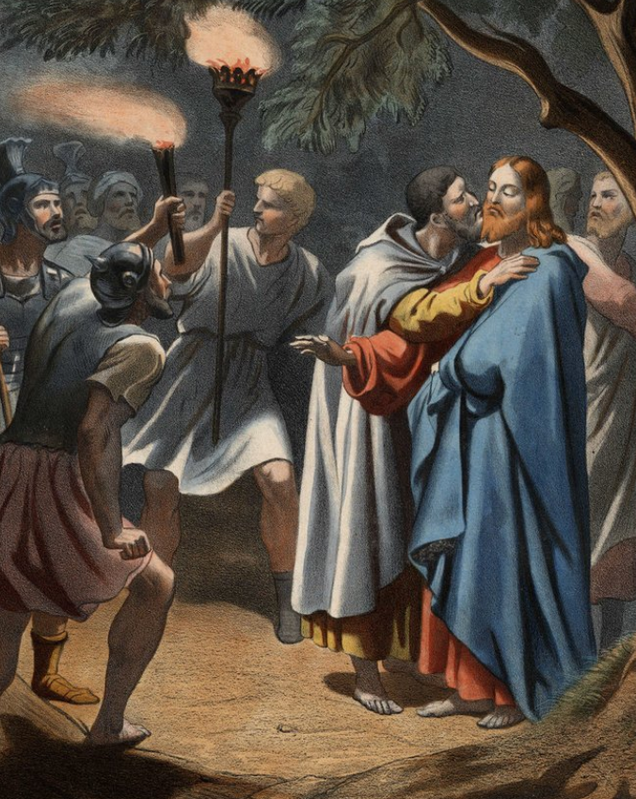
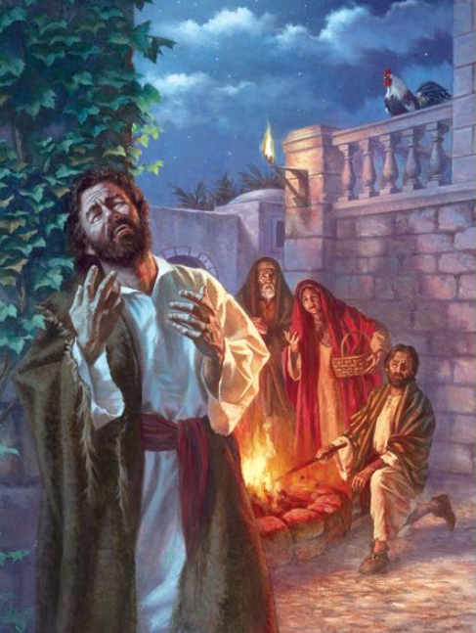
comparing repentance
Judas vs Peter
Disciple of Jesus Disciple of Jesus
Warned by Jesus Warned by Jesus
Betrayed Jesus Denied Jesus
Wept Wept
Ran away Ran away
Returned silver -
Refused Jesus Returned to Jesus
Killed himself Continued living
Went to hell Went to heaven
Notes:
Now that we have studied some aspects of true belief and true repentance, let us look at two examples of sin against Jesus and how the persons responded to their sin.
Judas vs Peter
Both were disciples of Jesus
Both were warned by Jesus
Both turned their backs on Jesus
Both wept
Both ran away
Judas even returned the silver in his ‘repentance’
But look at the difference: one man refused to return to Jesus. The other, after Jesus’ resurrection, returned to Jesus
One man went and killed himself; the other man continued living
One man went to hell (Matt 26:24), the other man went to heaven.

Slide 78
comparing repentance
Judas vs Pierre
Disciple de Jésus Disciple de Jésus
Averti par Jésus Averti par Jésus
A trahi Jésus A renié Jésus A pleuré A pleuré
S'est enfui S'est enfui
A rendu l'argent -
A refusé Jésus Est revenu à Jésus
S'est suicidé A continué à vivre
Est allé en enfer Est allé au paradis
Notes:
Now that we have studied some aspects of true belief and true repentance, let us look at two examples of sin against Jesus and how the persons responded to their sin.
Judas vs Peter

Slide 79
comparing repentance
Yuda vs Petro Mwanafunzi wa Yesu Mwanafunzi wa Yesu
Kuonywa na Yesu Kuonywa na Yesu
Alimsaliti Yesu Alimkana Yesu
Alilia Alilia
Akakimbia Akakimbia
Alirudisha FeZa -
Alikataa Yesu Alimurudilia Yesu
Alijiuwa Aliendelea kuishi
Alikwenda kuzimu Alikwenda mbinguni
9
Notes:
Now that we have studied some aspects of true belief and true repentance, let us look at two examples of sin against Jesus and how the persons responded to their sin.
Judas vs Peter

Slide 80
How does Jesus remove my sin? Comment Jésus enlève-t-il mon péché ? Yesu anaondoaje zambi yangu?
10
Appears 90+ times in the Bible
Notes:
Does God have a big eraser to simply remove our sins?
The truth in the Bible is more detailed than this. Let us study it now.

Slide 81
Substitutionary Atonement
Notes:
The method in which Jesus takes away our sin is called “Substitutionary Atonement”.
SUBSTITUTION: The act of putting one person or thing in the place of another to supply its place. Le fait de mettre une personne ou une chose à la place d'une autre pour lui fournir sa place
ATONEMENT: When a person takes action to correct previous wrongdoing on their part. Lorsqu'une personne prend des mesures pour corriger une faute antérieure de sa part.
Because Adam and Eve rejected God’s word and ate the fruit, they were stained with sin. They were full of shame and their hearts became evil. They died spiritually that day. And all their offspring, even you and me, were born spiritually dead, as slaves to sin. We are still in the image of God, but that image was broken when Adam and Eve fell.
[NEXT] Our state of sin is offensive to an infinitely holy God and we are deserving of infinite punishment in hell. This punishment comes from God. We can not clean our hearts, nor can we raise ourselves up from our spiritual death. We need Someone else to come and to remove our shame, remove our sin, and clean us so we can stand in peace before God.
[NEXT] God’s solution for man’s problem is to send His only Son, Jesus, in the form of a man to take away our sins.
[NEXT] How does Jesus take away our sin? He lived a perfect life without sin, and God’s plan is for Him to go to the cross to do the work to pay for our sins.
[NEXT] Jesus’ will was to follow the plan of God and suffer and die for our sins.
[NEXT] God put our sins on Jesus and punished Jesus for our sins. This cross was the wrath of God, and it is how God punishes Jesus for our sins.

Slide 82
Substitutionary Atonement
Notes:
When a person comes to Jesus in repentance and faith, God puts that person’s sin on Jesus,
[NEXT] and puts Jesus’ righteousness on that person.
[NEXT] Now, when God looks at that person, God does not see his sin and shame. Instead, God sees Jesus’ righteousness on that person!
[NEXT] The person passes from death to life! He is now a new creature, born again by the Holy Spirit, and has eternal life.
[NEXT] The person is able to stand in righteousness before the Holy God. He is not righteous because of his works or his will - He is righteous because Jesus’ righteousness is now on him.
Amen! Thanks be to God because of His incredible gift!

Slide 83
The Good News: Substitutionary Atonement
Jesus removes our sin through substitutionary atonement
Jésus enlève notre péché par l'expiation substitutive
Yesu anaondoa zambi zetu kwa njia ya upatanisho mbadala
Notes:
Here is a good exercise to understand the work of God in saving us through the person of Jesus Christ.
Read Isaiah 53. Then read it again, but substitute all the personal pronouns (“He”, “Him”, “our”, etc) with the words “Father”, “Son”, “belivers”, etc.

Slide 84
The Good News: Substitutionary Atonement
Isaiah 53:5-6
But He was pierced because of our transgressions, crushed because of our iniquities; punishment for our peace was on Him, and we are healed by His wounds. We all went astray like sheep; we all have turned to our own way; and the LORD has punished Him for the iniquity of us all.
Mais lui, il était blessé à cause de nos transgressions, brisé à cause de nos fautes: la punition qui nous donne la paix est tombée sur lui, et *c'est par ses blessures que nous sommes guéris. Nous étions tous comme des brebis égarées: chacun suivait sa propre voie, et l'Eternel a fait retomber sur lui nos fautes à tous.
Bali alijeruhiwa kwa makosa yetu, Alichubuliwa kwa maovu yetu; Adhabu ya amani yetu ilikuwa juu yake, Na kwa kupigwa kwake sisi tumepona. Sisi sote kama kondoo tumepotea; Kila mmoja wetu amegeukia njia yake mwenyewe; Na Bwana ameweka juu yake Maovu yetu sisi sote.
Notes:
Here is a good exercise to understand the work of God in saving us through the person of Jesus Christ.
Read Isaiah 53. Then read it again, but substitute all the personal pronouns (“He”, “Him”, “our”, etc) with the words “Father”, “Son”, “belivers”, etc.
It is important to understand that our sins were put on the Son, the Father punished the Son because of our sins, and then the Son’s righteousness was put on us who believe.

Slide 85
The Good News: Substitutionary Atonement
Isaiah 53:10
Yet the LORD was pleased to crush Him severely. When You make Him a restitution offering, He will see His seed, He will prolong His days, and by His hand, the LORD’s pleasure will be accomplished.
L'Eternel a voulu le briser par la souffrance. Si tu fais de sa vie un sacrifice de culpabilité, il verra une descendance et vivra longtemps, et la volonté de l'Eternel sera accomplie par son intermédiaire.
Lakini Bwana aliridhika kumchubua; Amemhuzunisha; Utakapofanya nafsi yake kuwa dhabihu kwa zambi, Ataona uzao wake, ataishi siku nyingi, Na mapenzi ya Bwana yatafanikiwa mkononi mwake.
Notes:
It is important to understand that this plan of Substitutionary Atonement was the will of God. It pleased Him to bring about our salvation in this way.

Slide 86
The Good News: Salvation by faith in Jesus
1 John 1:9
If we confess our sins, He is faithful and just to forgive us our sins and to cleanse us from all unrighteousness.
Si nous confessons nos péchés, il est fidèle et juste pour nous les pardonner, et pour nous purifier de toute iniquité.
Tukiziungama zambi zetu, Yeye ni mwaminifu na wa haki hata atuondolee zambi zetu, na kutusafisha na udhalimu wote.

Slide 87
The Good News: Salvation by faith in Jesus
John 5:24
I assure you: Anyone who hears My word and believes Him who sent Me has eternal life and will not come under judgment but has passed from death to life.
En vérité, en vérité, je vous le dis, celui qui écoute ma parole et qui croit à celui qui m'a envoyé a la vie éternelle; il ne vient pas en jugement, mais il est passé de la mort à la vie.
Kweli nawaambieni, anayesikia neno langu, na kumwamini yule aliyenituma, anao uzima wa milele. Hatahukumiwa kamwe, bali amekwisha pita kutoka kifo na kuingia katika uzima.

Slide 88
The Good News: Salvation by faith in Jesus
Romans 10:9-11
If you confess with your mouth that Jesus is Lord and believe in your heart that God raised him from the dead, you will be saved. For with the heart one believes and is justified, and with the mouth one confesses and is saved. For the Scripture says, “Everyone who believes in him will not be put to shame.”
Si tu reconnais publiquement de ta bouche que Jésus est le Seigneur et si tu crois dans ton cœur que Dieu l'a ressuscité, tu seras sauvé. En effet, c'est avec le cœur que l'on croit et parvient à la justice, et c'est avec la bouche que l'on affirme une conviction et parvient au salut, comme le dit l'Ecriture: Celui qui croit en lui ne sera pas couvert de honte.
Kama ukikiri kwa kinywa chako kwamba Yesu ni Bwana na kuamini moyoni mwako kwamba Mungu alimfufua kutoka wafu, utaokoka. Maana tunaamini kwa moyo na kukubaliwa kuwa waadilifu; na tunakiri kwa midomo yetu na kuokolewa. Maandiko Matakatifu yasema: "Kila amwaminiye hatakuwa na sababu ya kuaibika."
Notes:
Let us go and preach the Good News to everyone!

Slide 89
The Good News: Salvation by faith in Jesus
John 3:16
For God loved the world in this way: He gave His One and Only Son, so that everyone who believes in Him will not perish but have eternal life.
En effet, Dieu a tant aimé le monde qu'il a donné son Fils unique afin que quiconque croit en lui ne périsse pas mais ait la vie éternelle.
Maana Mungu aliupenda ulimwengu hata akamtoa Mwana wake wa pekee, ili kila amwaminiye asipotee, bali awe na uzima wa milele.

Slide 90
Do YOU believe the Gospel of Jesus Christ?
If you are not sure, come and talk to us so we can discuss how Jesus Christ can save you from your sins.
Si vous n'êtes pas sûr, venez nous parler afin que nous puissions discuter de la façon dont Jésus-Christ peut vous sauver de vos péchés.
Kama hauna uhakika, kuja uzungumze nasi ili tuweze kuzungumza pamoja jinsi Yesu Kristo anavyoweza kukuokoa kutoka zambi zako.
Notes:
Do YOU belive the Good News of Jesus Christ?
Do you understand that one day, God will judge every person for their sins? If you are not saved from your sins, God will find you guilty, and will throw you into hell. You will be burned up in the fire.
Are you saved from the wrath of God?
If you are not sure, please talk to one of our leaders immediately about your spiritual condition so we can help explain more deeply the things of God!
Only Jesus can save you from your sins. Let us give God the glory for His wonderful plan to save us from our sins for His glory and His Name’s sake.
Amen!

Slide 91
Produced by Christian Mission for the Deaf
www.CMDeaf.org

